Slide 1
Cooperatives Background Slides
Jonathan Nunn, Kirklees Council

Slide 2
The Range of Alternative Business Models
Community Business
Community Business
Charity
Cooperative
Charity
Cooperative
Social enterprise
Social enterprise
Employee-Owned Business
Employee-Owned Business

Slide 3
How does this fit together?
Voluntary Community and Social Enterprise (VCSE)
Co-operative
Charity
Social Enterprise
Community Business

Slide 4
What is a cooperative?
A co-operative is a business or organisation that’s democratically owned and controlled by its members, to meet their shared needs.
The members can be its customers, workers, residents, service users or suppliers.
Co-operatives can take multiple legal forms
Notes:
Mention multi-stakeholder coops.

Slide 5
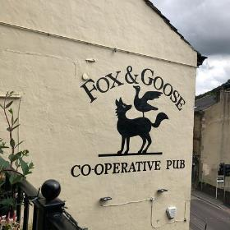
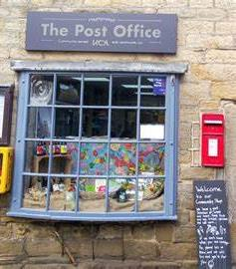
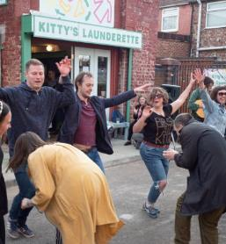
Community Business

Slide 6
Legal Forms
Incorporation
Company
LLP
(S)CIO
Registered Society
Private Company Limited by Guarantee
Private Company Limited by Shares
Public Limited Company (PLC)
Co-operative Society
Community Benefit society
CIC Limited by Guarantee
CIC Limited by Shares
Community Interest PLC
Charitable Benefit Society
Notes:
LLP = Limited Liability Partnership
CIO = charitable incorporated organisation

Slide 7
Employee-owned Business
Employee-owned businesses are totally or significantly owned by their employees but experience different levels of democracy.
Employee ownership can take one of three forms:
Direct employee ownership
Indirect employee ownership (e.g. employee trust)
Combined direct and indirect ownership
Employee ownership typically happens in one of the following scenarios:
Business succession or ownership succession
Growth and Expansion
Public Service Spin-Outs
Start Ups
Insolvency or closure threat
Employee Ownership Trusts as a business succession route received tax incentives through the Finance Act 2014.

Slide 8
Why do we need something different?

Slide 9
A Key Part of Community Wealth Building
Concept articulated by CLES based on the five pillars:
Plural ownership of the economy
Making financial power work for local places
Fair employment and just labour markets
Progressive procurement of goods and services
Socially productive use of land and property
Source: https://cles.org.uk/community-wealth-building/what-is-community-wealth-building/

Slide 10
How do we really create inclusive growth – what do we need to do differently?
Nationally the bottom 10% have seen no improvement in living standards in 20 years
Source: New Economics Foundation, 2021. Analysis ONS HBAI in The UK’s Living Standard’s Crisis.

Slide 11
Connections to Doughnut Economics
climate
change
ECOLOGICAL CEILING
REGENERATIVE AND DISTRIBUTIVE ECONOMY
the safe and just space for humanity
ozone layer
depletion
ocean
acidification
Mainstream business models focused on wealth accumulation, linear extraction-production-disposal models
Alternatives increase focus on meeting social foundations and keeping within ecological limits
SOCIAL FOUNDATION
OVERSHOOT
water
food
energy
health
air pollution
networks
SHORTFALL
chemical
pollution
education
housing
income
& work
gender
equailty
peace & justice
social
equity
political
voice
biodiversity
loss
nitrogen &
phosphorus loading
land conversion
freshwater withdrawls
Source: Doughnut Economics Action Lab, About Doughnut Economics

Slide 12
Thinking Like a 21st Century Economist
Regenerative by Design
Distributive by Design
Source: Doughnut Economics Action Lab, About Doughnut Economics

Slide 13
Anchor Networks
Greater impact can be achieved when anchor institutions work together. These are defined by CLES as organisations which:
Have an important presence in a place, usually through a combination of: being largescale employers, the largest purchasers of goods and services in the locality, controlling large areas of land and/or having relatively ﬁxed assets.
Are tied to a particular place by their mission, histories, physical assets and local relationships. Examples include local authorities, NHS trusts, universities, trade unions, large local businesses, the combined activities of the community and voluntary sector and housing associations.
Organisations may wish to conduct an Anchor Self-Assessment using the JRF progression framework in 2019
Source: https://cles.org.uk/what-is-community-wealth-building/what-is-an-anchor-institution/
Notes:
We see other anchors (besides the council) as important because of the combined force we have as employers and economic actors but also for the varied perspectives that they bring on the issues that concern our residents.

Slide 14
What we know about coops & EOBs

Slide 15
Cooperatives Globally
3m cooperatives
US$2.15tn revenue
1bn members
1 in 10 of global employed population
Source: International Cooperative Alliance. https://www.ica.coop/en/cooperatives/facts-and-figures. Accessed 10/11/2023.
Source: International Cooperative Alliance 2022. World Cooperative Monitor 2022.

Slide 16
The Coop Economy in the UK
7,586 businesses
£40.9bn revenue
14.3m members
249,142 employees
Source: Co-operatives UK, 2023. Co-operative and Mutual Economy 2023

Slide 17
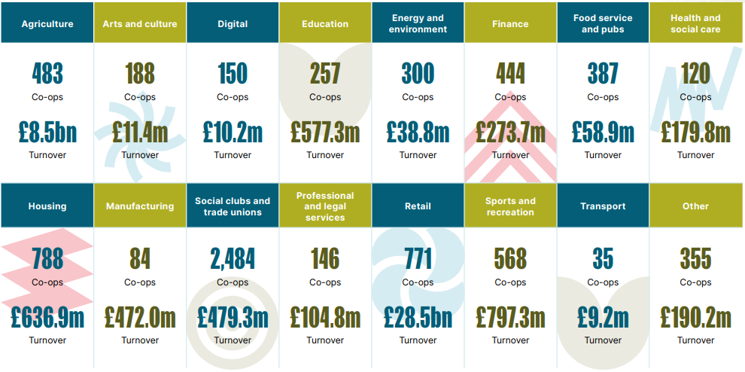
There are coops in every industry
Source: Co-operatives UK, 2023. Co-operative and Mutual Economy 2023

Slide 18
Believed Benefits of Cooperatives
Productivity / growth
Resilience
Community / social capital
Good work
Environmental impact
Reduced poverty

Slide 19
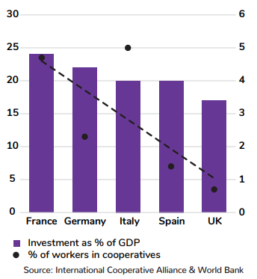
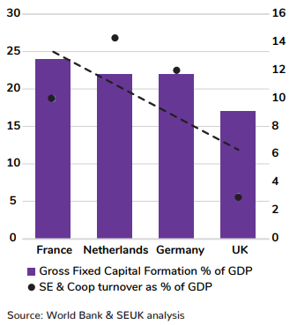
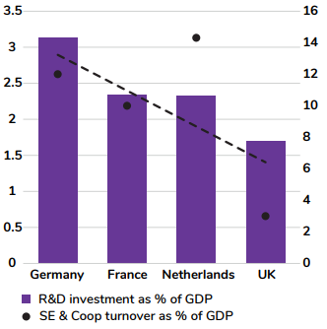
Benefits of Coops and Social Enterprises
Investment as % of GDP and % of workers employed by cooperatives in Europe’s five largest economies by country
Investment as % of GDP and social enterprise and cooperatives turnover as % of GDP
R&D investment as % of GDP and social enterprise and cooperatives turnover as % of GDP
Source: Ending the Monoculture. Social Enterprise UK, 2024.

Slide 20
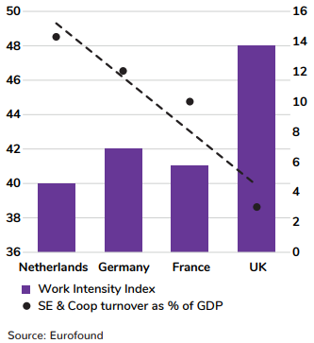
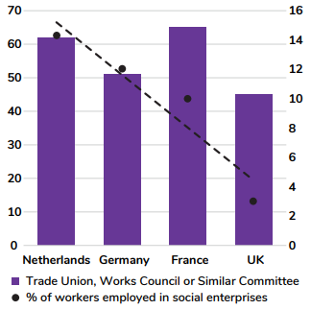
Benefits of Coops and Social Enterprises
Workers that report having access to a trade union, works council or
similar committee and social
enterprise and cooperatives
turnover as % of GDP
Work Intensity Index (2005-2015 average score) by country and social
enterprise and cooperatives
turnover as % of GDP
Source: Ending the Monoculture. Social Enterprise UK, 2024.

Slide 21
Employee-Owned Businesses

Slide 22
Benefits of Employee Ownership
Productivity
EOBs are 8-12% more productive than non-EOBs (GVA / employee).
R&D Investment
EOBs >50% more likely to have increased R&D investment than non-EOBs in last 5yrs
Job Creation
EOBs >50% more likely to be expanding their workforce than non-EOBS (64% of EOBs increased employee headcount in the last five years, compared to 41% of non-EOBs).
Economic contribution
Company profits
EOBs make up 0.1% of businesses but drive 0.8% of direct GVA and 1.7-2.1% of overall economic activity (reflecting direct, indirect and induced GVA).
The majority of EOBs (57%) reported profits increasing since becoming EO and EOBs are over 25% more likely to have seen profits increase in the last five years than non-EOBS.
Source: Employee Ownership Association 2023. The Knowledge Hub 2023.
Notes:
Brazilian saying “O olho do dono engorda o boi”

