Slide 1

Welcome AGM starts at 0830

Slide 2


Slide 3

Annual General Meeting
2 November 2023

Slide 4

Councillor Louise Gittins
Chair of CCIN & Leader of Cheshire West & Chester
@weezegee | @CoopInnovation

Slide 5
Agenda
Welcome, introductions and apologies
Minutes of the last meeting –
online 23 November 2022
Review of the Year: Aug 2022 – July 2023
Budget Report 2022/23
Report back from Values & Principles Board
Our Direction of Travel
Launch of 2024 funding round
Policy Lab Report Launches
  Arts & Culture for Social Cohesion
  Democratising Policy Solutions
Any Other Business

Slide 6

Councils who are committed to finding better ways of working with local people
Action focused
Membership-based
Open to all UK councils
Part of the local govt family

Slide 7
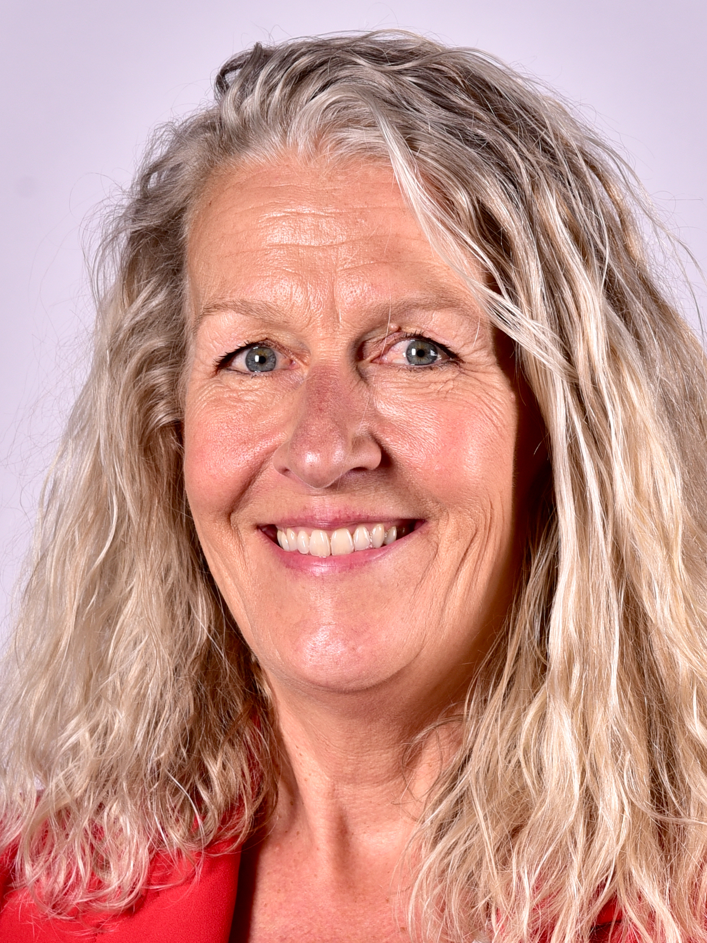
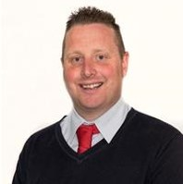
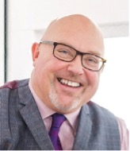
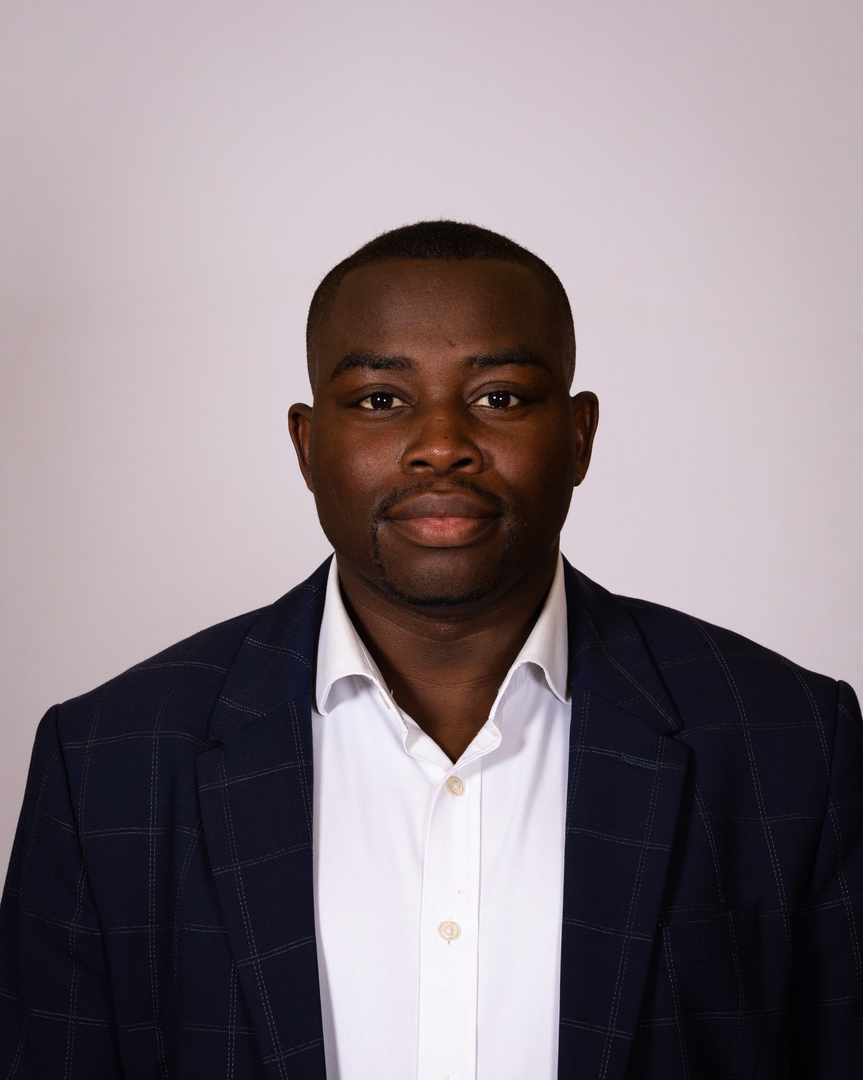
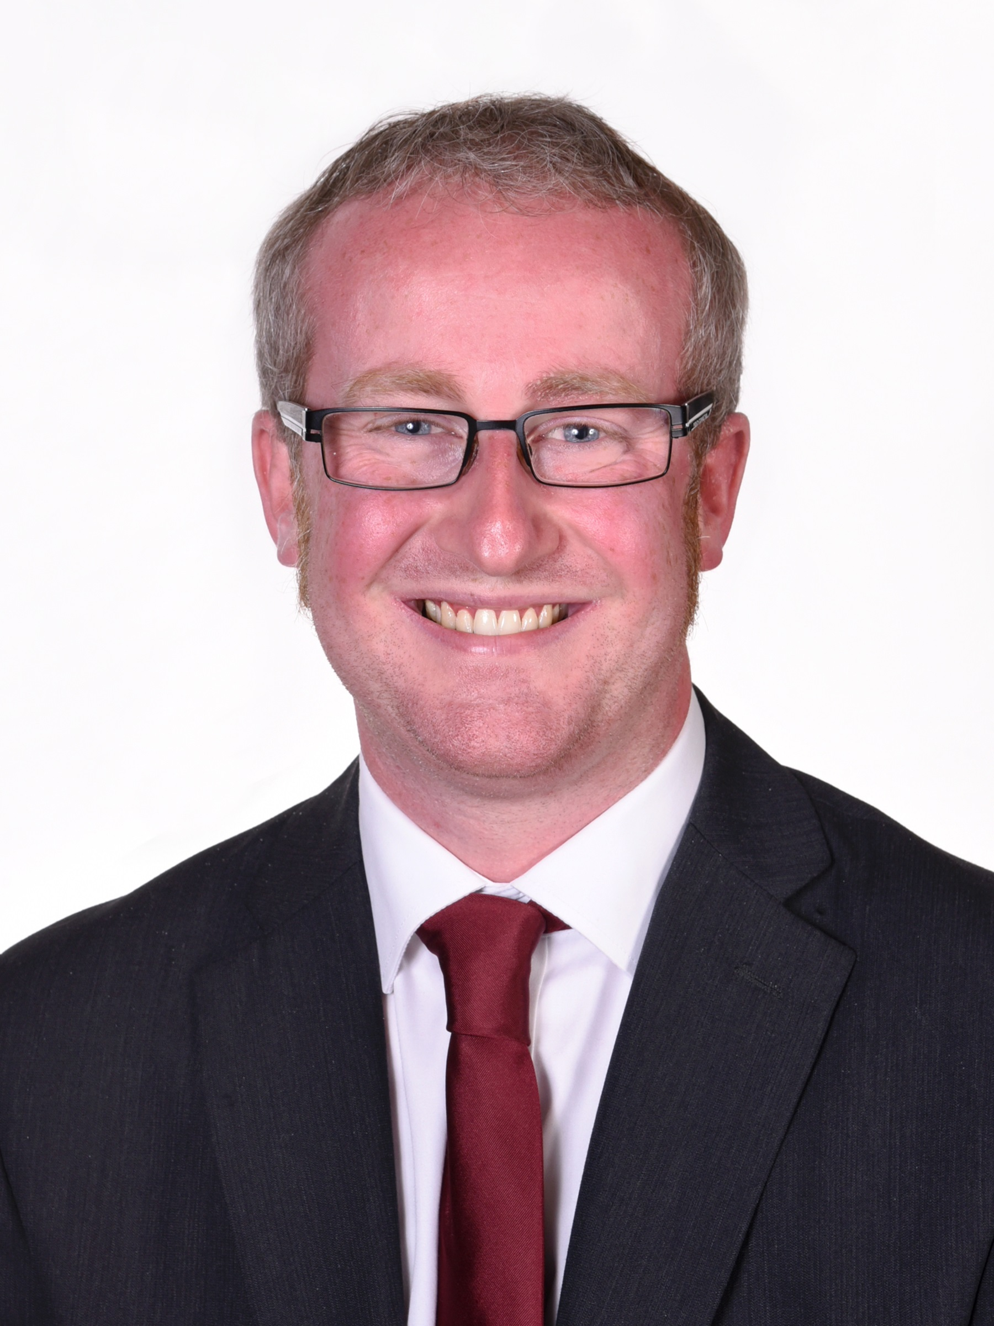
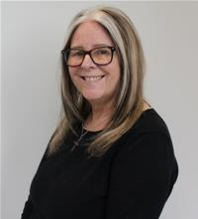
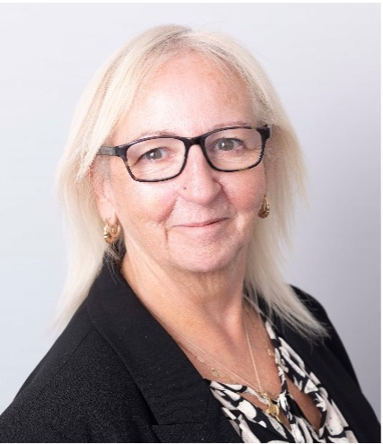
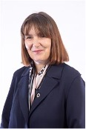
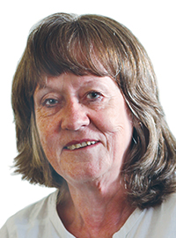
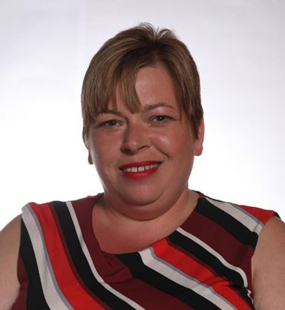
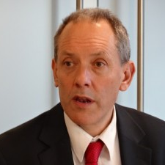
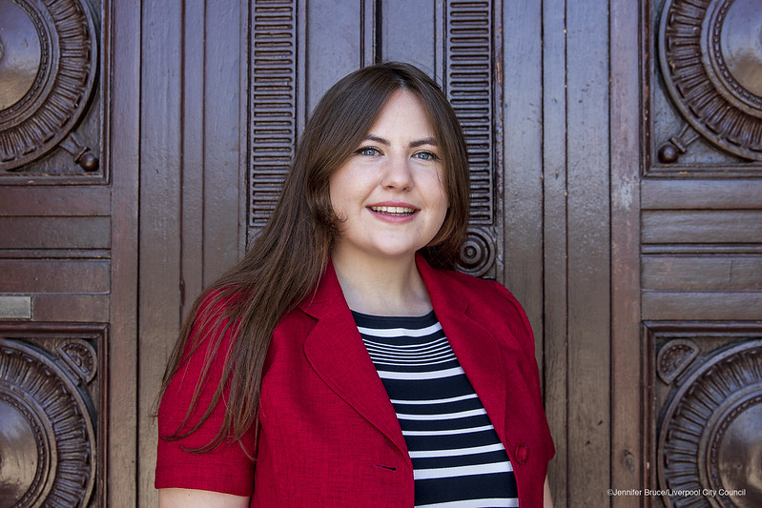
Executive Oversight Committee 2023-4
Cllr Louise Gittins
Chair of CCIN
Cheshire West & Chester Council
Cllr Peter Bradbury
Vice Chair of CCIN
Cardiff Council
Cllr Graeme Miller
Leader
Sunderland City Council
Cllr Anthony Okereke
Leader
Royal Borough of Greenwich
Cllr Paul Cassidy
Vice-Convenor
Inverclyde Council
Cllr Sue Smith
Cabinet Member
Rochdale MB Council
Cllr Cathy Scott
Leader
Kirklees Council
Cllr Kelly Middleton
Cabinet Member
Telford & Wrekin Council
Cllr Barbara Brownridge
Cabinet Member
Oldham Council
Cllr Clare Gamble
Chair
Billingham Town Council
Jonathan Bland
Managing Director – Social Business International/E3M
Cllr Sarah Doyle
Chair of V&P
Liverpool City Council

Slide 8
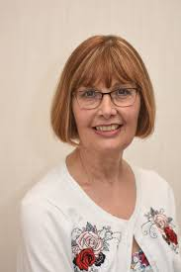

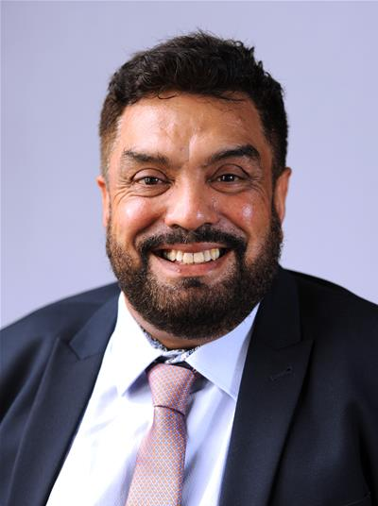
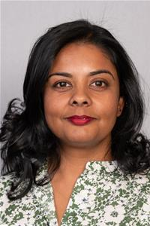
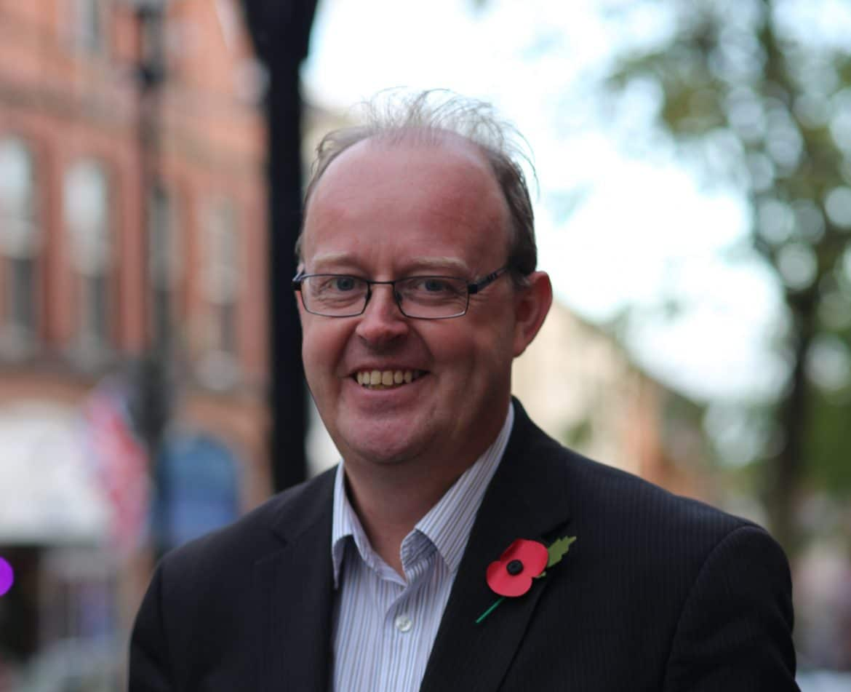
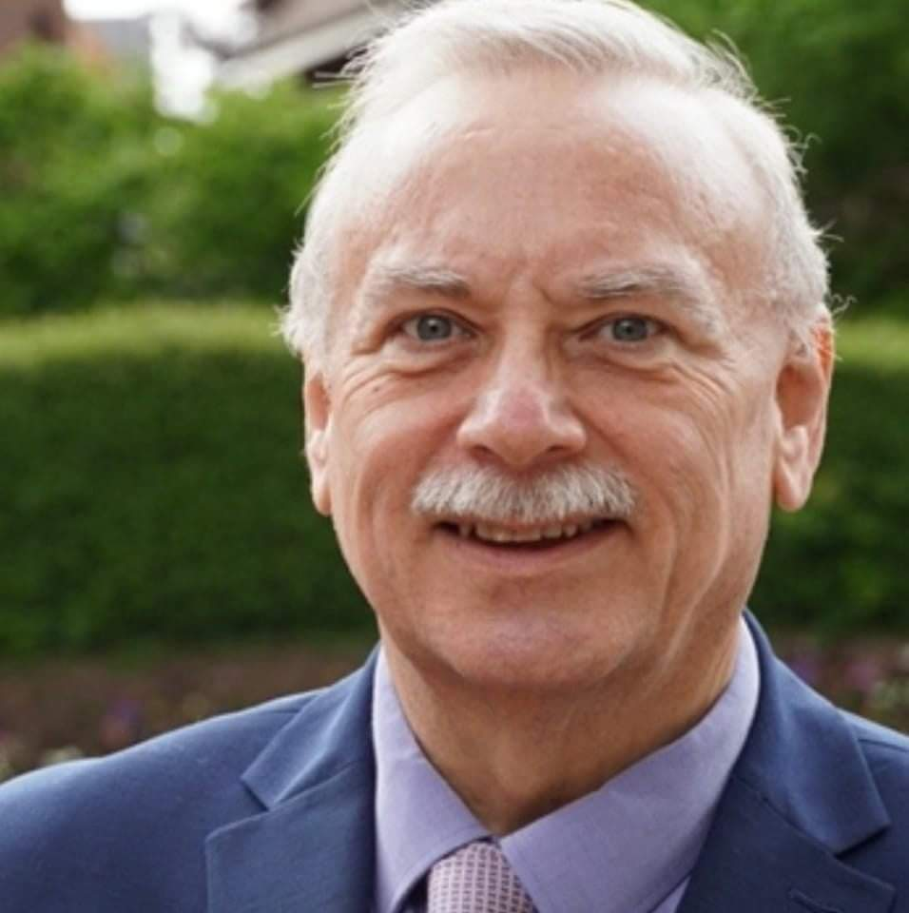
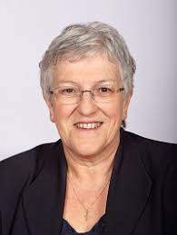
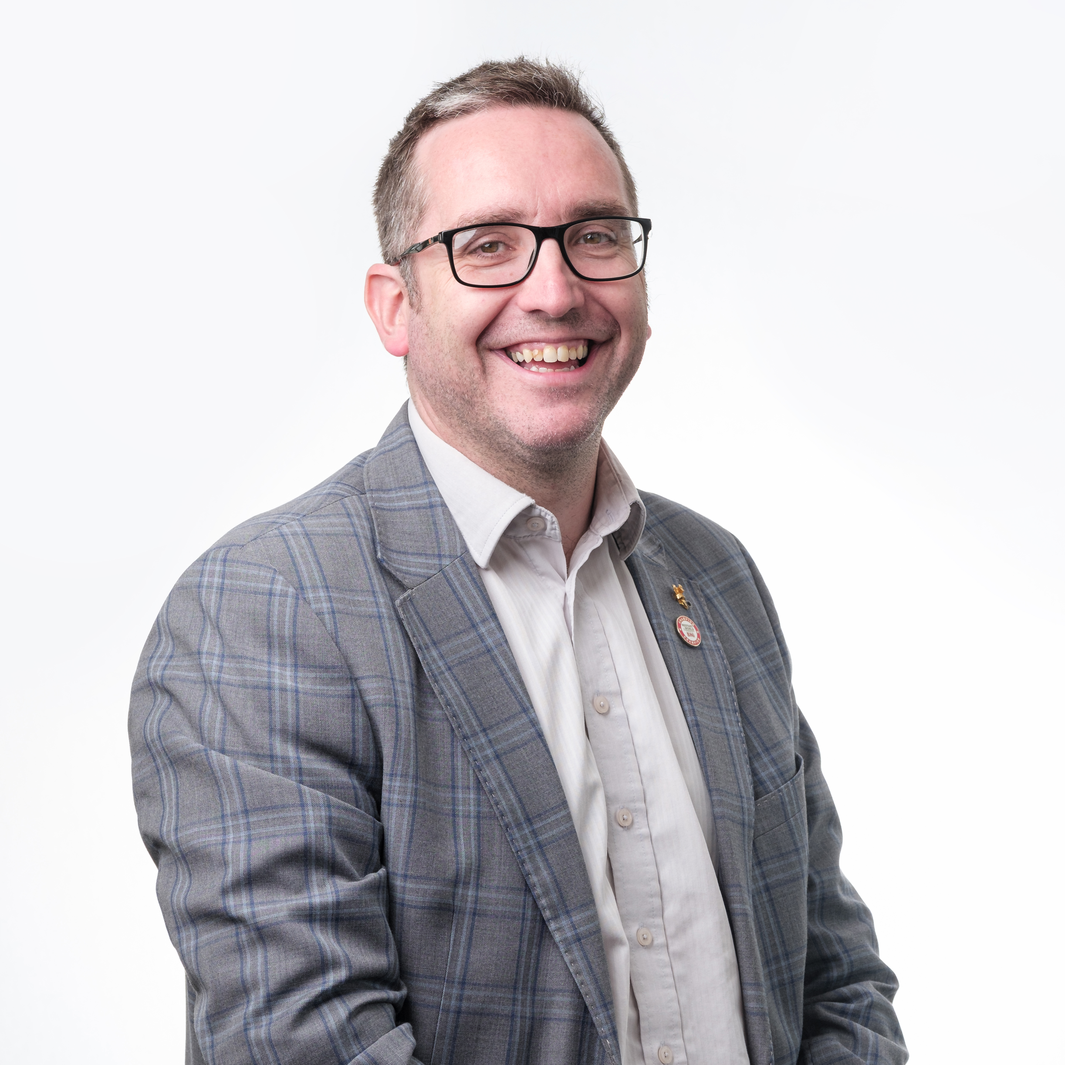
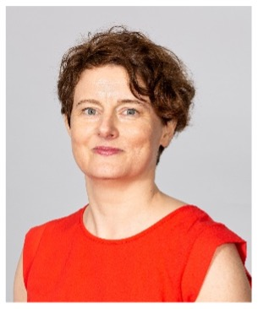
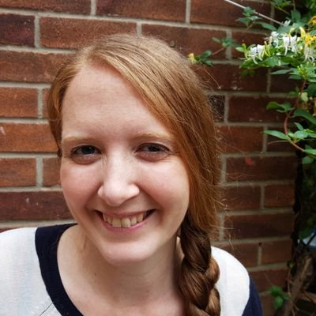
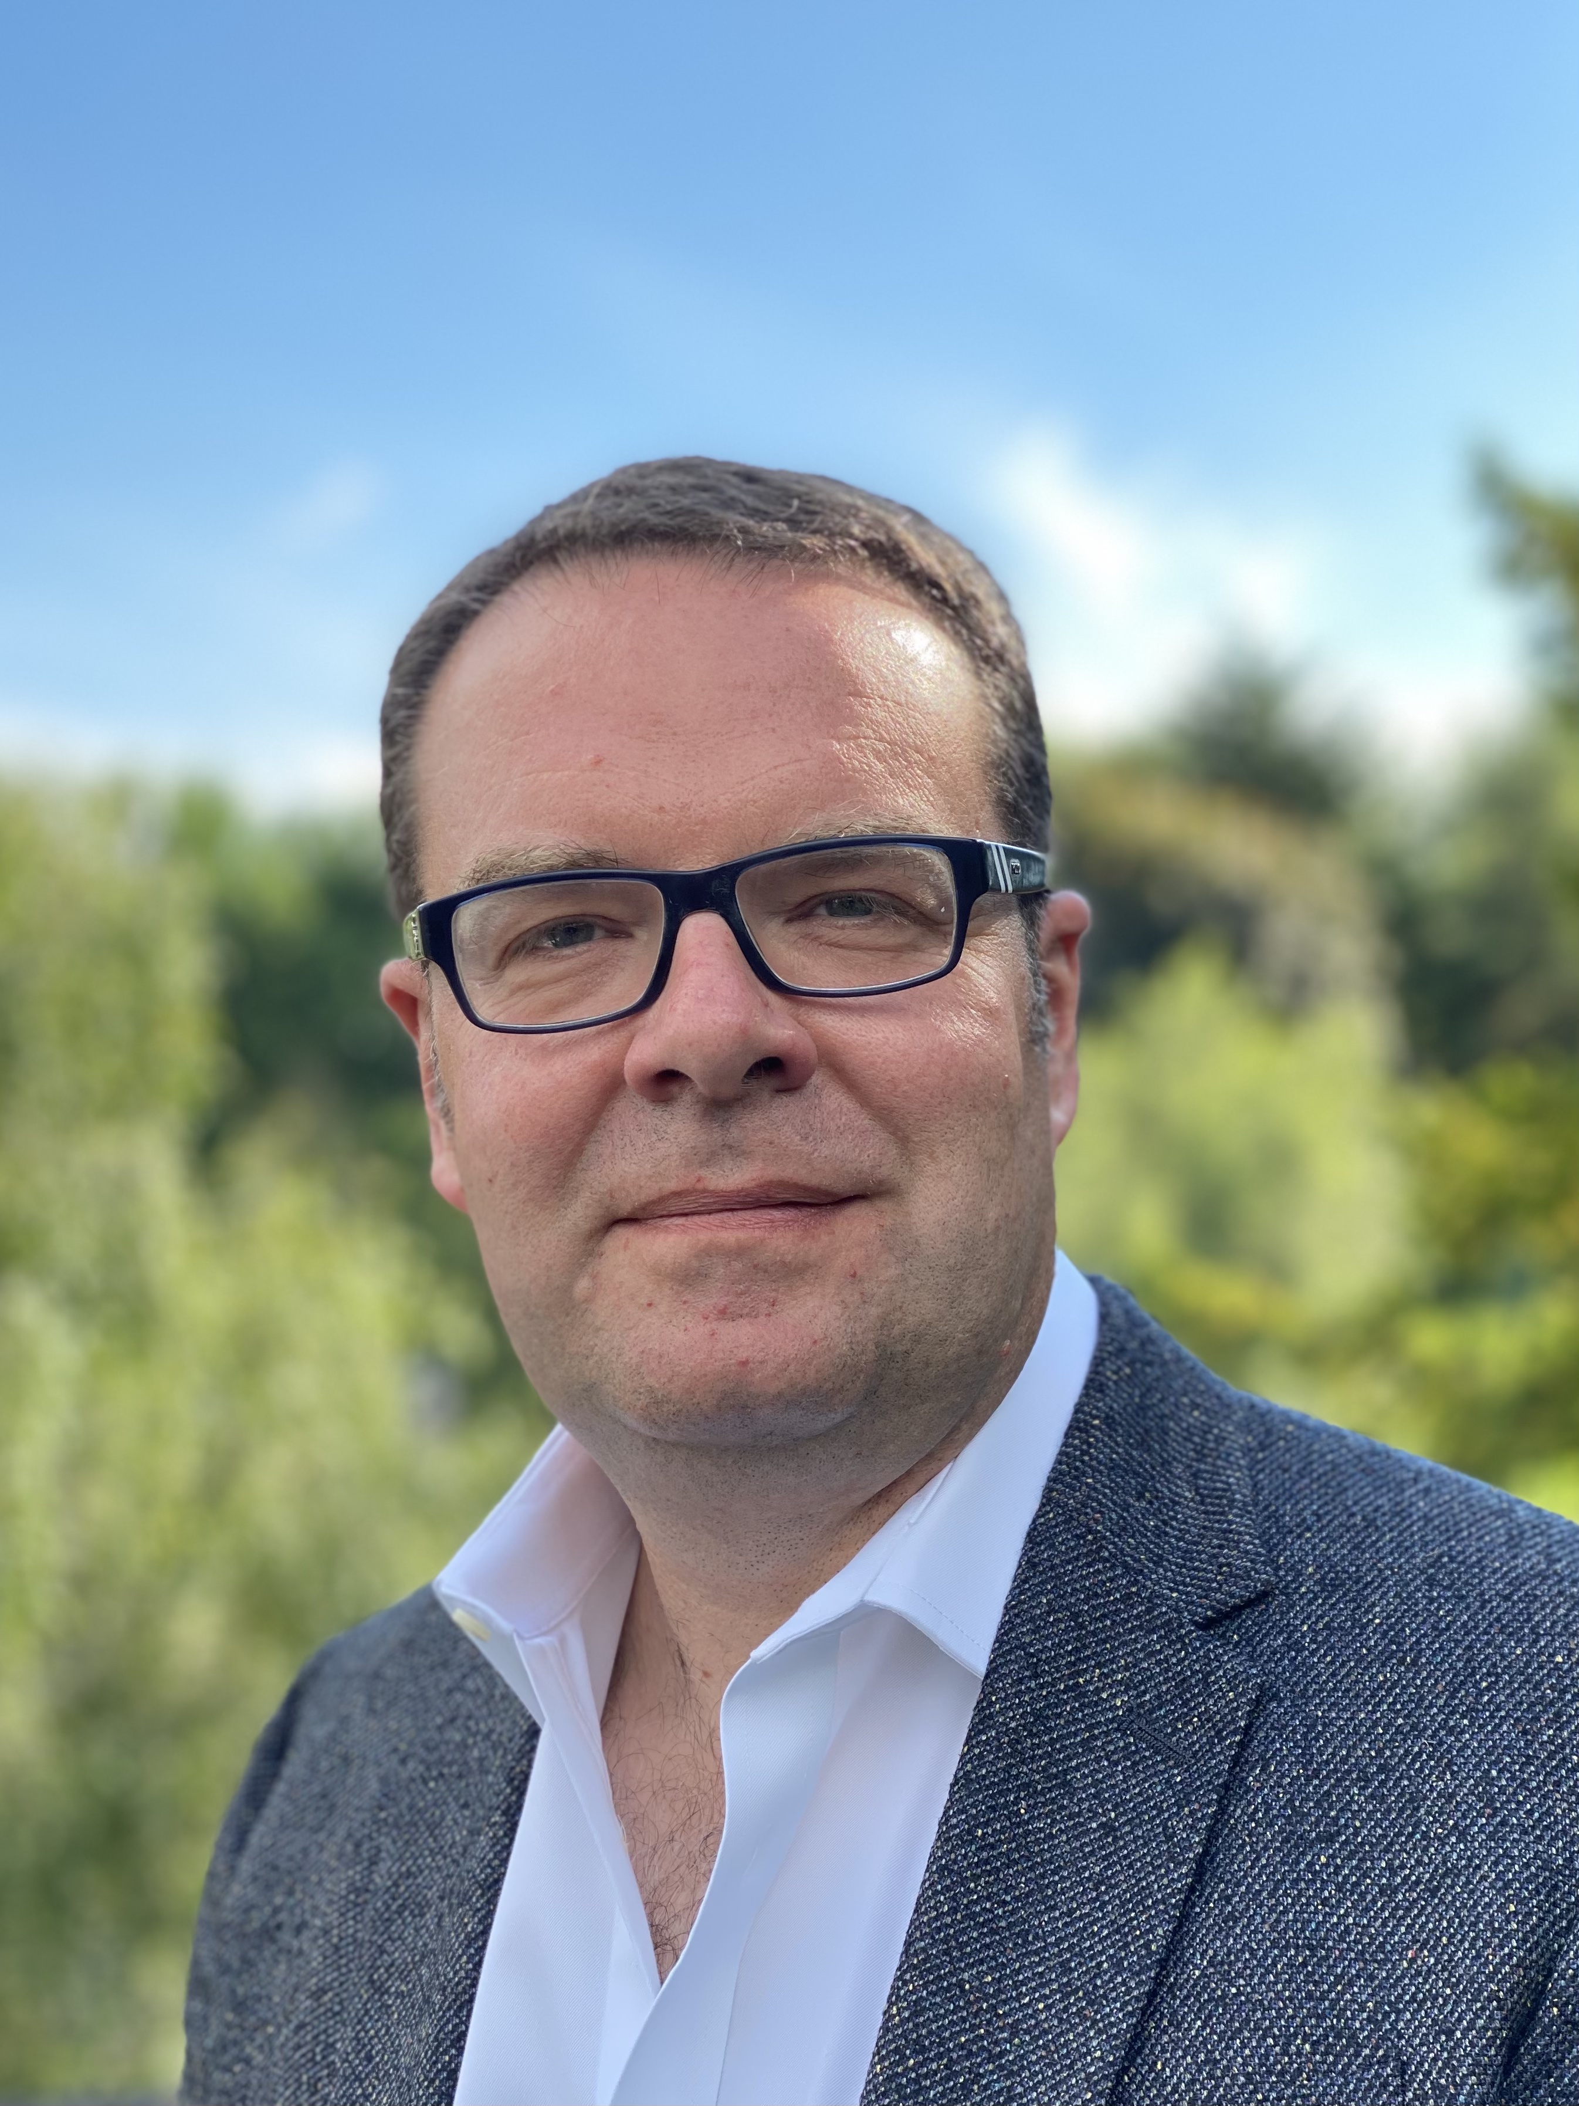

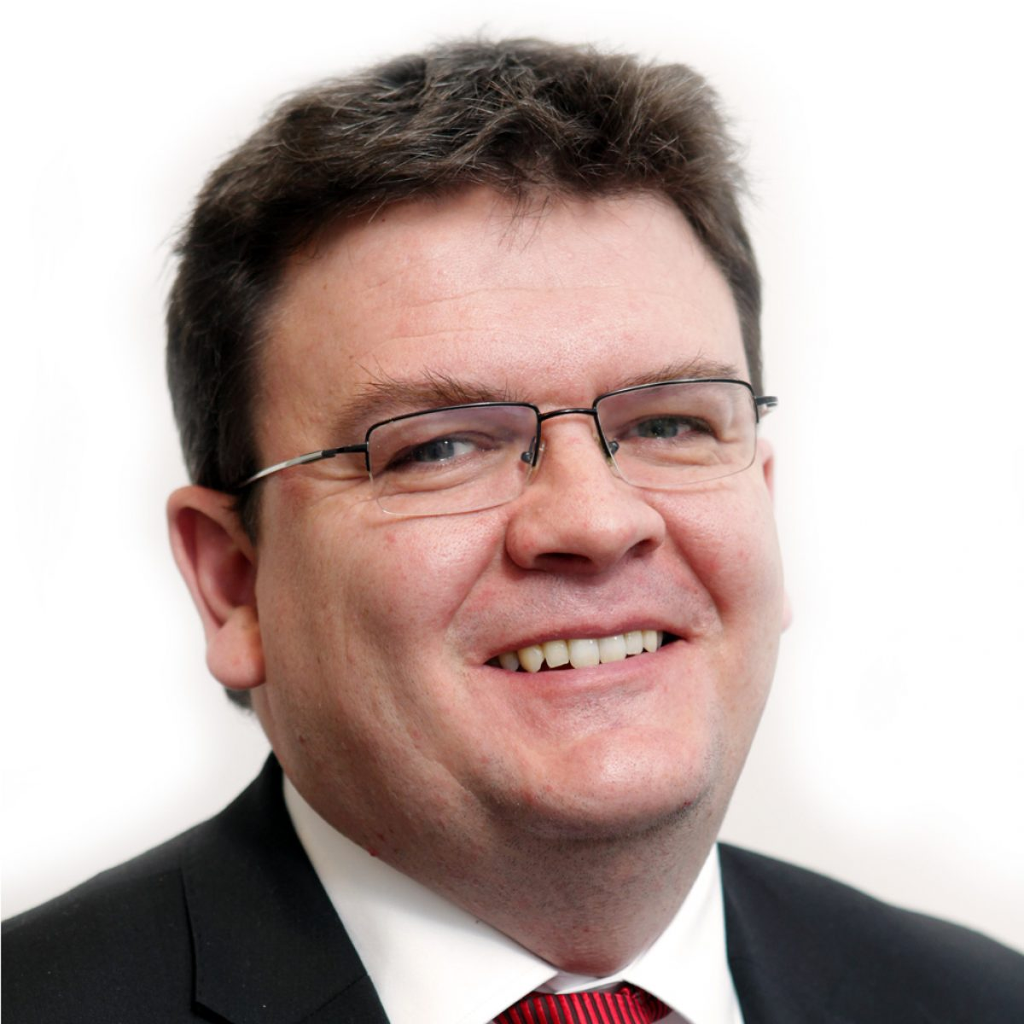
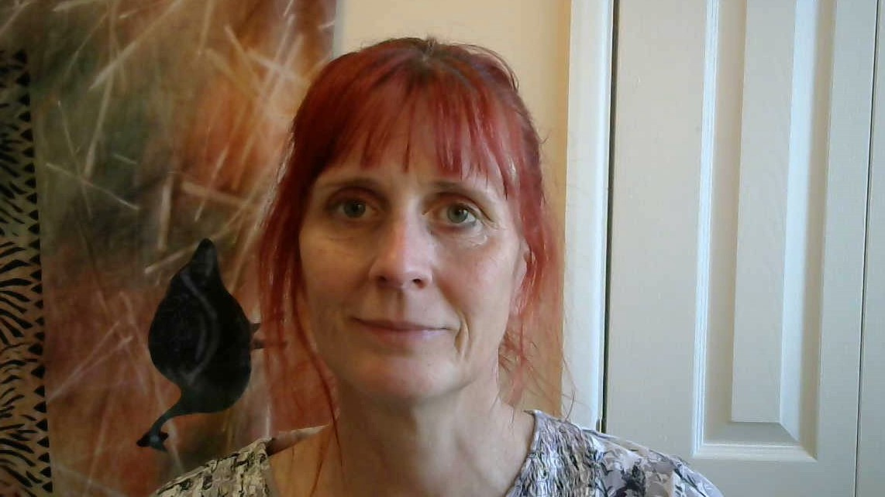
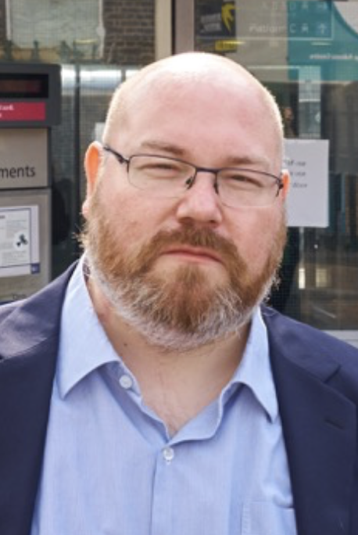
Values & Principles Board 2023-24
Cllr Sarah Doyle
Chair of V&P
Liverpool City Council
Cllr Joyce Welsh
Vice Chair
South Tyneside Council
Cllr Sandra Barr
Stevenage Borough Council
Cllr Ajaz Rehman
Oxford City Council
Cllr Mili Patel
Brent Council
Cllr Michael Stubbs
Vice Chair
N-U-L Labour & Coop Group
Cllr Peter Curling
Hillingdon Labour Group
Cllr Sue Woodward
Burntwood Town Council
Cllr David Darkin
Llanelli Town Council
Vacancy –
Associate Member
Claire Ward
Anthony Collins LLP
Vacancy –
Affiliate Member
Vacancy –
Affiliate Member
Rebecca Harvey
Co-operative News
Neil Calvert
Co-operative College
Cheryl Barrott
Co-operatives UK
Richard McCready
Co-operative Party
Jo White
Co-operative Futures
Paul Bell
Unison

Slide 9
124 Members
23 Supporters
47
24
53

Slide 10













































47 Councils 12.35m citizens £21.4bn budget

Slide 11























Slide 12






















































Slide 13
Agenda
Welcome, introductions and apologies
Minutes of the last meeting –
online 23 November 2022
Review of the Year: Aug 2022 – July 2023
Budget Report 2022/23
Report back from Values & Principles Board
Our Direction of Travel
Launch of 2024 funding round
Policy Lab Report Launches
  Arts & Culture for Social Cohesion
  Democratising Policy Solutions
Any Other Business

Slide 14
Agenda
Welcome, introductions and apologies
Minutes of the last meeting –
online 23 November 2022
Review of the Year: Aug 2022 – July 2023
Budget Report 2022/23
Report back from Values & Principles Board
Our Direction of Travel
Launch of 2024 funding round
Policy Lab Report Launches
  Arts & Culture for Social Cohesion
  Democratising Policy Solutions
Any Other Business

Slide 15

ITEM 3

Slide 16
Highlights from 2022-3
The number of Full Member Councils increased by almost one-third, from 34 to 45 Councils
Four Opposition Groups in our Associate Members took control of their council in May 2023 and have transitioned into Full Council members
The CCIN is the fastest-growing cross-sector Network in local government
Bestowed the titles of Honorary Vice President on Jim McMahon OBE, MP and Baroness Sharon Taylor OBE
Funded four Policy Labs & five Policy Prototypes
Published 478 Case Studies on our website: www.councils.coop
Organised a Study Visit to Mondragon
Launched three Policy Lab Reports
  – Cooperation at the Grassroots – Led by Stevenage
  – Growing an Inclusive Cooperative Economy – Led by Oxford
  – Community Economic Development Plans – Led by Birmingham

Slide 17
Being a Cooperative Council
#OurCoopDifference

Slide 18

What you can do as a council
Sign the ‘Councils for Fair Tax' Declaration
Pay Real Living Wage
Are part of a Real Living Wage City/Borough/Town
Sign the ‘Modern Slavery’ Charter
Actively encourage
co-op innovation within staff teams
Playing a central-role in tackling the Climate Emergency

Slide 19

What you can do with the CCIN
Encourage Members and Officers to undertake CCIN certified training modules
Offer CCIN accredited training courses for member and officer development
Actively participate in the CCIN Officer Network
Join the CCIN governance
Engage in Policy Labs and / or Prototypes
Engage in WhatsApp Groups
Submit regular Case Studies for inclusion on CCIN website
Engage with CCIN social media channels
Use the CCIN Dynamic Purchasing System to bring in capacity & expertise

Slide 20
community wealth building
Develop an Inclusive Economy Charter
Promote a progressive procurement policy
Support the creation of a regional mutual/community bank by investing
Work with local anchor institutions to buy and recruit local
Regulate rent and rates for ‘local’ businesses in council-owned property
Offer business rate rebates for those businesses that become Living Wage Accredited
Champion Local Employment schemes
Have insourcing Council Services as an objective

Slide 21
cooperative placemaking
Develop a cooperative development strategy
Establish a cooperative development network
Commit to community engagement in local decision making including participatory budgeting
Invest in local community production, particularly those focusing on community energy to tackle the climate emergency
Promote the circular economy
Support local enterprises to convert into coops/worker coops
Have an Asset Transfer policy to manage land and assets which support Community Land Trusts

Slide 22

Policy Labs 2023
Coop Option Training –
Lead: Kirklees Council
Tackling Violence Against Women and Girls –
Lead: Trafford Council
Social Value Toolkit for Councils – Lead: Oxford City Council
Study Visit to Emilia Romagna – Lead: CCIN

Slide 23
Policy Prototypes 2023
Engaging & Empowering the residents of Woolwich Common Estate – Greenwich Council
Co-operative Community Bank of Kindness – Stevenage Borough Council
Turning Strategic Plans into Art – Inverclyde Council
Cooperative Culture Making in Rochdale – Rochdale Council
Health and wellbeing support delivered via a Community Wellbeing Project – Brent Council

Slide 24
Dynamic Purchasing System
Allows new suppliers to join at any point
Mini Competition must be undertaken when using the DPS, ensuring the CCIN is promoting industry best practice
As pre-checking has already been done, there are no financial limits on the mini-competition process
5-year contract 2020-2025
Councils often need to move quickly and flexibly to be on the front foot when it comes to ‘doing things differently’.
Sometimes it is necessary to bring in extra capacity and specific expertise to be able to do this, and there can also be a need to seek independent challenge to test assumptions and policy design

Slide 25














DPS Suppliers 2020 - 2025

Slide 26
2023 Event Calendar
28 Jan
North & East & Cumbria Coop Party Regional Conference
17 - 19 Feb
Scottish Labour Conference - Edinburgh
11 - 12 Feb
Labour Local Government Conference - Nottingham
4 – 6 July
LGA Conference & Exhibition - Bournemouth
19 - 20 May
Stir to Action Urban Playground – Trafford, GM
23 - 26 Sep
Liberal Democrat Party Conference - Bournemouth
8 – 11 Oct
Labour Party Conference - Liverpool
12 – 14 March 2024
Study Visit to Emilia Romagna
3 March
National Association of Local Councils (NALC) – London
1 – 2 Nov
Annual Conference & AGM - Sunderland
11 - 12 March
Welsh Labour Conference - Llandudno
17 - 18 June
Cooperatives UK Congress - Manchester
18 June
Coop Party Local Government Conference - Manchester

Slide 27
Agenda
Welcome, introductions and apologies
Minutes of the last meeting –
online 23 November 2022
Review of the Year: Aug 2022 – July 2023
Budget Report 2022/23
Report back from Values & Principles Board
Our Direction of Travel
Launch of 2024 funding round
Policy Lab Report Launches
  Arts & Culture for Social Cohesion
  Democratising Policy Solutions
Any Other Business

Slide 28
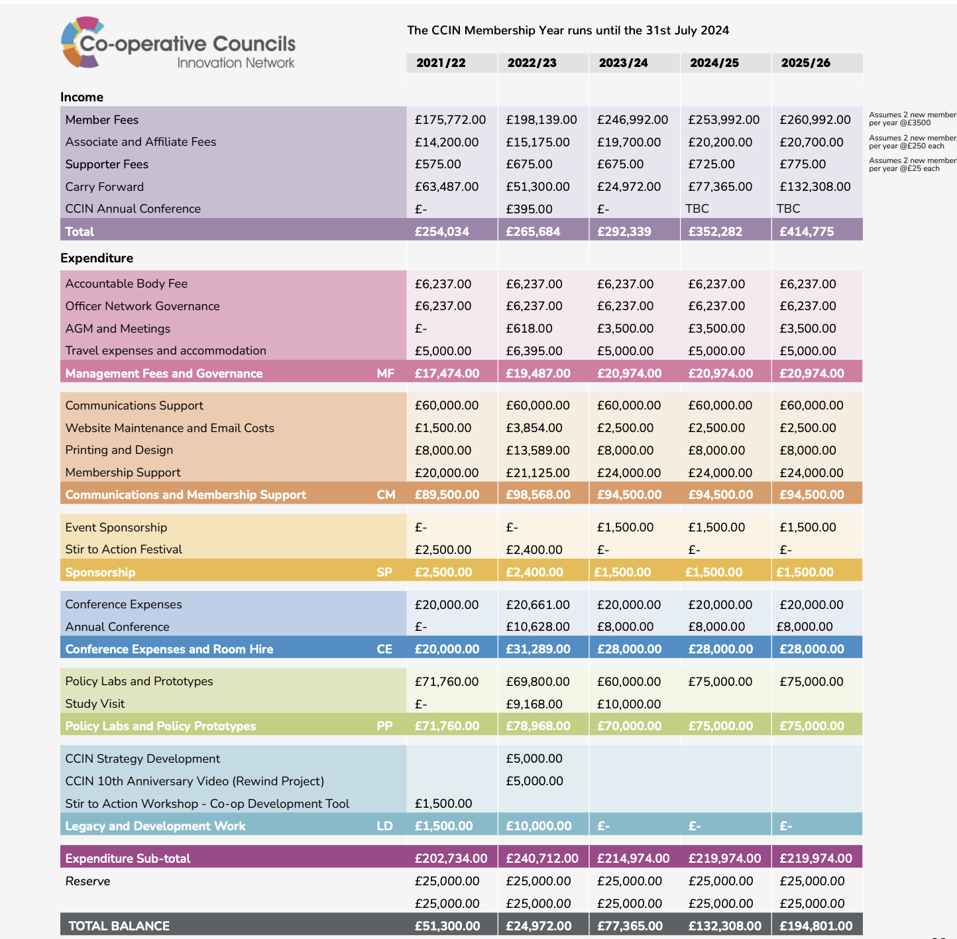
Budget Report 2022/23

Slide 29
Agenda
Welcome, introductions and apologies
Minutes of the last meeting –
online 23 November 2022
Review of the Year: Aug 2022 – July 2023
Budget Report 2022/23
Report back from Values & Principles Board
Our Direction of Travel
Launch of 2024 funding round
Policy Lab Report Launches
  Arts & Culture for Social Cohesion
  Democratising Policy Solutions
Any Other Business

Slide 30
Cllr Sandra Barr
Cabinet Member for Neighbourhoods and Cooperative Council
Stevenage Council
ITEM 5
@Sandie_B | @StevenageBC

Slide 31
Values & Principles Board 2023-24
Cllr Sarah Doyle
Chair of V&P
Liverpool City Council
Cllr Joyce Welsh
Vice Chair
South Tyneside Council
Cllr Sandra Barr
Stevenage Borough Council
Cllr Ajaz Rehman
Oxford City Council
Cllr Mili Patel
Brent Council
Cllr Michael Stubbs
Vice Chair
N-U-L Labour & Coop Group
Cllr Peter Curling
Hillingdon Labour Group
Cllr Sue Woodward
Burntwood Town Council
Cllr David Darkin
Llanelli Town Council
Vacancy –
Associate Member
Claire Ward
Anthony Collins LLP
Vacancy –
Affiliate Member
Vacancy –
Affiliate Member
Rebecca Harvey
Co-operative News
Neil Calvert
Co-operative College
Cheryl Barrott
Co-operatives UK
Richard McCready
Co-operative Party
Jo White
Co-operative Futures
Paul Bell
Unison

Slide 32
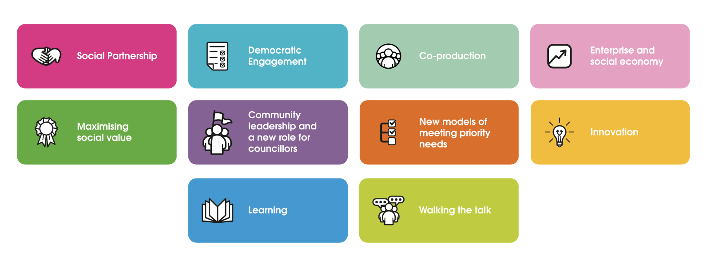
Our Principles
https://www.councils.coop/about-us/values-and-principles/

Slide 33

These icons demonstrate how Co-operative Councils are putting our co-operative principles into practice, demonstrating the
#cooperativedifference
in the work that they are doing.

Slide 34

53 new Case Studies illustrating some of the many ways Co-operative Councils are working with local people to build strong and resilient neighbourhoods. www.councils.coop/case-studies
478 Case Studies

Slide 35
Agenda
Welcome, introductions and apologies
Minutes of the last meeting –
online 23 November 2022
Review of the Year: Aug 2022 – July 2023
Budget Report 2022/23
Report back from Values & Principles Board
Our Direction of Travel
Launch of 2024 funding round
Policy Lab Report Launches
  Arts & Culture for Social Cohesion
  Democratising Policy Solutions
Any Other Business

Slide 36


Slide 37
Agenda
Welcome, introductions and apologies
Minutes of the last meeting –
online 23 November 2022
Review of the Year: Aug 2022 – July 2023
Budget Report 2022/23
Report back from Values & Principles Board
Our Direction of Travel
Launch of 2024 funding round
Policy Lab Report Launches
  Arts & Culture for Social Cohesion
  Democratising Policy Solutions
Any Other Business

Slide 38
Cllr Paul Cassidy
Member of CCIN Executive Oversight Committee
Vice Convenor Environment and Regeneration Inverclyde Council
ITEM 7
@PCassidy29| @inverclyde

Slide 39

Policy Labs and Prototypes 2024

Slide 40
CCIN Policy Lab & Prototype funded projects
Member led projects to find co-operative policy solutions to the challenges facing local government.
Open to all ideas, the more innovative the better!
Policy Labs - more significant collaborative pieces of work that CCIN members work on together and eligible for between £10,000 - £20,000 of funding.
Policy Prototypes - smaller projects delivered in a locality on behalf of the Network and eligible for up to £2,000 of funding.

Slide 41
Key points of 2024 process
Policy Labs –
£60k total budget
24 months to deliver
Policy Prototypes –
£15k total budget
12 months to deliver
Notes:
For Policy Labs We recommend engaging a minimum of three other CCIN members to create a working group to support the development of your project. We welcome applications from all Members, but the application must be submitted and overseen by a Full Member Council. Members will have up to two years to deliver a Policy Lab. Applications will be considered for funding of up to £20,000, dependent on their scale and ambition.
Policy Prototypes are smaller projects for members who want to deliver in their locality on behalf of the Network. This funding is available to councils of all sizes, Opposition Groups and Minority Administrations. Members will have up to nine months to deliver a Policy Prototype. Applications will be considered for funding of up to £2,000.

Slide 42

We want to hear your ideas
There is no limit to the number of Policy Labs you are engaged in BUT you can only lead on one

Slide 43
Timetable for 2024 Bids
Dates
2 Nov 2023 | Launch
5 Feb 2024 | Closing date for submission of all Bids
20 Feb 2024 | EOC & V&P Board consider Bids
21-29 Feb 2024 | Bidders asked to respond to any further questions from Governance
w/b 4 March 2024 | Sign-off of successful bids by EOC
31 March 2024 | Contracts awarded/work starts
For more information visit https://bit.ly/CCINbids24

Slide 44
Agenda
Welcome, introductions and apologies
Minutes of the last meeting –
online 23 November 2022
Review of the Year: Aug 2022 – July 2023
Budget Report 2022/23
Report back from Values & Principles Board
Our Direction of Travel
Launch of 2024 funding round
Policy Lab Report Launches
  Arts & Culture for Social Cohesion
  Democratising Policy Solutions
Any Other Business

Slide 45
Policy Lab Launches 2023

Slide 46
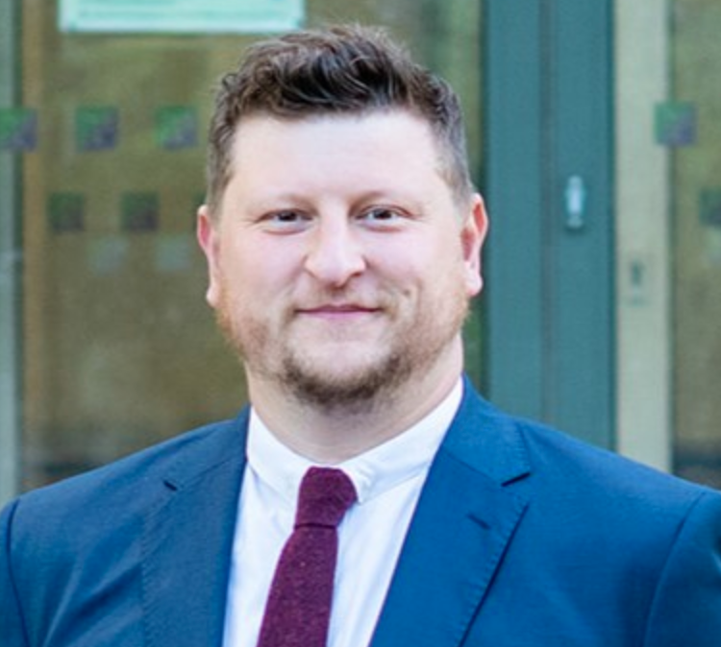
Cllr Alistair Willoughby
Executive Member for Community Partnerships
North Herts Council
@AliWLabour | @NorthHertsDC

Slide 47

Arts & Culture for Social Cohesion
Cllr Alistair Willoughby,
North Hertfordshire Council’s
Executive Member for Community & Partnerships

Slide 48
Why Arts & Culture
to demonstrate how culture and arts can be strong drivers of development, social cohesion, and change.
communities that have poor social cohesion also have poor involvement or access to civic participation, economic opportunity, and social engagement.
supporting the role of arts and culture in our communities we can build better and more meaningful social cohesion.
Cultural projects can be used to help to prevent conflicts within our communities and assist in resolving pre-existing conflict too.

Slide 49
Why Arts & Culture
Art can communicate across language barriers, it empowers people, and it facilitates social cohesion, including among our refugees, migrants, and host communities, which creates a stronger wider community.
It prevents marginalisation of people based on their cultural identity, socio-economic status, age, and other factors.
By increasing cultural offerings in town centres, encourages more people into the area which increases footfall, and the time people spend in our retail, hospitality and leisure businesses as well as other high street amenities.

Slide 50
The aim of our policy lab was to:
Widen engagement with arts and culture offerings by developing an understanding of how to reach a broader range of the community.
Understand what other kinds of arts and culture events/activities we could offer.
Understand which groups and voices were missing and could be better represented within our arts and culture activities (for example, this could include more LGBTQ exhibitions, or history events related to a particular culture)

Slide 51
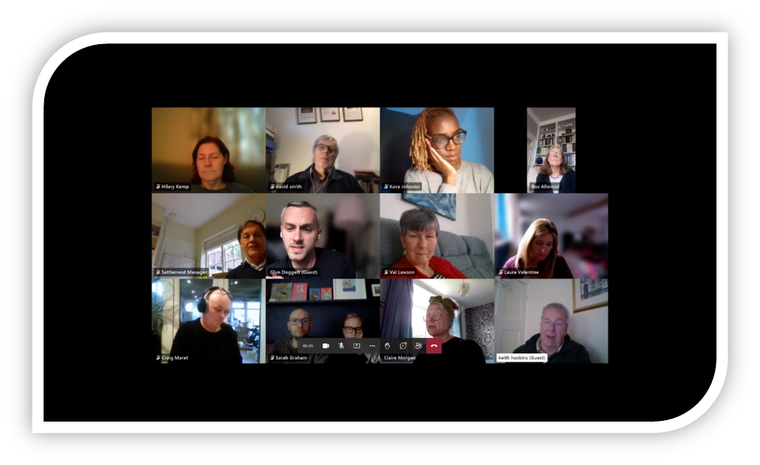
The CCIN Members
working in partnership

Slide 52
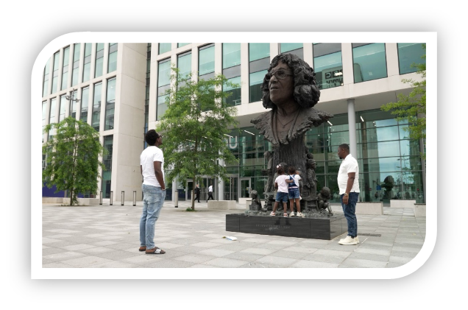
Cardiff Council
Their project centres around cultural activities during refugee week and celebrating the life of Betty Campbell. Betty Campbell was told that a working-class black girl could never succeed, and that her desire to become a teacher would face “insurmountable” problems. She is now immortalised in a statue in Cardiff; Wales' first black headteacher and responsible for putting Black culture and history on Cardiff's curriculum.

Slide 53

North Herts Council
focused on how our Arts & Culture Network brings people and their creativity together and helps to increase the vibrancy of our town centres. It focuses on the ‘place festival’ in each of our main town centres and highlights our LGBTQ+ community coming together at North Herts Pride

Slide 54

Oldham Council
Outlines the benefits of their Linking Schools Programme and highlights an initiative to bring school children together from different communities to work on arts activities that encourage learning about each other, their differences, and similarities.

Slide 55
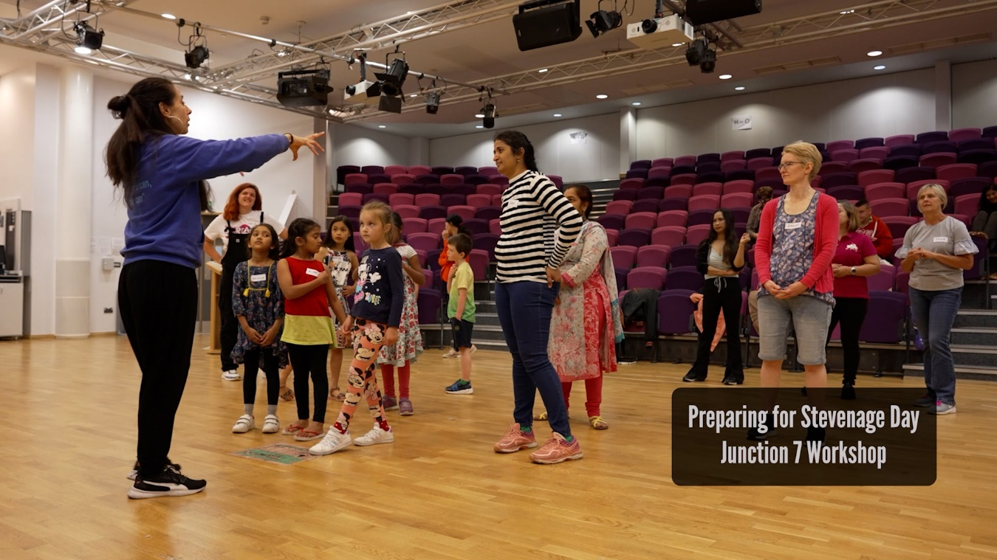
Stevenage Council
Presented their arts and heritage forum and the benefits of Stevenage Day and how it brings all elements of their multicultural communities together to encourage community cohesion and improving mental health.

Slide 56

CCIN Values and principles

Slide 57
CCIN Values and principles
Social Partnership – by demonstrating how the projects have improved social partnerships and bringing communities, groups, and organisations together.
Maximising Social Value – by listening to communities, discovering more about diverse cultures, recognising distinctions between communities, and not making assumptions about what is needed or wanted.
Enterprise and social economy – by providing cultural activities for the community to get involved in, which enables people to feel part of our towns or cities, whilst also encouraging use of retail and hospitality business.

Slide 58
CCIN Values and principles
Learning - Arts, Heritage, and Culture should not be seen as passive. Make it an integral part of everyday life to enable people and our communities to have a sense of their place.
Demographic Engagement - This development opportunity has enabled the authorities to better support the communities which they serve. Equally, the values and principles of the CCIN have enabled the local authorities taking part in the policy lab to better focus their delivery of services through coproduction, engagement, consultation and sharing of knowledge.

Slide 59
Conclusion
Arts & Culture are an integral part of every community
Bringing together the diverse groups that make up our communities allows the use of the arts as a vehicle to share culture and heritage and provide individuals with a sense of place and belonging.
It encourages cohesion within the community and enables groups to share their lived experiences with each other, to learn about each other’s differences and similarities
It helps to integrate those that might otherwise be socially isolated, or not engaging with the wider community
Bringing arts and culture events and activities into Town Centres encourages visitors in otherwise diminishing High Streets
The local councils, museums, businesses, creatives, and community must connect in order to develop a strong sense of belonging and social cohesion in our areas

Slide 60
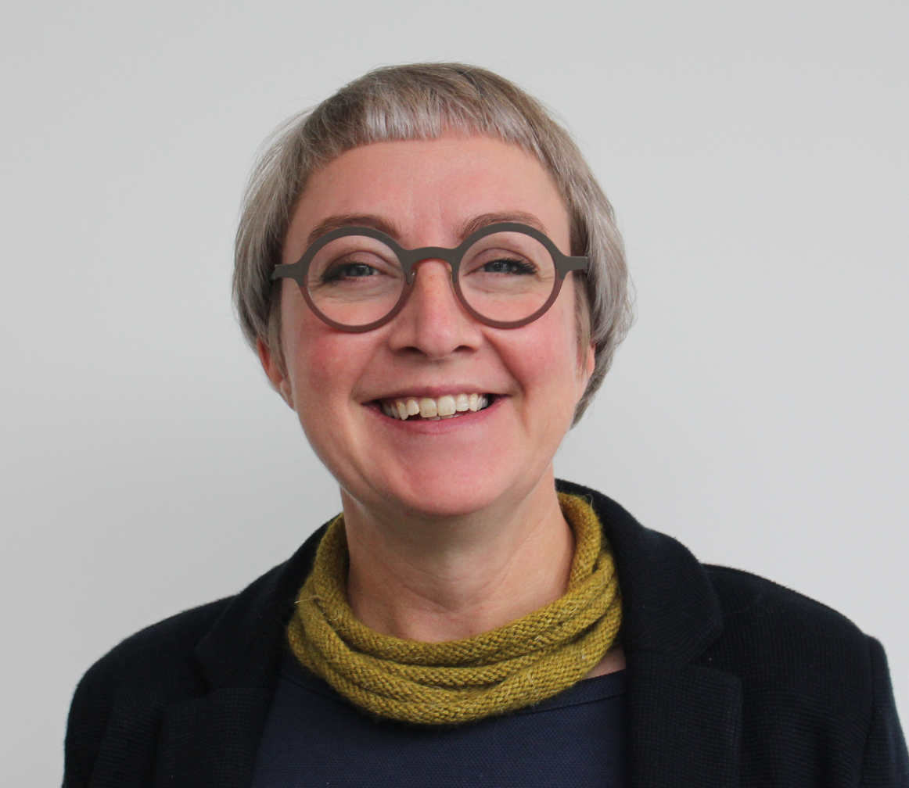
Helen Chicot
Rochdale Borough Council
@RochdaleCouncil

Slide 61


Slide 62
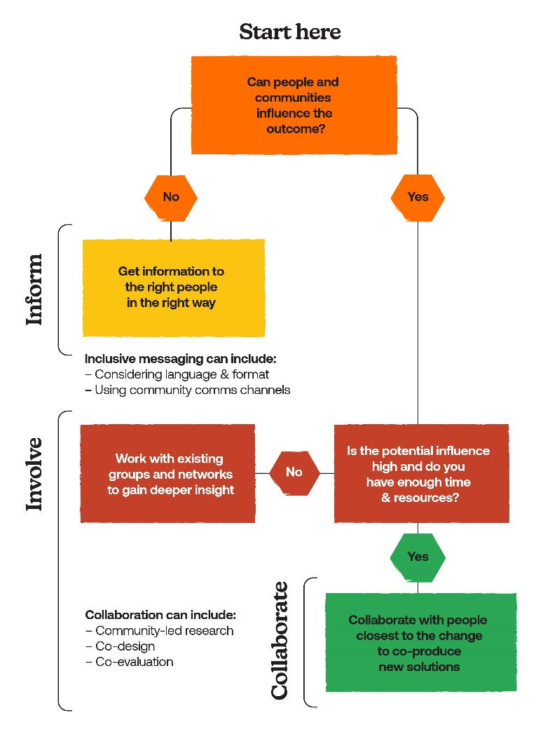

Slide 63
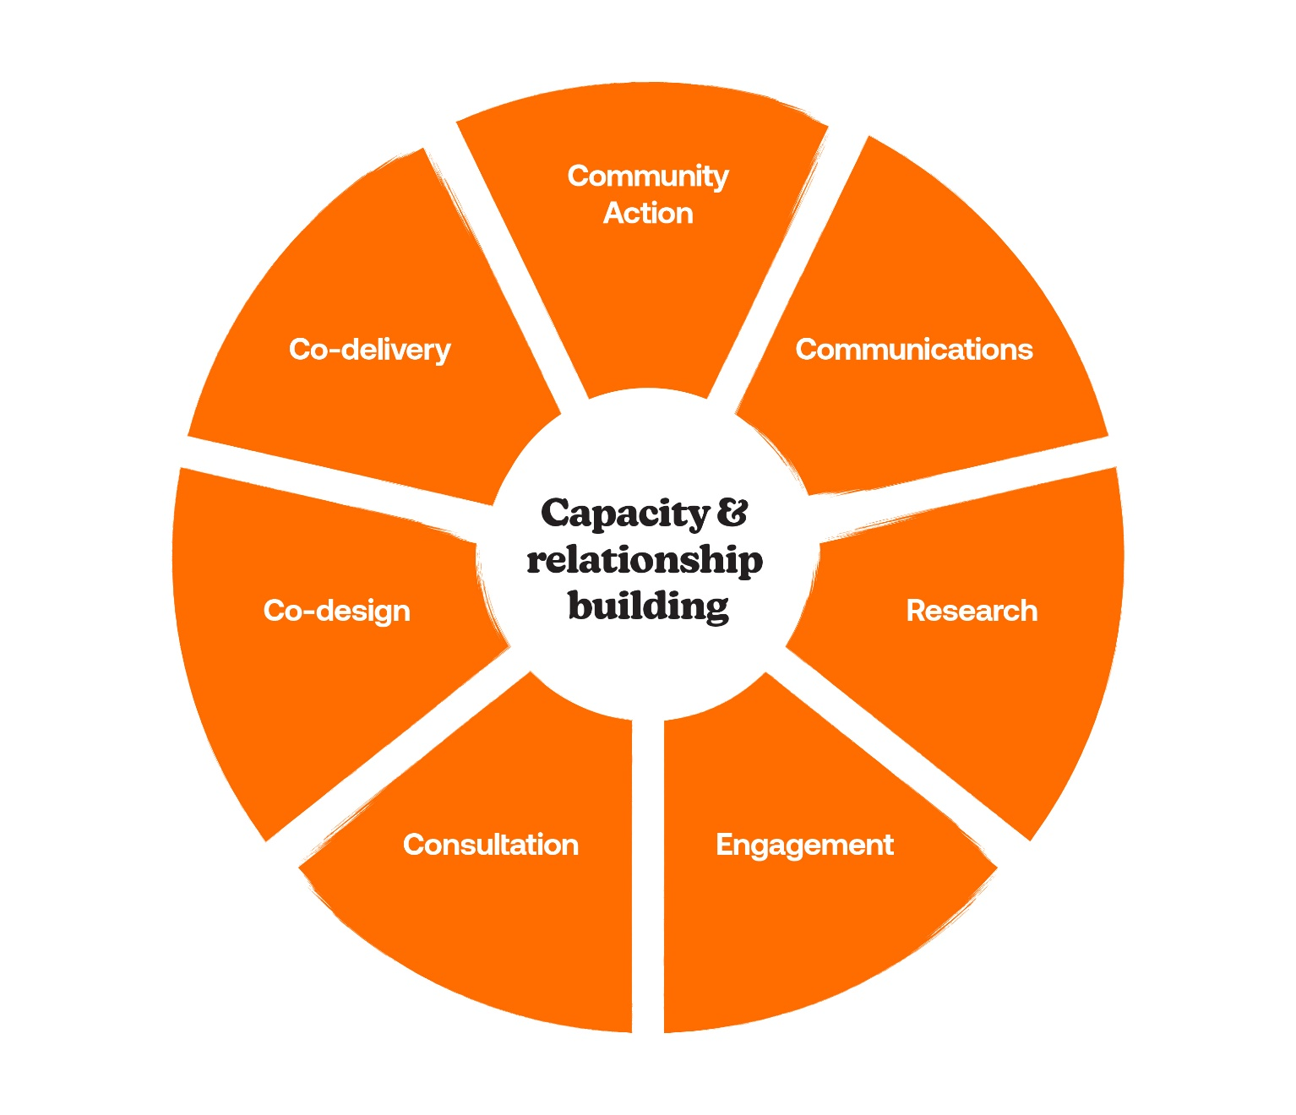
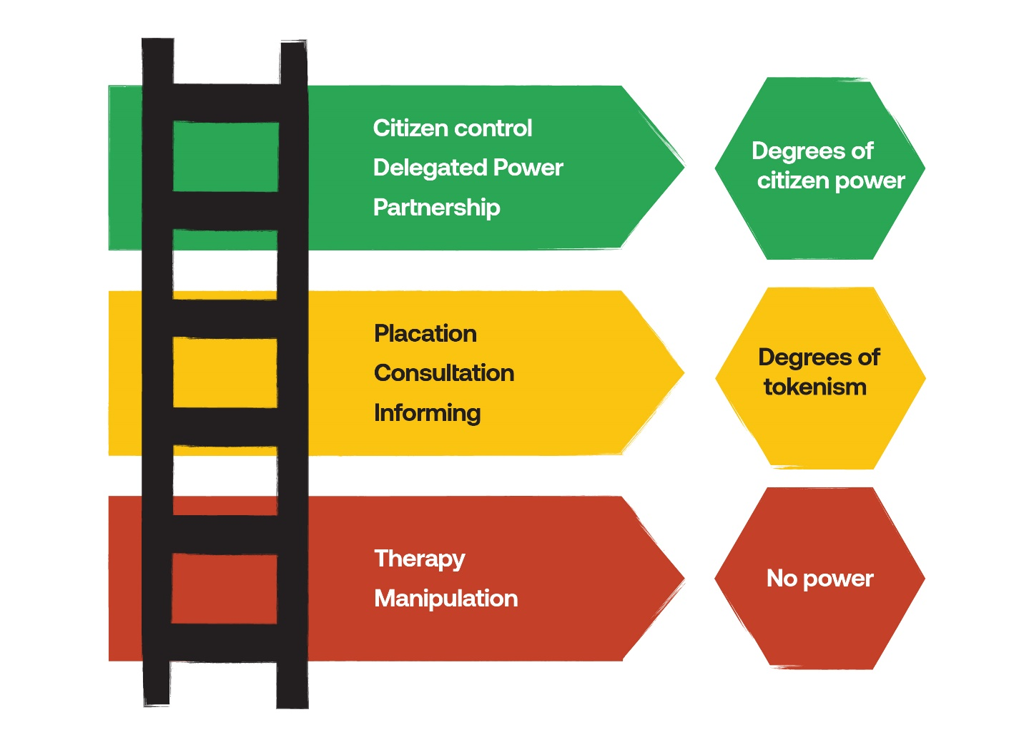

Slide 64
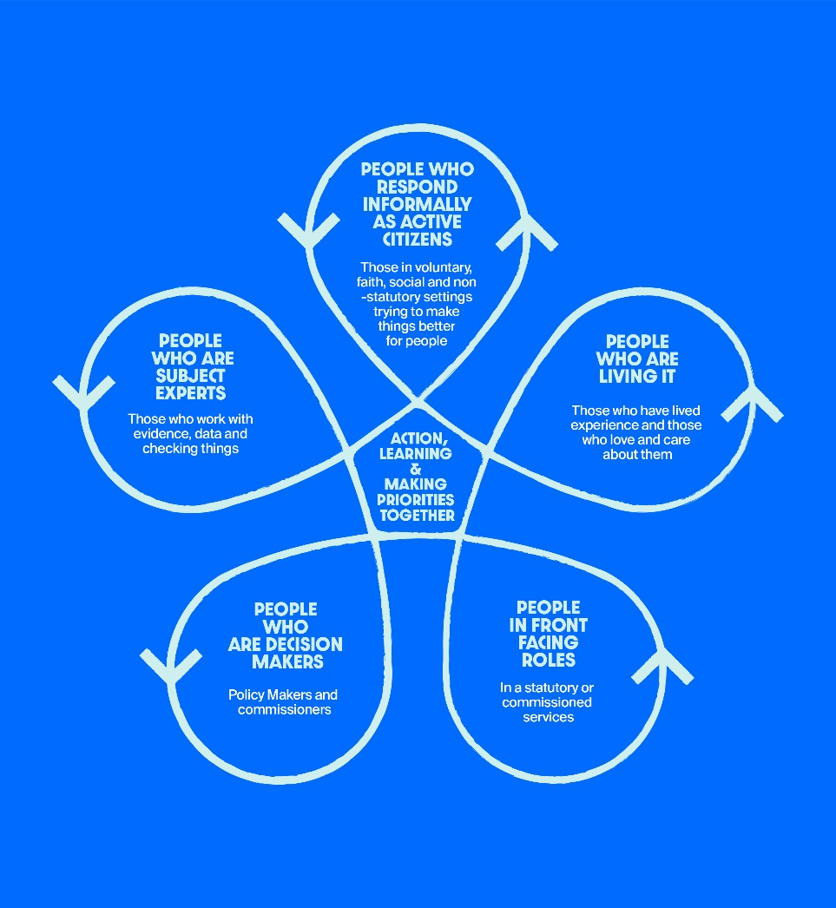

Slide 65


Slide 66
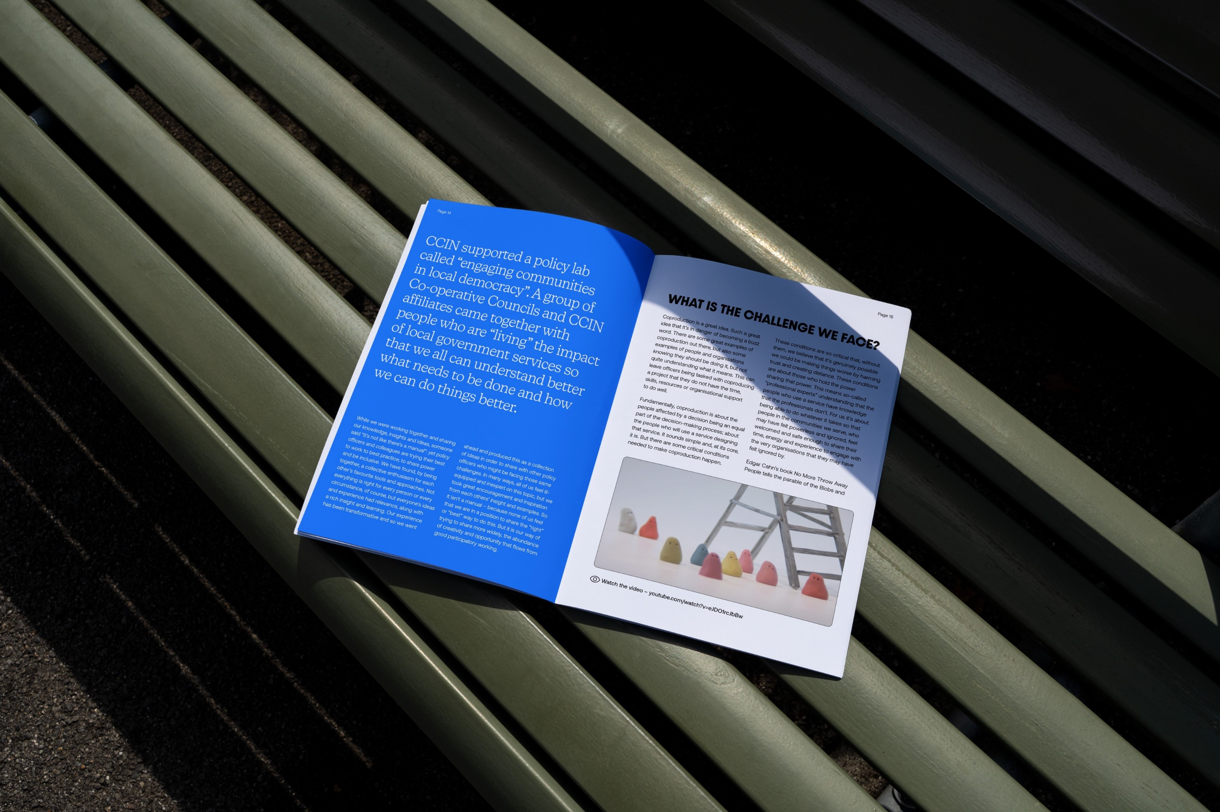

Slide 67

Thank you

