Slide 1
CYNGOR DRÊF
LLANELLI
TOWN COUNCIL
A Cooperative Council's Manifesto for The General Election
Cllr David Darkin
Leader
Llanelli Town Council
2 November 2023
www.llanellitowncouncil.gov.uk

Slide 2
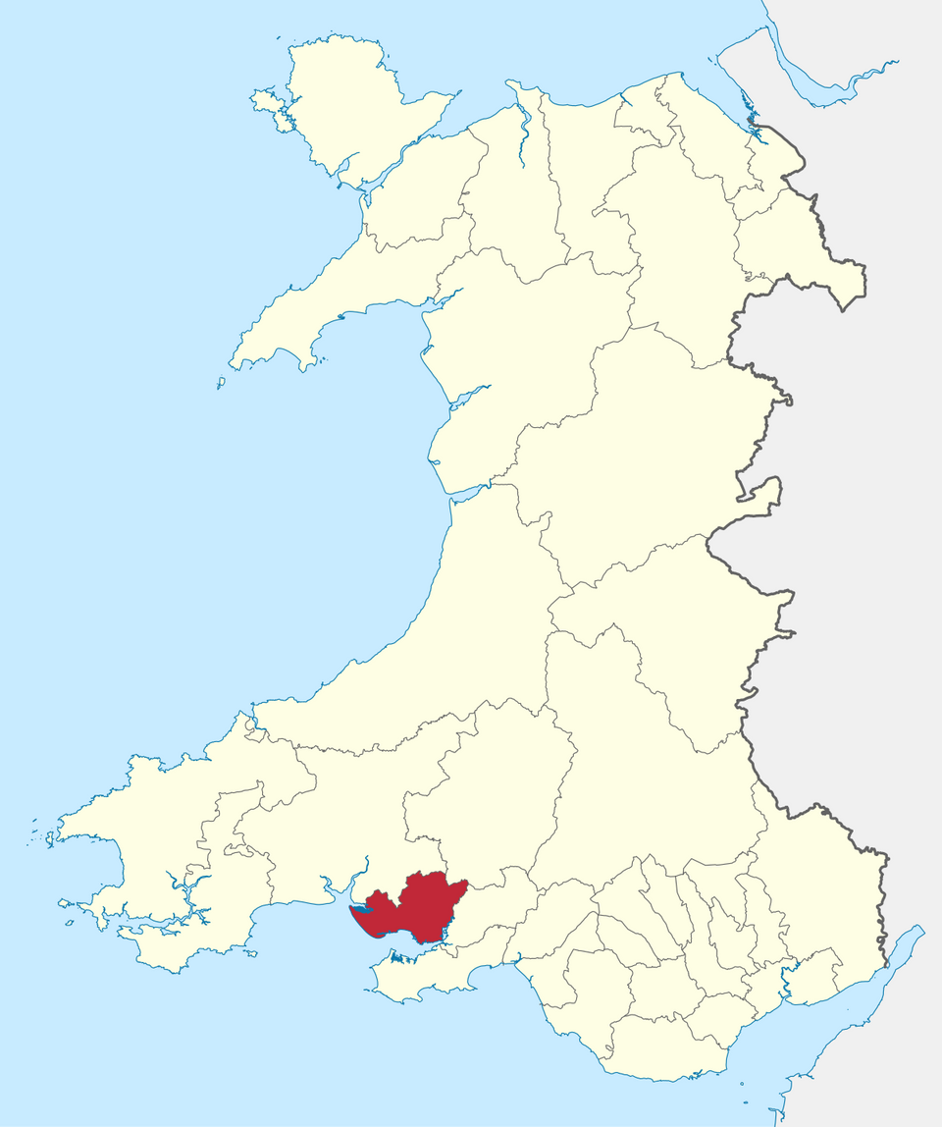
CYNGOR DRÊF
LLANELLI
TOWN COUNCIL
Llanelli
26,225
£1.5m
#CoopDifferences

Slide 3
Values
self-help
self-responsibility
democracy
equality
equity
solidarity
#CoopDifference

Slide 4
Deddf Llesiant Cenedlaethau'r Dyfodol (Cymru) 2015)
Well-being of Future Generations (Wales) Act 2015
#CoopDifferences

Slide 5
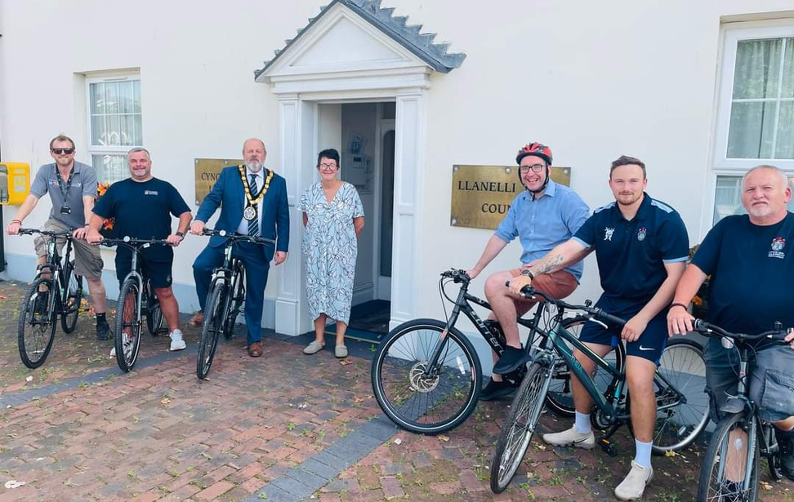
Delivery In Partnership
#CoopDifference

Slide 6
A Cooperative Council's Manifesto for The General Election
#coopdifference

