Slide 1
Reviewing the Policy Lab and Policy Prototype approach

Slide 2
Policy Labs and prototypes
Policy Lab funding supports research, collaboration and implementation of cooperative initiatives that involve multiple Network members (recommended to be at least three). They can last up to two years, and receive up to £20,000
Policy Prototypes are smaller projects for members who want to deliver a project in their locality on behalf of the Network. This funding is available to councils of all sizes, Opposition Groups and Minority Administrations. Members will have up to twelve months to deliver a Policy Prototype. Applications will be considered for funding of up to £2,000.

Slide 4
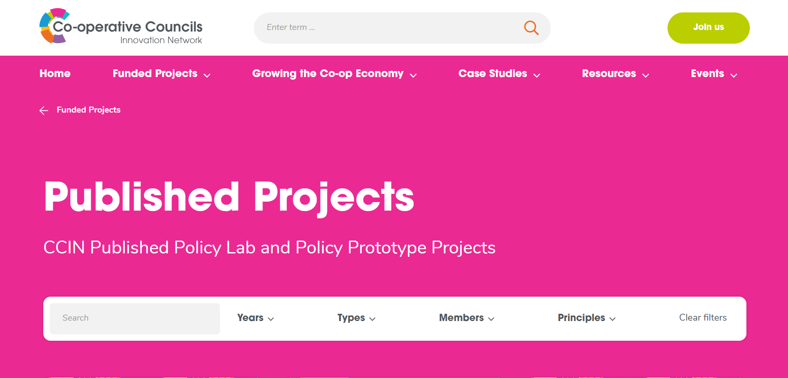

Slide 5
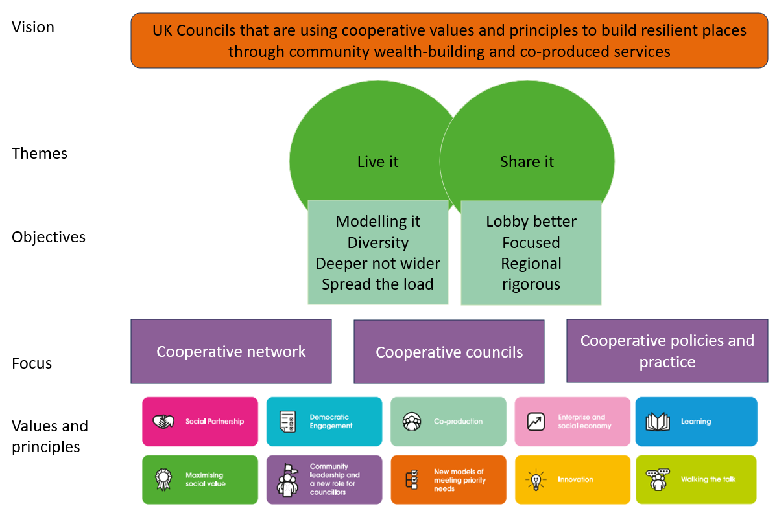
The CCIN Strategy

Slide 6
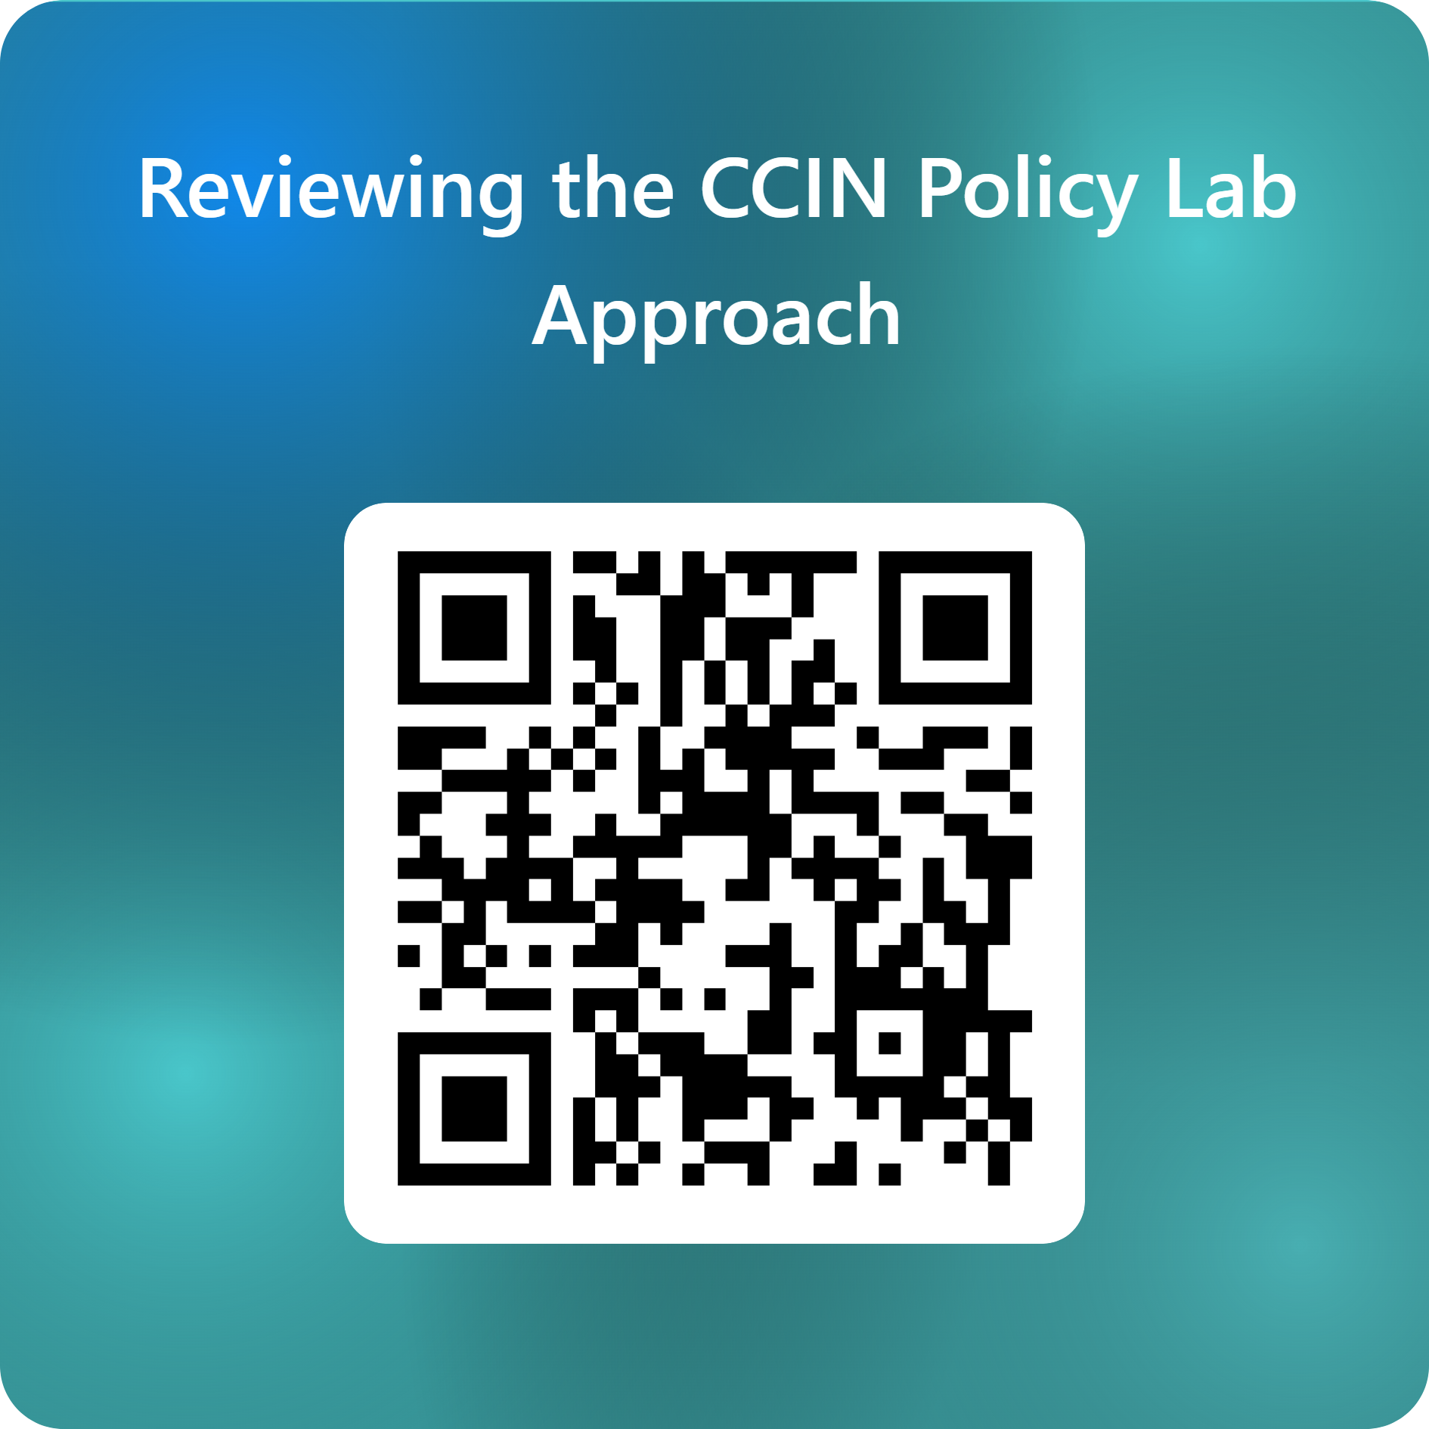
Survey Feedback

Slide 7
Experiences
Very valuable - huge benefit
Very different experiences with different labs
Benefitted far more from being part of a lab, rather than reading a final report
Useful way of getting to know some people within the network and becoming a more active network member
Useful way to drive awareness and understanding of the Network within my council
Involvement in a policy lab was positive but left me questioning whether I would ever have the capacity in my team to deliver one
All responses were about Policy Labs people had been involved in delivering – there were no comments received about taking the learning from published reports

Slide 8
Key challenges
Capacity - to lead and to contribute
Loss of specific officers, their enthusiasm and expertise
Impact of purdah / events on timelines
Mismatch in ambition and delivery – initial impetus doesn’t last
Corralling effective contributions from across the Network
Balancing the bureaucracy of applying with rigour
Tracking or evidencing change as a result of a Policy Lab – Legacy -

Slide 9
Questions Arising?
What is the purpose of the policy labs? Would it be useful to define which are intended to be how-to guides and which think-tank, ‘lobbying’ pieces?
How do we better evaluate the impact of Policy Labs over the longer term? Very little response on people using finished reports.
Should there be different approaches for Council-lead Labs and those that are Partner lead with the Council playing a more passive ‘hosting’ role?
Do we need a middle ground between Labs and Prototypes?
Could it be counterproductive to try to standardise the approach too much?
Is there a potential tension between work being done for the benefit of the employing council and the benefit of the network?
Could a central resource help smaller councils ‘raise their hands’
Should involvement be opened up to non-CCIN members?

Slide 10
Proposals
Set out key basic requirements that contributing councils must commit to
Formalise the sign up of Councils as interested / involved
Stronger management of the bidding and delivery process – regular updates to V&P
Clarify and specify the outputs that are expected (webinar, articles, social media)
Consider developing annual impact reports demonstrating how Policy Labs have been implemented – case studies of councils using
Develop a mutual aid approach where e.g. a council loses a key officer
Develop core policy lab programme management capacity sitting within the CCIN – a) for managing the delivery of funded projects and b) to support smaller councils to take part
Clarify the distinction between policy labs and prototypes – not just about the number of councils involved?
Develop the practical framework for lobbying following a policy lab
Consider how interested parties can be involved in labs without being directly funded – corral enthusiasm and interest

Slide 11
Discussion

Slide 12
Policy Lab Review Next Steps
You can still complete the online survey
Key recommendations will go to the EOC and V&P for consideration
Initial recommendations are to be in place for the 2024/25 Policy Lab programme

