Slide 1
Social Value Toolkit for Cooperative Councils
Unlocking transformative social value
Notes:
the social value toolkit has been a collaboration between a number of member councils (including Oxford, Hackney, Birmingham, Liverpool, Oxfordshire, Wigan, Rochdale, Westminster, and Kirklees...) as well as lawyers, academics, cooperatives, social enterprise leaders, construction industry leaders, and consultants.
I started this process whilst working in economic development at Oxford City Council meeting some of the limitations of Social Value as a tool for community wealth building, I’m now doing on a freelance basis since leaving last summer.
Group coalesced around the idea that transactional, standardised models of Social Value aren’t effective when working towards the deeper aims of the CCIN. And we’ve tried to unpack that at root, exposing some of the system assumptions that get in the way.
18 months of interviews, working group meetings and workshops we’re approaching a key milestone, where we publish the toolkit put the ideas out, but we’re really hoping to ensure that this lives and breathes beyond publication. And the recommendations reflect that. So we want to get your thoughts and ideas on those ahead of the full launch next month.
Shared working drafts of the two key outputs –
The Toolkit – a practical, action-oriented slidedeck – processes, key questions, distinctions, examples, and how to start
Companion report – in depth argument, historical context, different theories of value, expanded case studies, further legal interpretation
I’ll hand over to Carys who’s going to dig into the problem…
We’ll leave some time at the end to discuss the recommendations but if you want to ask something, contest what we’re saying,

Slide 2
Charities, CICs, Cooperatives and organisations of inherent social value, losing contracts to private sector “They are a Community Interest Company and they are super brilliant and deliver all kinds of intrinsic social value. But when they have bidded for things, they would have won the contract until it came to the scoring on social value…. [the things they do] are not counted in the scoring, but they are this brilliant kind of potential partner for a local authority” (Interview participant) “ [Dominant framework involves] creating proxy monetory value rather than measuring real social value” (Interview participant) Said to systematically favour bigger, slicker corporate actors with resources to ‘play the game’

Slide 3
- ‘Gamification’ of Social Value with big claims that never followed up “The contract was for supporting vulnerable people with learning disabilities and to achieve the level of social value promised by the provider [who was awarded the contract] they would have had to have had a turnover of 85% of the existing staff to create vacancies for disadvantaged employees including young offenders and disabled people.” (Interview participant) - Frustration (from councils and providers alike) at time and resources required to quantify and evidence ‘Social Value’ in this way

Slide 4
The Influence of New Public Management
New Public Management still often dominant and default approach to local government processes
People are self-interested, ‘utility maximsing’ , will never willingly cooperate, must be incentivised and monitored
= outsourcing, Compulsory Competitive Tendering, ‘outputs’ and ‘outcomes’ specified in advance, extensive monitoring systems.
Social Value = a tick-box list of specific quantifiable outcomes and measures, to be specified in advance.
…Most significantly: it is ‘additional’ to the actual contract

Slide 5
Legal Principles – a permissive, flexible framework
Councils have obligations under the legal framework
Duty of Best Value and Maximising Public Benefit should guide decisions
These terms are more flexible and open to interpretation than commonly appreciated
What this means in a given local context should be locally determined through an applied, informed judgement – not just a mathematical model and standard service specification.
National Procurement Policy Statement provides a steer
At a local authority level the concepts are given further substance by corporate policy and strategy
They should reflect the values, aims and ambitions of people and place
So setting the right policy framework is all important
Legal summary – Mark Cook
The Art of the Possible In Public Procurement PCR15
The Art of the Possible in Public Procurement - PA23

Slide 6
Legal Principles – a permissive, flexible framework
In procurement there is a need to demonstrate:
Objectivity – having a clear and defensible basis for choosing one course of action over another
Transparency – information about intention and process must be clear, accurate, and accessible to all
Non-discrimination – ensuring that anyone who could have provided the specific goods/services required is given the same opportunity
Integrity – acting on what you said you’d do
Value for money – a balanced judgement about finding the best way to use public resources to deliver policy objectives.
None of these principles are a barrier to procuring or investing in whatever specific things are considered important for achieving the outcomes and policy aims of the local authority.

Slide 7
Overarching commissioning process for councils
Setting organisational goals/values
The essential pre-requisite for action
Identifying needs and capacity
Developing the case for action
What is the council trying to achieve and how does this relate to corporate policy and council powers?
Who best understands the needs of the system - what are the views of service users, citizens, VCSEs? Do you know what they want?
Do they provide a clear justification for action?
Are they clearly articulated?
What is the potential social, economic, environmental value that could be delivered through this intervention?
What are the system and market conditions? Is there an opportunity to stimulate new capacities/delivery models?
Selecting the approach/method
Deciding how to best achieve the objectives from the ranges of tools/approaches/powers available
Is there a functioning market which can achieve the aims?
Is there a need to stimulate new options?
What form of subsidy will best achieve the aims?
What relational qualities will best ensure ongoing delivery of benefit and value for money?
Designing a fair objective assessment
Ensuring that contract/project monitoring incentivises learning and adaptation
Is there clear alignment of purpose between different parts of the system?
How should underperformance be addressed?
Delivering in partnership and monitoring impact
Ensuring that assessment and award criteria encourage the right relationships/ behaviours and deliver the right value
How can the contract/governance be structured to create conditions for aligned purpose and cooperation rather than adversarial zero-sum relationships?
How will behaviours, values, and principles of positive working relationships be assessed and be built into the agreement?
Will the arrangement need to evolve as system dynamics and opportunities change?
What governance will steward the overarching vision?
Where does intelligence about the system sit? What perspectives should be included?
Have all parties done what they said they would?
How have we incentivised providers to transparently share what is actually happening – positive and negative?
Can social and environmental goals be built into the contract specification and award criteria?
All council commissioning involves working through certain steps. This toolkit provides a fresh perspective on how to ensure that Social Value objectives can be enhanced and achieved through this process.
There are a number of different forms this can take, not just procurement.

Slide 8
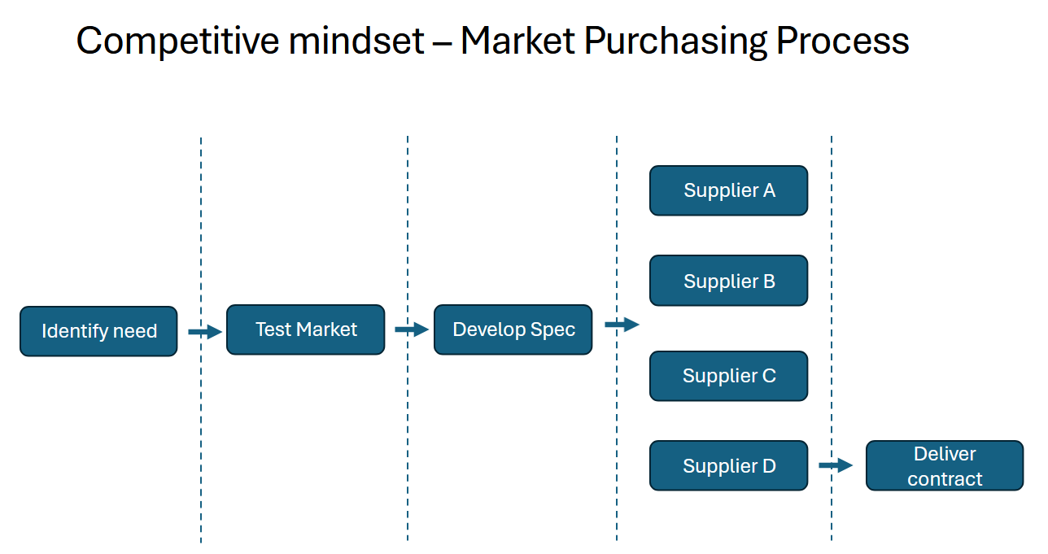
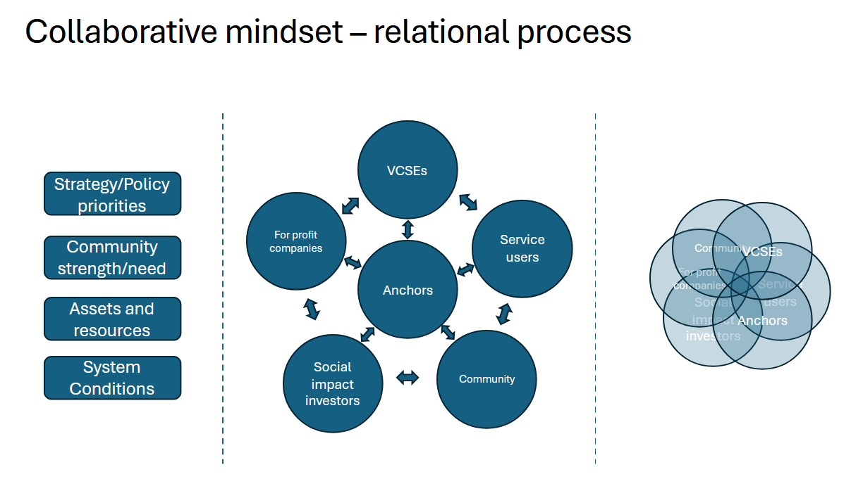
Key distinction – different social value lenses for CCIN Councils
Toolkit explores two fundamentally different lenses for how social value is generated:
Theory of competition
Theory of collaboration
Both have their place.
Competitive processes are more widely used and better understood but in many cases need to be used more effectively to enable genuine social value.
Collaborative processes are generally less well known but in many cases can better achieve things the CCIN is concerned with as a network

Slide 9
Understanding the differences: Competition and Collaboration
 | Competition models | Collaboration models
Motivating when... | Interests of parties diverge | Interests of parties converge
Delivers value through... | Clear specification | Emergent, ongoing, goal-aligned iterative process
Tightly specified Social Value requirements can… | Discipline market behaviour | Constrain deeper engagement with shared goals
Test suitability through... | Track record, tender commitments, best price | Capability, values and purpose alignment, transparency and/or open book accounting
Incentivises through… | Winner takes all competition | Working to common purpose
Value for money assured by… | Competitive tension/profit incentive | Transparency of costs/profit across partners, shared interest in financial sustainability of all partners
Use when… | Seeking clearly defined, identifiable outputs in market purchasing contexts | Seeking emergent, uncertain value streams in complex systems
Public authority is… | Market manager | System steward and/or convener (or responding to another steward/convener)
Value is… | Zero sum | Generative

Slide 10
Theory of Competition – Market purchasing
Most of our procurement processes are based on a Theory of Competition which says that Value is best achieved and assured through a competitive tender process.
Starts from certain commercial assumptions:
The interests of the purchaser and the potential providers are different:
The purchaser wants to extract the maximum value from the potential providers at the lowest cost.
The providers are motivated to deliver this value because of the profit opportunity that would come from winning the tender.
The prospect of winning the contract over others who could do so too pushes down the cost
This allows the purchaser to identify the optimum balance between cost, quality, and efficiency – i.e. the best Value for Money.
The purchaser therefore has the greatest leverage to extract ‘value’ from the relationship before a contract has been signed.
It therefore delivers (social) value under certain conditions:
The purchaser needs to have a very clear understanding of the value sought prior to tender.
That value needs to be describable in terms clear enough to hold the provider to account later.
There needs to be a functioning competitive ‘market’ for the goods or services being purchased, with a number of providers offering the same ‘product’ and competing to offer the best price/quality.
The product/service that the purchaser needs already exists in the form that they want it.
The contract itself, and the contract management capabilities of the purchaser, need to be robust enough to hold the supplier to account for the delivery of the value promised

Slide 11
Competitive mindset – Market Purchasing Process
Supplier A
Supplier B
Identify need
Test Market
Develop Spec
Supplier C
Supplier D
Deliver contract

Slide 12
Embedding social value in a competitive process
3 - Explore what the market can offer in light of the policy goals and user needs
7 - Be intentional and directional - don’t leave it to the market to define what’s valuable.
Supplier A
1 - Establish a clear policy basis for the social, economic, and environmental value that is sought
4 - Engage with social enterprises, cooperatives or SMEs – can they deliver any/all of the thing you want?
8 - Include Social value requirements in the core specification
Supplier B
Identify need
Test Market
Develop Spec
10 - Include end users in the assessment process
11 - Monitor social value clauses alongside other contract deliverables
Supplier C
2 - Test intentions with target audience (service recipients, impacted community)
5 - Co-design the specification with the end user
9 - Break contract into lots and consider simplifying bid criteria, where there is an identified opportunity for VCSEs, SMEs, Cooperatives to bid.
6 – identify proportionate and relevant social value objectives
Supplier D
Deliver contract

Slide 13
Embedding Social Value example: Westminster - Church Street Regeneration
Council recognised that the needs of the community needed to be understood and addressed in the regeneration scheme and that this could not be boiled down to KPIs but needed to be part of an ongoing dialogue.
Tender pack included design features identified by panel, and a requirement that the design of the project should be responsive to the views of the community panel
Pre-market engagement included the views of the community panel in the brief
Community panel members sit on the programme delivery board and continue to hold the project accountable
Supplier A
Supplier B
Identify need
Test Market
Develop Spec
Community panel members included in the bid assessment team
Supplier C
Brought together a community panel, which met regularly to discuss the scheme. Council sought to understand their priorities before the process started. People's time was paid for to ensure a broad representative group
Supplier D
Deliver contract

Slide 14
But approaching everything as a competition can obscure the bigger opportunities...
Not everything is available through a functioning free market
Sometimes profit isn't the main motivator for partners (many organisations operate for 'common good' purposes – e.g. VCSEs, cooperatives)
Sometimes we can't specify exactly what's needed – we won't know until we start doing
Sometimes we want to engage and work with a wider range of partners
Sometimes the impetus to do something is emerging from a community of concern rather than the local authority itself
...in these cases we may need other ways to determine what constitutes Best Value or Maximum Public Benefit, beyond simply competitive tender processes.
We think a relational theory of value can help...

Slide 15
Theory of Collaboration – commissioning in complex systems
The CCIN follows a set of values drawn from the cooperative movement: self-help, self-responsibility, democracy, equality, equity, and solidarity.
These are all relational qualities and point towards a shared conception of the 'common good'.
The science of complex systems tells us that the world is infinitely complex and interrelated.
A systems theory perspective on value recognises that value is not something located in things or people, but is created through an emergent process as people, organisations and things relate to one another.
It follows that:
the starting point for creating any value is the existence of a relationship
The qualities of that relationship determine whether the value that emerges will be positive (generative) or negative (degenerative)
There is contagion, and emergence in system relationships – i.e. positive relationships self-perpetuate by creating the conditions for more positive relationships to emerge.
Therefore, if we are looking to generate lasting and generative social value then setting the conditions for the right kinds of relationships should be the first concern.

Slide 16
Collaborative mindset – relational process
VCSEs
Strategy/Policy priorities
For profit companies
Service users
Community
VCSEs
Community strength/need
For profit companies
Anchors
Service users
Social impact investors
Anchors
Assets and resources
Social impact investors
Community
System Conditions

Slide 17
Collaborative Mindset – identifying the right structures and partners for 'emergent' value
5 – convene those with an interest in the problem/opportunity
9 - Select partners based on 'relational imperatives' - shared commitments and necessary capabilities
10 - Establish flexible governance and legal agreements that can evolve to amplify what works well and dampen what doesn't
VCSEs
1 - Start with broad long term goals/missions
Strategy/Policy priorities
For profit companies
Service users
Community
6 - Open enquiry into the problems and opportunities
VCSEs
2 – consider the strengths and needs of communities
For profit companies
Community strength/need
Anchors
Service users
Social impact investors
Anchors
Assets and resources
8 - consider system stewardship and subsidiarity – how/where should vision be held and decisions be made?
3 - what are the resources and assets that can be mobilised?
Social impact investors
7 - Identify shared interests and aims. Consider how narrow 'self-interest' can be neutralised/mobilised towards 'common good' goals
Community
System Conditions
11 - Monitor progress towards shared goals with curiosity and transparency
4 - what are the system conditions and relationships? Who is involved and how? What's not working?

Slide 18
Wigan Ethical Homecare Framework – creating systemwide collaboration through 'social value imperatives'
7 - Providers were invited to bid on an Ethical Provider Framework against eight geographically defined lots.
8 - Assessment was values (as opposed to output) driven - Providers selected based on test of ethical practices as identified in the discussion stage. Focus on in person interviews and discussion. Selected by rigourous multiagency panel which included service users
1 - Wigan Commissioners recognised problems with the local care market and block commissioning approaches, including zero-hour contracts, excess profits, and disinterested providers
4 - Council engaged extensively with everyone who cared about current state of care market.
Service Users
Need to repair broken care market
Carers
6 - Identified non-negotiable 'imperatives' for potential partners:
willing to work with full transparency on an open book basis
Committed to paying real living wage
Capable of delivering quality care outcomes
Committed authentically to the borough and local people, knowing, caring and contributing to the borough beyond a contract.
Health and care system anchors
Health and Care System Anchors
Wigan Council
Wigan Values – codevelop solutions with communities
Carers
Wigan Council
Service users
5 - Open enquiry into:
Fair unit costs for care
Needs of service users
Strengths and needs in local communities
Logistical challenges
Statutory duties
Residents
Care Providers
2- Council was committed to authentic partnership and collaboration with local communities, valuing respective knowledge, expertise and insight
Influencing social and economic determinants of health
Care Providers
Residents
Strengthening employment conditions in care
9 - Social Value delivered (10 years on):
No waiting lists for home care
Highest CQC rated homecare services in North West
Improved recruitment and retention of staff
Diversified workforce – 50% under 30 years old
86% of workforce live in the place where they are delivering care.
Collaborative rather than competitive provider relationships
Reduced travel times and carbon footprint for care workers
3 - Sought to establish a model 'where everyone plays their part'

Slide 19
Link to further examples
CNI
Plymouth Alliance
Leicestershire Children’s Innovation Partnership
Public Commons Partnership
Hackney Antiracist commissioning

Slide 20
Relational commissioning tools and pathways
Relational Tool | Use case | Further reading
Social Value Imperatives | A set of values, behaviours, principles and that set the conditions for participation | https://e3m.org.uk/social-value-imperatives/
PA 23 Competitive flexible procedure | Contracting authorities can tailor procurement processes towards goals/missions | https://www.gov.uk/competitive-flexible-procedure
Alliance Contracts | Outcome-based multi-stakeholder public service contracts | https://theplymouthalliance.co.uk/
Thin Layer Cooperative | Trading relationships can be iteratively governed through cooperative rather than multiple contracts | https://cni.coop/about
Relational Contracts | Assess and prioritise right values and behaviours over tightly specified outputs | https://golab.bsg.ox.ac.uk/the-basics/relational-contracting/
Innovation Partnerships | Development of new products or services and mechanisms for profit sharing | https://innovation_partnership
Community-led regeneration | Community led redevelopment of land and assets | https://reflect.ucl.ac.uk/community-led-regeneration/
Public Commons Partnerships | Participative, democratic models for the management of assets and public services | https://www.in-abundance.org/reports/commoning-the-public

Slide 21
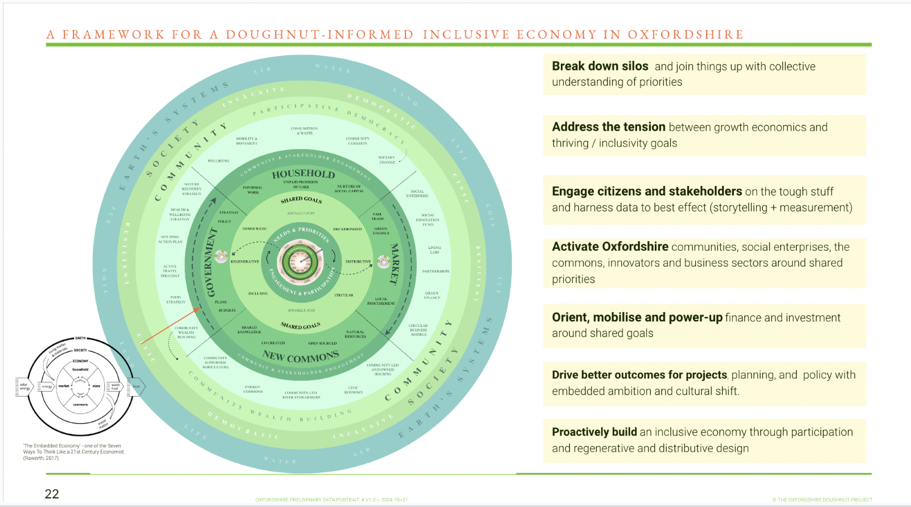
Setting Enabling Policy Frameworks
Local Authority Corporate Policies provide the golden thread for including broader social, economic and environmental goals into the procurement and commissioning cycle. They set the parameters of how we should determine Best Value and Public Benefit.
To enable effective social value in competitive markets policies should clearly articulate the social value outcomes we're seeking to address. Examples include:
Islington Progressive Procurement Strategy
Westminster Responsible Procurement and Commissioning Strategy
To enable effective relational collaboration, policy frameworks may also need to explicitly recognise:
the value of coproduction and relational working
The complexity and inherent unpredictability of human systems
The importance of subsidiarity, and democratic processes for defining value, developing social capital, and generating agency
Examples of expansive policy frameworks which recognise and seek to work with 'complexity' by inviting bottom-up innovation include:
We Make Camden
Our Greenwich
Framework for a Doughnut Informed Inclusive Economy – Oxfordshire (this is not council policy but provides an expansive framework for collective action)

Slide 22
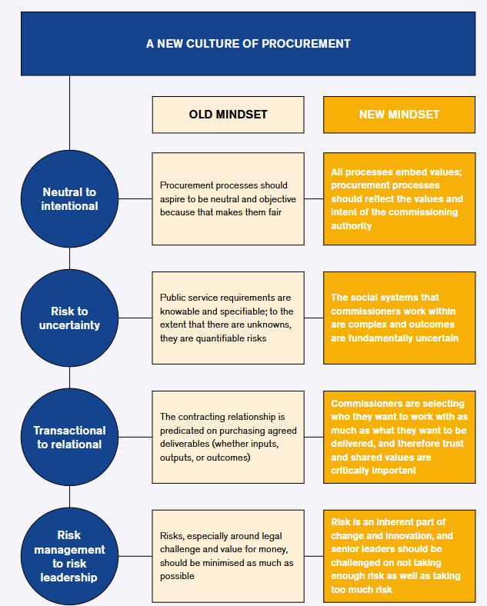
Mindsets and Culture
Starting point is recognising that Best Value and Public Benefit are flexible and context-specific concepts and should not be reduced to mathematical formula.
Officers should be encouraged to discern this in dialogue with communities, markets, and other local authorities.
Camden IIPP report on mission led procurement identifies four essential mindset shifts:
Neutral to intentional
Risk to Uncertainty
Transactional to Relational
Risk Management to Risk Leadership
Mazzucato and Wainwright: https://www.ucl.ac.uk/bartlett/public-purpose/sites/bartlett_public_purpose/files/2024.10.04_iipp_camdenreport_pr_2024.06.pdf

Slide 23
Skills and People
Standardised Social Value processes lead to a necessary focus on compliance and a need for enforcement resources
This can be especially resource heavy when social value is 'additional' and unrelated to subject matter of contracts
Where social value is relevant and embedded in the contract this is just good contract management – it is monitoring the delivery of the contract
In contrast, relational commissioning models need greater focus on setting the conditions for good relationships. Effort should go into:
Selecting and initiating the right process
building genuine relationships
assessing for the right qualities
Ongoing learning and open dialogue
Being curious about the system
These are different roles requiring different mindsets and approaches – e.g. Camden have appointed Mission Leads and System Designers to support their transition.
More upstream effort to get the right partners and leverage a wider range of resources will create less friction and more effective delivery downstream. Effectiveness and efficiency are assured through ongoing iterative process and transparency of costs and profit.
Officers should be encouraged to cultivate systematic curiosity - See Human Learning systems

Slide 24
How the CCIN can support councils
Most local authorities have templates and standard processes for competitive procurement and contracts. There is a need to develop shared tools which make relational models more accessible.
Pool investment in further tools which can support member councils to bring this into practice, including:
Prototyping a shared 'Common Good Supplier Framework' built on relational principles.
Template models for less well-known commissioning pathways, including:
Public Service Community Partnerships
Alliance Contracts
Public Commons Partnerships
Relational contracts
Innovation Partnerships (or using the Competitive Flexible Procedure to achieve same ends)
Establish a CCIN Community of Practice which can continue to develop learning and share good practice

Slide 25
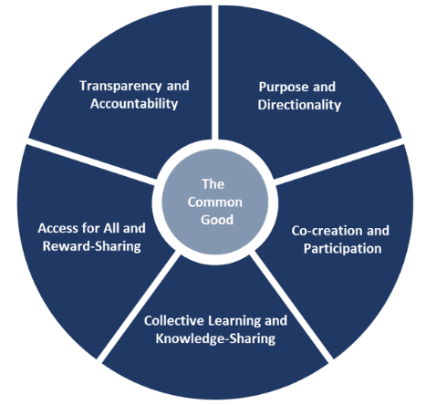
Illustrative process: 'Common Good' Supplier Framework based on collaborative commissioning principles
Framework Purpose and Directionality
Suppliers required to demonstrate commitment to:
Set direction
Open invite to participants to develop specification (without prejudice)
Refine scope
Collectively define the scope
Ethical working practices
Multistakeholder collaboration
Reward sharing, learning, and knowledge sharing
Transparency and accountability – willingness to work 'open book'
Purchaser/convener specifies the 'common good' goals/mission:
skills and capabilities needed
Resources available
E.g. doughnut economics (Raworth), Public Value/Common Good (Mazzucato)
Final call off
Long term social, environmental, economic outcomes
Enabling purchasing and investment toward the common good:
Common good over private gain
Co-creation and participation
Establish collaboration agreement
Consult with recipients/ beneficiaries
Select final partners against scope
Pre-selection process
Cover costs of contributions
Monitoring and Evaluation
Define evaluation and learning processes
HLS approach - assess performance on how well the system is learning
Monitor long term outcomes
Five Pillars for the Common Good: Governing the Economics of the Common Good -Mazucatto

Slide 26
Recommendations – CCIN Member Councils
To achieve lasting social value in communities, this Toolkit recommends that the CCIN Member councils should:
Set broad aspirational policy frameworks and goals which can guide context-specific social value decision making
Councils seeking to grow the cooperative and social economy, should explicitly reference the value of cooperation and 'the commons' as generating ‘common good’ outcomes including economic and social agency and articulate the distinction with organisations operating for ‘private gain’ – see CCIN’s Cooperative Development Toolkit and for evidence base to support this case.
Recognise the importance of open, iterative governance structures like relational contracts, ‘thin layer’ cooperatives, alliance contracts and public commons partnerships when working with complex, long-term social, economic and environmental goals.
Actively promote use of collaborative commissioning pathways where systems are complex and goals are long term.
Embed social value requirements in the core contract deliverables in competitive market purchasing and avoid using 'pick and mix' social value menus
In competitive markets, tailor assessment processes and contract specifications to a scale which enables SMEs, social enterprises, and cooperatives to access opportunities
Support staff to understand principles of collaborative commissioning and how this might apply to their professional context
Look for local opportunities to seed public commons partnerships, public service community partnerships, and innovation partnerships, and invite communities and partners to initiate proposals.
Consider how internal commissioning resources could be reprofiled towards service design and system stewardship, as opposed to social value compliance and audit.
Advocate for an independent National Social Value Taskforce

Slide 27
Recommendations – CCIN Network
The CCIN network should support councils in these efforts by:
Developing a social value community of practice to continue to share best practice and examples of collaborative commissioning
Funding an open collaboration to develop a set of open-source template models for the collaboration models introduced.
Scoping the development of a purchasing framework for purchasing for the common good to replace the CCIN’s dynamic purchasing system when it expires in March 2025.
Lobbying local government umbrella organisations and central government to:
Recognise the different approaches needed when carrying out market purchasing vs intervening in complex social systems
Recognise the importance of relational working and collaborative commissioning models in setting the conditions to achieve ambitious long term social value goals
Discourage the use of pick and mix social value menus, especially when commissioning in complex social systems

