Slide 1


Plenary 1: Launch of findings of the Greenwich Co-operative Commission
14.25-15.25

Slide 2
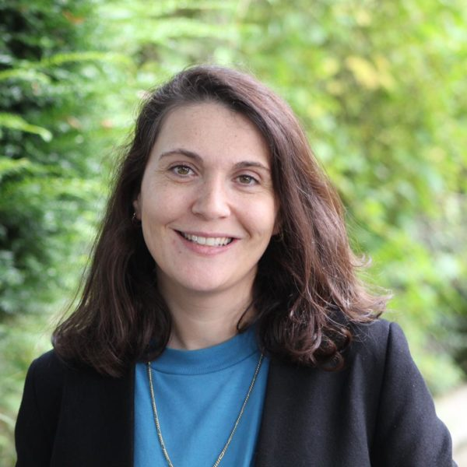

Chair – Cllr Mariam Lolavar
Cabinet Member for Health, Adult Social Care and Borough of Sanctuary

Slide 3
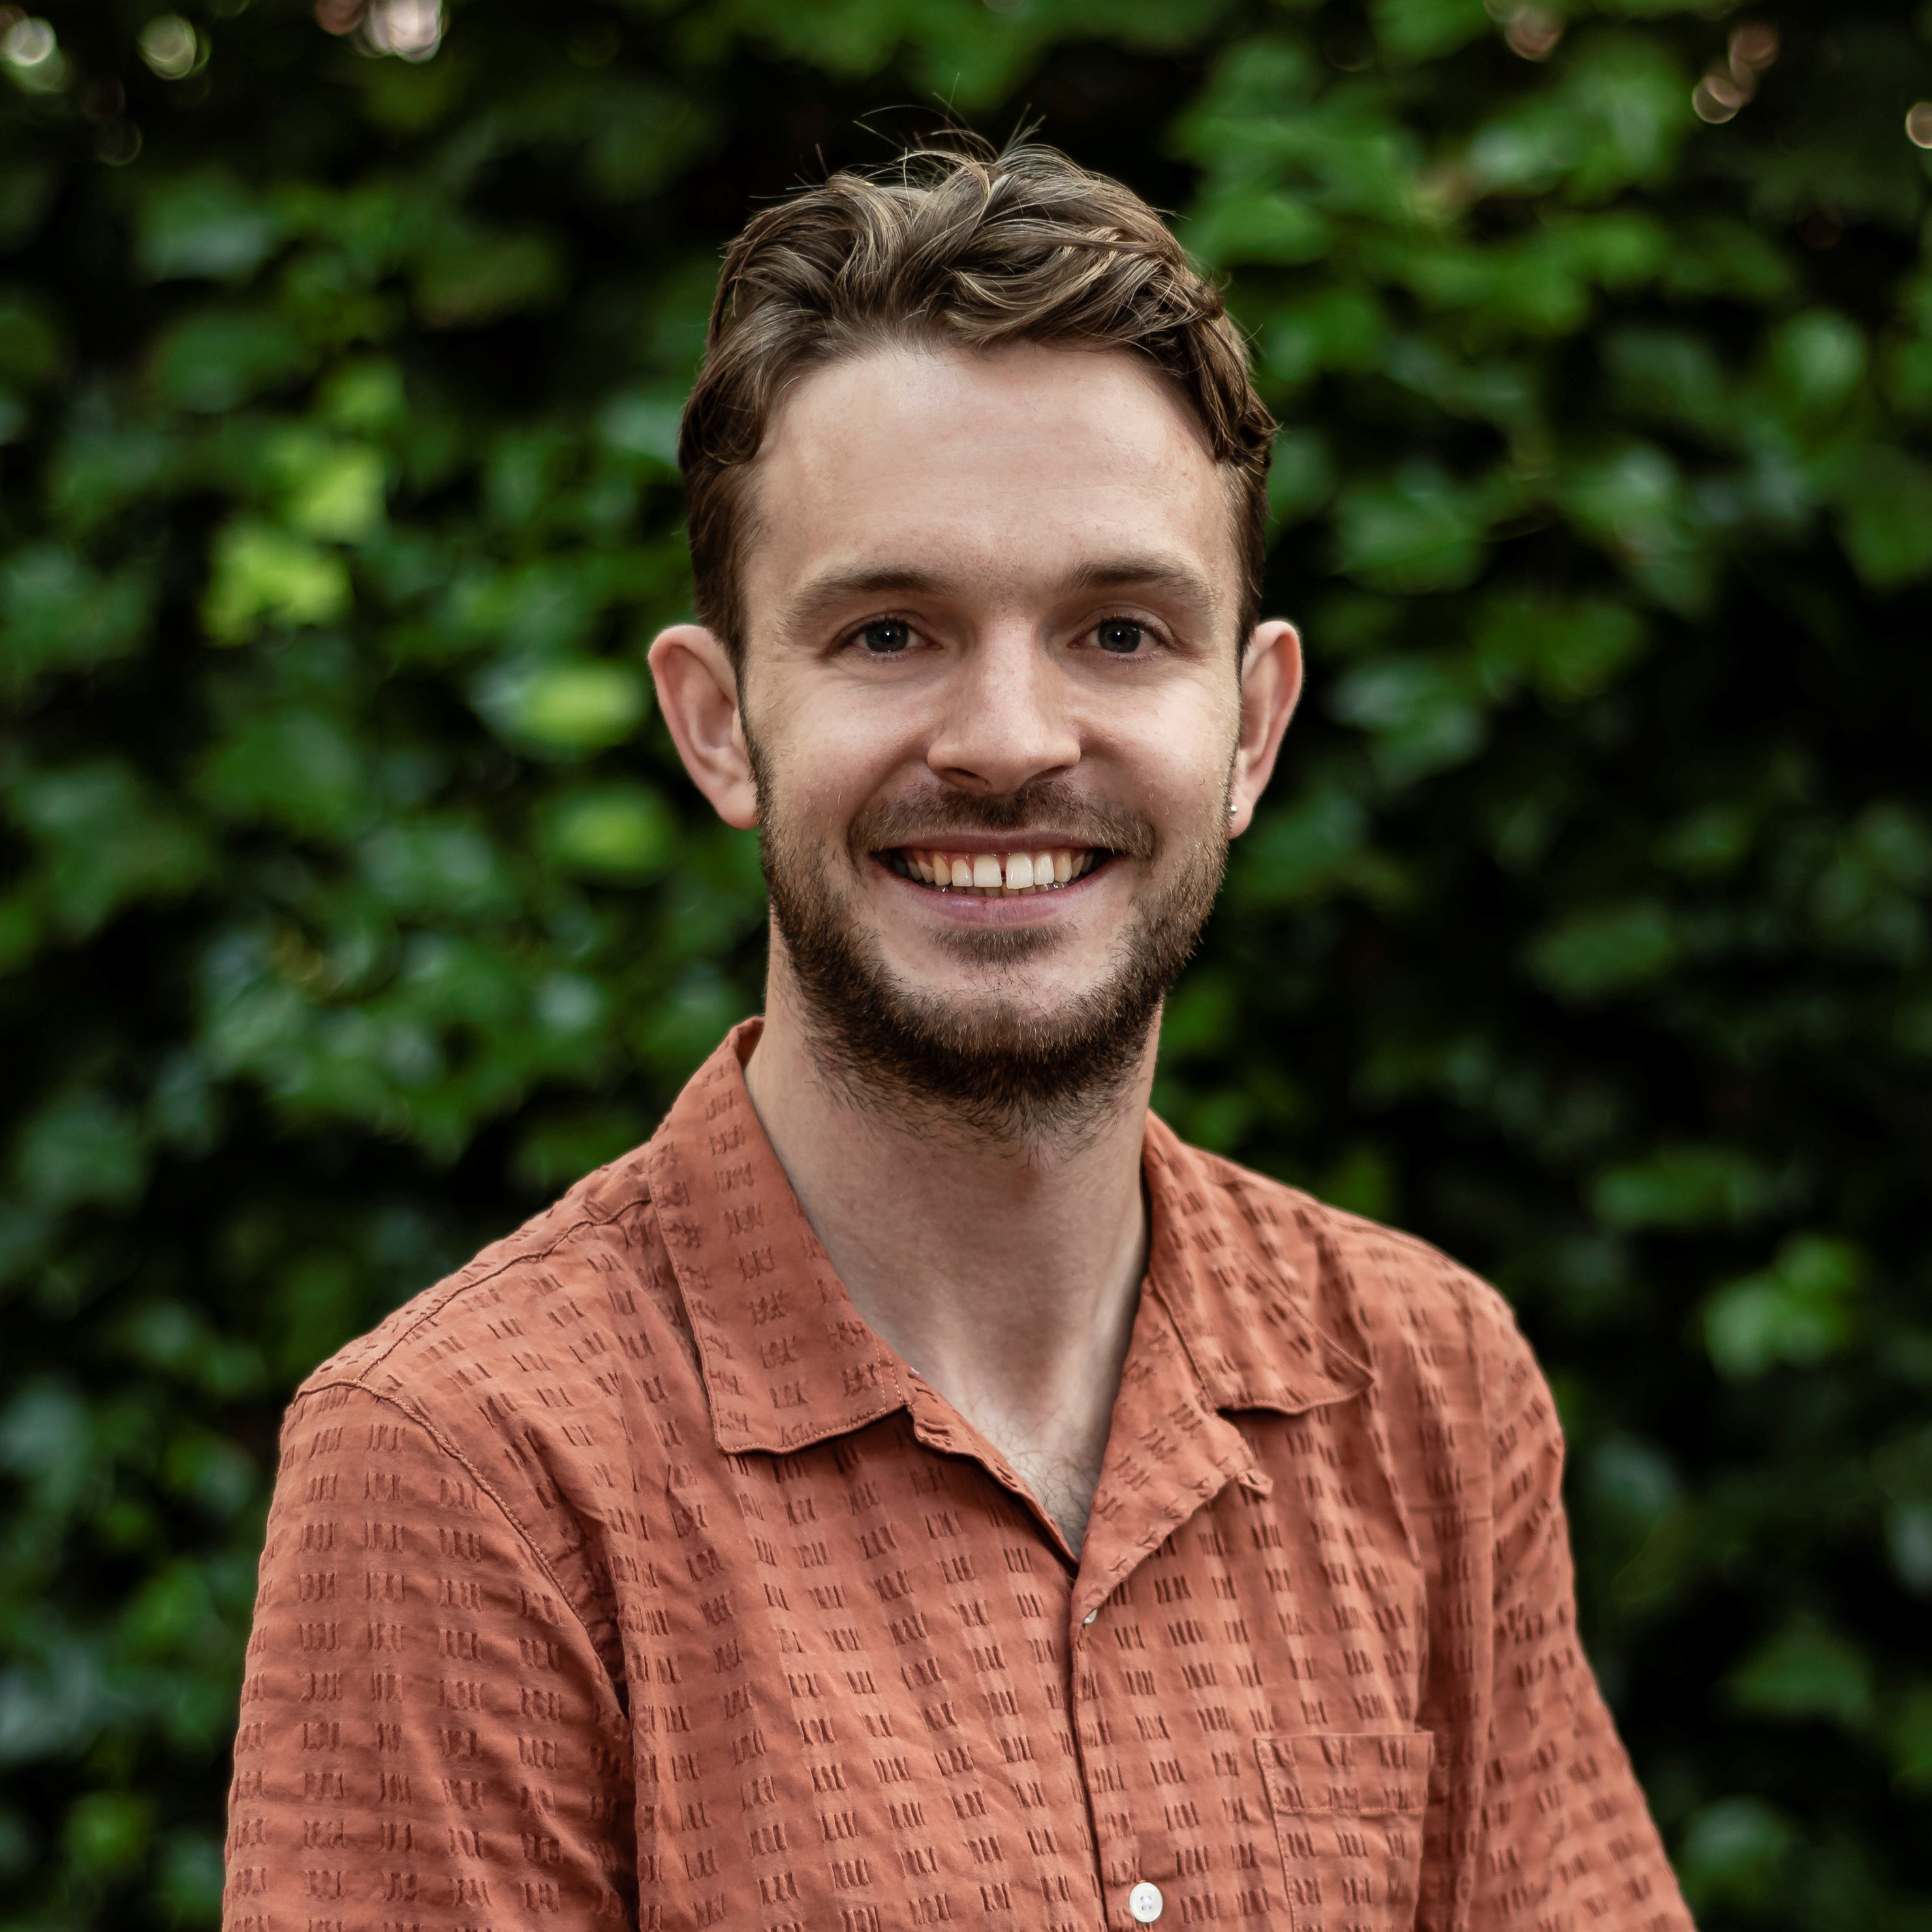
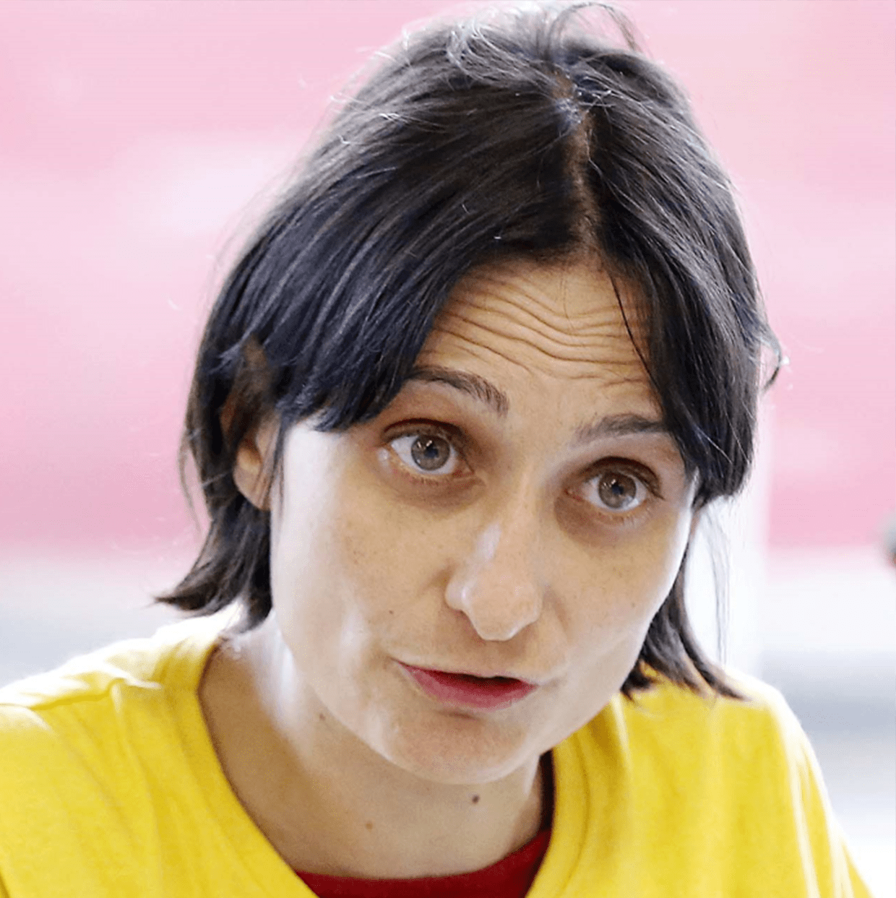

Panel Members
Dr Giovanna Speciale, Co-founder and CEO of South East London Community Energy (SELCE)
Emma Back, Founder of Equal Care Co-op
Nick Plumb, Director of Policy and Insight at
Power to Change

Slide 4
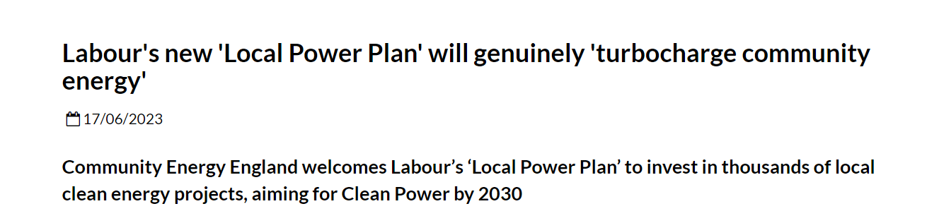
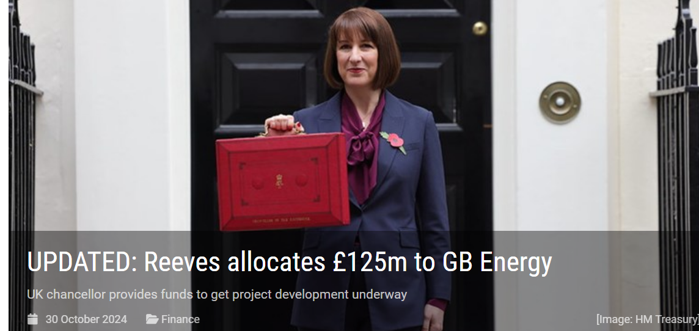
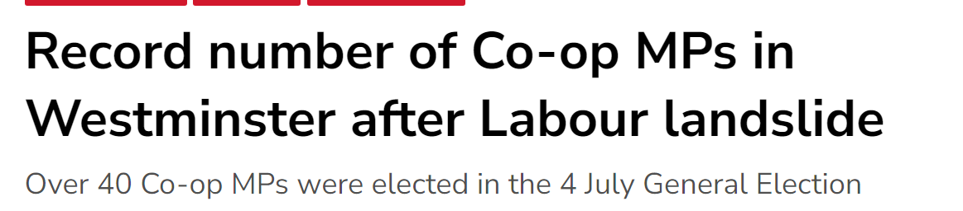

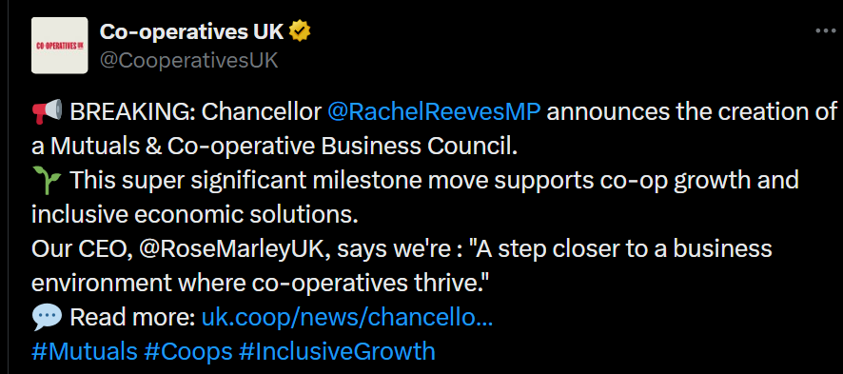

Existing National Developments

Slide 5
What did we do?
In Our Greenwich, we committed to establishing a Co-operative Commission. In early 2024, the commission was formed.
Chaired by Lord Bassam of Brighton, the Commission sought to outline a long-term vision for the growth of co-operative businesses, and the integration of co-operatives values in the borough.
Through this work, we aim to empower our communities and foster community-led, co-operative solutions to the challenges faced by both residents and businesses.
The Commission was made up of a panel of independent commissioners, including Councilors and external experts in the sector.
The commission focuses on three core strands:
  Supporting new and existing co-operative businesses
  Social care
  Community energy

Slide 6
Our Journey
In March 2024, we launched a public call for evidence, inviting residents to share their views on the three strands, receiving 63 responses.
We held 10+ workshops, hearing presentations from a range of expert witnesses on best practice and how we can apply this to Greenwich.
We held a series of 1:1 deep dives with relevant local, regional and national organisations to delve further into some of the ideas raised.
We reviewed the findings and developed 12 actionable recommendations.

Slide 7
Supporting new and existing co-operative businesses ​
1. Explore opportunities to collaborate with local universities and other anchor organisations to raise awareness and support the growth of democratic and co-operative business models across the borough.​
2. Ensure local businesses utilise existing co-operative business support programmes and consider the local offer to grow the pipeline of co-operatives and democratically owned businesses.​
3. Invest in training and capacity-building for officers to embed a co-operative mindset within the council, ensuring it informs decision-making. This includes equipping key officers with specialised knowledge of the co-operative business model.​
4. Explore opportunities to establish a London co-operative network, for cross-council collaboration and building a knowledge exchange forum, with a focus on increasing procurement opportunities with community businesses and co-operatives.​

Slide 8
Social Care
1. Create a Co-operative Care Compact to embed co-operative principles across the borough. To facilitate this, the Council should leverage its existing networks across South-East London, as well with regional and national organisations such as Social Enterprise UK, and the Department of Health and Social Care (DHSC).
2. Undertake a review of future commissioning to identify opportunities for adopting the co-operative model and elevate the status of co-operatives and democratically owned business models within the commissioning and procurement processes within health and adult social care.
3. ​Encourage the growth of micro-businesses in health and adult social care through development initiatives to support the set-up and development of existing small local enterprises.
4. Establish a Greenwich health and social care workforce board, and a local care workers network.​

Slide 9
Community Energy
1. Launch a Community Energy Fund (CEF) to enable communities within the borough to apply for funding to support and/or deliver community energy projects that deliver carbon reductions. There will be an initial one-year pilot programme, with the potential for an additional three years of funding.
2. Ensure the council and the community energy sector is ready to deliver the vision and objectives set out in the Great British Energy founding statement: this sets out the vision for a Local Power Plan to provide funding opportunities to help implement community energy schemes.
3. Create a Community Energy Partnership Board to collaborate and bring people together across the borough who are working towards a common community energy goal including a taskforce of stakeholders from across the community, private sector and council to produce a Greenwich Local Power Plan.

Slide 10
Governance
Establish a Co-op Commission Board to provide oversight and governance to monitor the progress of the recommendations | The board will meet every four months during the first year and will include the Leader and three Cabinet Members. It will also identify a lead officer and Cabinet lead from the council, responsible for oversight of an annual delivery plan to ensure partners and council teams are supported to take the work forward. The commission will be launched at the CCIN Conference taking place in Woolwich Works on the 12-13th February.

Slide 11
Panel Members
Chair – Cllr Mariam Lolavar
Cabinet Member for Health, Adult Social Care and Borough of Sanctuary
Nick Plumb, Director of Policy and Insight at
Power to Change
Dr Giovanna Speciale, Co-founder and CEO of South East London Community Energy (SELCE)
Emma Back, Founder of Equal Care Co-op

Slide 12
Q&A

Slide 13
Thank you
See the RBG Co-operative Commission Report: Together for Greenwich by following this code:

