Slide 1
Commissioning for people, resilience and relationships
Lisa Wilson – Integrated Director of Commissioning (Adults)
Emma Back – Equal Care Coop

Slide 2
Strategic context for Greenwich

Slide 3
Why are we doing this?
The current adult social care system is in crisis, due to record demand and severe underfunding, often leading to poor outcomes for people, their families, and care workers. The care market is dominated by private providers where the focus on profits can lead to poor quality of care, unfair wages and lower staffing rates.
Pivoting the focus off profit alone is a long-term goal, however, a solution that is being explored is the commissioning of local, small, ethical, or third sector provision while also building up publicly owned capacity.
By providing a clear path and direction for how social care co-operatives can grow in our borough and contribute to a robust social care system, we’re backing alternative options that empower everyone.

Slide 4
Integrated Commissioning Vision and Approach
Our new approach to commissioning across Adults, Children's and Public Health

Slide 5
OUR vision for commissioning in Greenwich
We want to ensure that in Greenwich, people’s health, care, learning, wellbeing and relationships support them in living their best lives.
To do this we need to be commissioning for transformational change in the way we deliver our services for people, neighbourhoods and place.
Our ambition is to enable our residents, providers and other stakeholders to co-design the development of our services, based on what matters most to Greenwich people.
This will mean a far greater focus on local services, join-up, outcomes, collaboration and impact.
Preventing avoidable poor outcomes, promoting and protecting good health, learning, safety and wellbeing and tackling health and care inequalities will remain key priorities.

Slide 6
What are the challenges?
WORKFORCE CHALLENGES
Colleagues recognise they will need to learn and develop new ways of working, many with limited experience of:
outcomes based specification development and contract monitoring,
developing hybrid approaches to service delivery and reporting with providers – not exclusively inputs/activities or outcomes,
incentivising outcomes and impact, not just activity/tasks,
co-developing solutions with potential/actual providers,
consumer input and co-creation – not just consultation,
migrating from universal services to tailored/multi-faceted interventions around the person,
market engagement and facilitation, and
alignment and consolidation.
DEMOGRAPHIC CHALLENGES
Healthy life expectancy in Greenwich notably worse than regional and national averages; inequalities in health & wellbeing across neighbourhoods.
Continuing growth in demand for NHS and social care services, persisting health problems and backlogs.
Growing number of people with complex long-term conditions.
Financial challenges caused by increasing demand and ongoing pressures
COMMISSIONING CHALLENGES
Diverse stakeholder priorities.
Lack of shared understanding of ‘what matters’ to communities; limited influence over services.
Fragmented services often difficult to navigate.
Siloed working with one-way relationships.
Limited opportunity for innovation.
Services and targets based on activities and inputs.

Slide 7
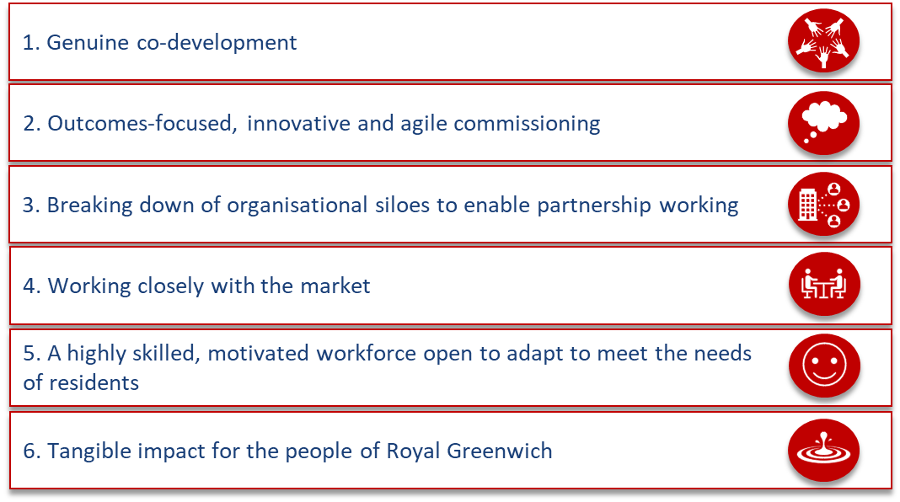
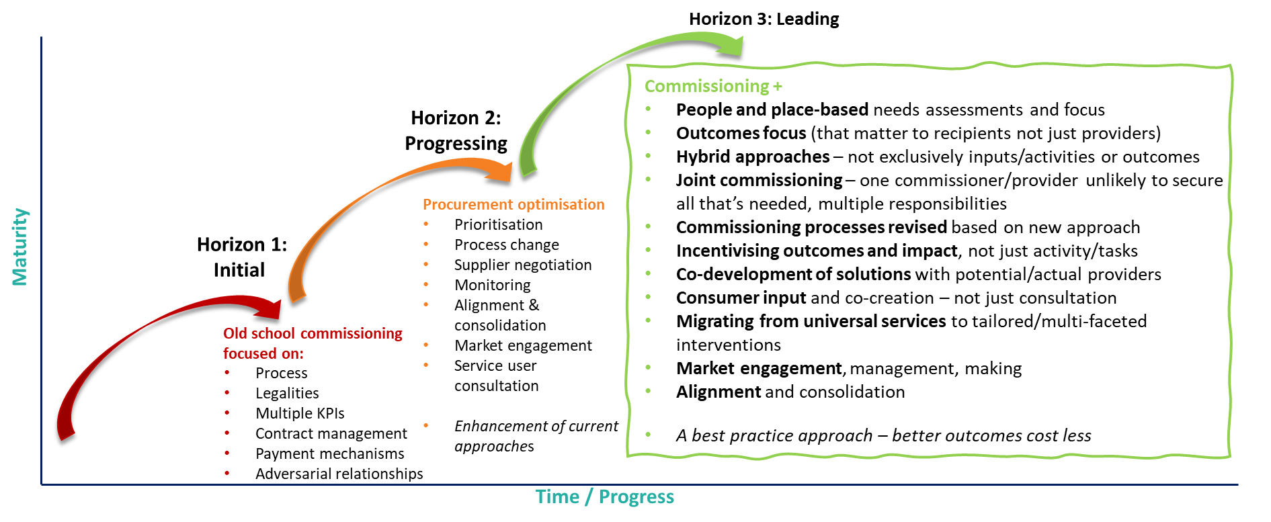
Shift in commissioning practice
Our 6 commissioning ambitions
Shift to Horizon 3 commissioning

Slide 8
Shift in commissioning practice
What ‘good’ looks like for Greenwich
Ambition 1:​ Genuine co-production​
Resident engagement is fully interwoven into all commissioning activity – whether that is intensive co-design and co-creation, or consultation, as appropriate
Engagement is inclusive, and draws on a diverse range of voices in a way that encourages friendly criticism, and leads to genuine changes to commissioned services
Engagement is not just limited to specific services, but also to system-wide, innovative change across different areas
Resident engagement reflects the diverse voices of RBG
Ambition 2: Outcomes-focused, innovative and agile commissioning
100% of service specifications and contract management arrangements are based on outcomes that matter to people
Decisions are balanced and made based on qualitative and quantitative evidence, focused on the resident experience
Staff are empowered to innovate, and take positive, well-judged risks – even if they don’t always work as we’d planned
We work shoulder-to-shoulder with providers, balancing accountability with empowerment, and work with them to incentivise the right outcomes
Our 6 commissioning ambitions
Ambition 3: ​Breaking down organisational siloes to enable partnership working​
Work is structured around outcomes, not historical arrangements/contracts
We work across different teams and disciplines to get the right input, by the right people, at the right time
We trust VCS groups as equal partners, who have frequent opportunities to input their invaluable expertise
We draw on our resources and assets in the widest sense – including people, VCS, money etc. – to improve outcomes
Ambition 4: ​Working closely with the market
Market providers are trusted partners, who are given space to honestly feed back the challenges they are facing and the insights from the services they are delivering
Greenwich is welcoming to new market entrants, who may be able to improve outcomes, innovate or enhance service delivery
Commissioners have a ‘finger on the pulse’ of the financial sustainability of all providers that deliver services locally
Ambition 5: ​Highly skilled, motivated workforce open to adapt to meet needs of residents​
Commissioners across all teams and areas are engaged, and have the right skills, insights and experience to maximise their contributions to their roles
Staff feel fully supported to work in a new way, and feel able to raise any opportunities or challenges they see that might affect them
Senior leaders visibly role-model these new behaviours, and provide supportive, helpful challenge to facilitate change
Ambition 6: ​Tangible impact for the people of Greenwich​
Tangible improvement in outcomes for Adults, Children’s and Public Health services
Health and social inequalities are reduced in Greenwich
Demand into health and social care is prevented, reduced and delayed – meaning that outcomes are improved, and contribute to the financial sustainability of RBG and Greenwich ICB
A vibrant community offer that supports our outcomes: whether that is supporting children and young people and their transition to adulthood, or thriving neighbourhoods

Slide 9
Workshop Section 1 – Commissioning for Resilience (20mins)
Working in twos or threes:
As many examples of fragile systems, structures and organisations as you can come up with in two minutes.
As many examples of resilient systems, structures and organisations as you can come up with in two minutes.
These are all structures that you must have direct experience of (this can be personal as well as professional).
Notes:
Go round room and get people to share one of each thing they’ve named.
Give an example of each to get people going.

Slide 10
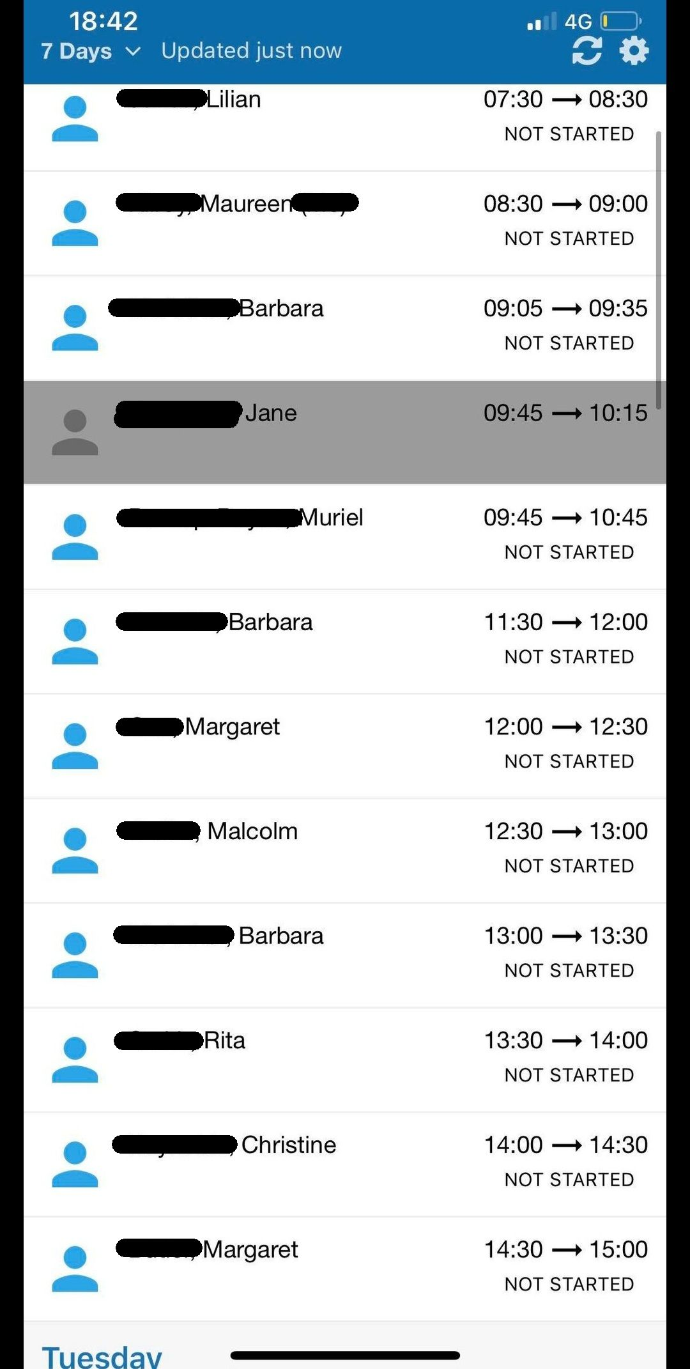
Fragility: Characteristics
‘Long chain’ dependencies
Many-stepped feedback loops with long delays
Single point reliance
Low adaptive capability
Performative bureaucracy
Volatility and unpredictability
Transactional relationships / Bad Faith
Uniform approach, one size fits all
Public Accounts Committee: Reforming Adult Social Care in England (March 2024)
AID DROPS: “multiple short-term, top-up funding announcements for adult social care in response to crises.”
DISPLACEMENT: The Department “said that profits in social care were to be made more on the self-funder side than on local government funded care.”
VOLATILITY / TRANSACTIONAL: “last year just under one-fifth of directors responsible for social care reported they were not confident they could meet their statutory duties for care in 2024–25.”
Notes:
Example of long chain: central gov disbursement of funding to LAs to providers to people back to providers creating unequal distributions of cost to supplement Examples of single point; one family member, one RM, one locus of decision-making and control (the more independent of the system, the more fragile it is). Eg rotas decided by other parties not subject to or only distantly subject to their effects. Funding decided by other parties only distantly subject to the effects.
Handout examples – package of 30 min double ups, the emails? Demonstrate: transactional relationships, low adaptive capacity (rigid expectations). Handout features of fragility & resilience.
“This was actually a good rota for me! Other days I would be doing these but then added on 3 people in lud foot/Kershaw area and Mytholmroyd with 0 or minimal travel time! I have anxiety just looking at that rota now 😆😆”

Slide 11
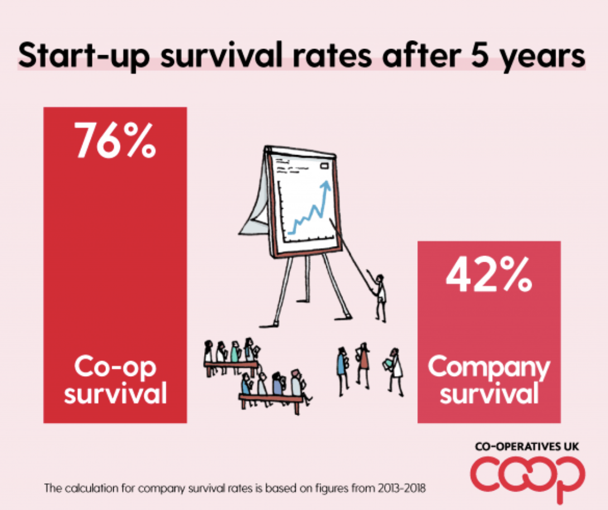
Resilience: Characteristics
Ownership
Redundancy
Self-interest aligns with common interest
‘Good enough for now, safe enough to try’
Tight, small feedback loops with short dependencies
90% prevention, 10% reaction
Prioritise sustained relationships
Diversity and variety
Modularity
Notes:
Key person syndrome, thinking about how this shows up in social care (family members, burnout, one superhero care worker etc, one manager per service who shoulders all the legal responsibility)
Handout; EC Rota screenshots. First page of cover policy? Also hats ref redundancy. Also welcome book

Slide 12
Workshop Section 1 – Commissioning for Resilience
Working in twos or threes:
For each fragile system you have named identify one element in the scope of your control that would contribute to its resilience.
For each resilient system you have named identify one element in the scope of your control that would contribute to its fragility.

Slide 13
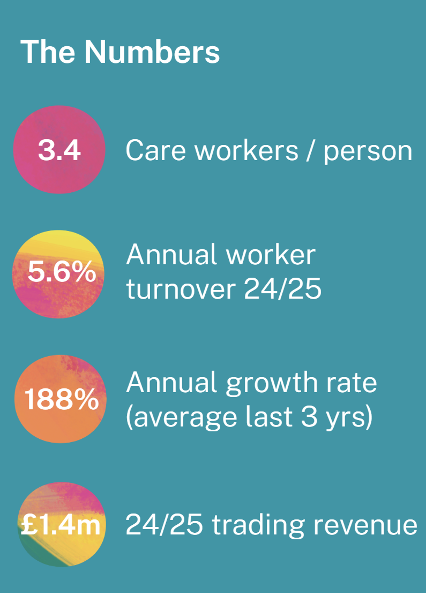
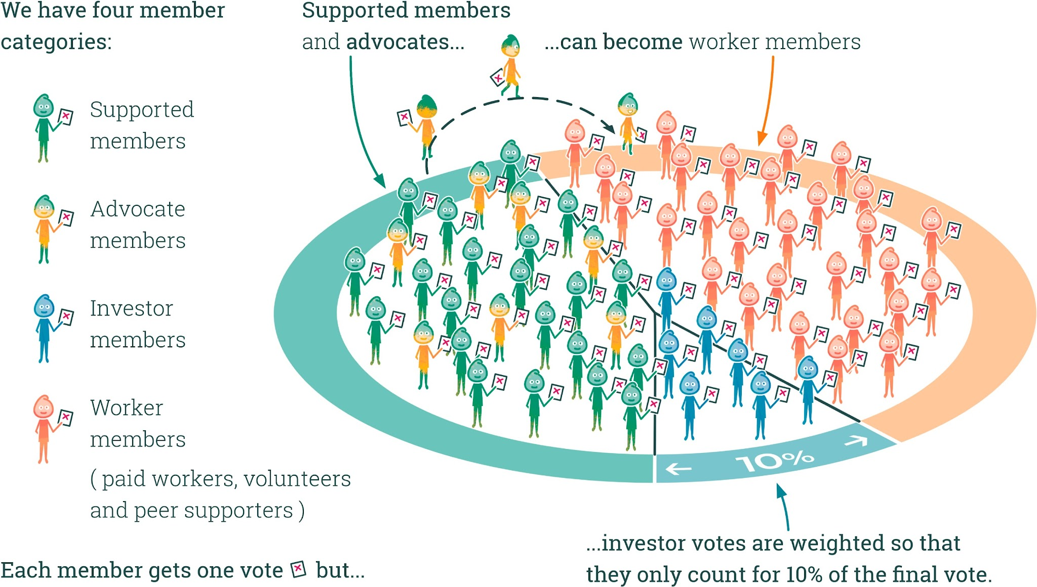
About Equal Care Co-op

Slide 14
Equal Care Co-op’s Experience
Building for resilience in a fragile system. Even the most resilient of systems will fail with enough shocks applied.
Our Challenges
The pay & funding gap (margins)
Rigid commissioning expectations
Consumer culture
“Anxious adult” syndrome (CQC, LA, statutory structures)
Covid
Raising capital – without it we cannot grow
Bootstrapping the model
Clarity of responsibility, accountability and line management, particularly during an evolving design process
Our Successes
Real Living Wage / Self-employment choices and an ethical version of the gig economy
Not gigs but enduring relationships
No shortage of high-quality applicants (nurses, social workers, creatives)
A good reputation for dealing with complex situations
Many transformational experiences for our members (eg KS, CB. HR, RH, LR, SC)
A scalable model with bespoke technology built from relational principles
Notes:
4 MIN:
Pick out pay & funding gap, consumer culture, anxious adult and accountability.
Pick out relationship focus, recruitment pipeline, experiences of KS, SC and CB

Slide 15
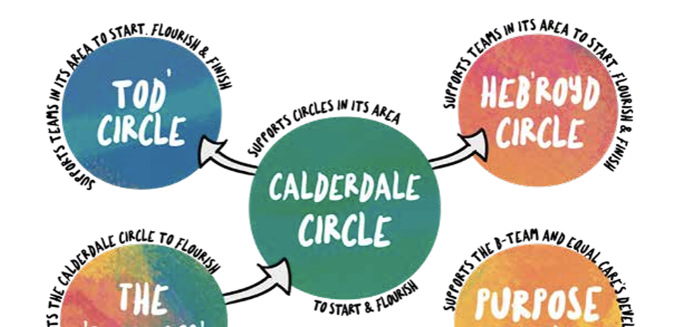
The Model
Teams: Modularity, diversity, variety, feedback loops
Team Owner
Advocate (Meeting Maker)
Rota Holder (Employed Worker)
Team Member (Agency / PA)
Profile Holder (Independent Worker)
Hat Holder (Independent Worker)
Hats
Redundancy
Good enough, safe enough
Growth mindset, learning, skills development
Circles: Modularity, connectedness, resourcefulness

Slide 16
Journeys between two poles
We started our support with JC four years ago when she fired her existing agency. We started with two regular people supporting her and carried on like this for at least a year. Team members gradually joined as her condition worsened and eventually she moved to 24-hour care with a team of 18 people (some as backup), a large chunk of which she was funding herself. The emotional challenges associated with this team were immense. JC’s condition was very distressing and took its toll.
JC:
Had an intro with and consented (or objected) to every single member of her team, maintaining autonomy over who joined and who didn’t
Attended her own team meetings and led them up until she became unable to speak
Clarified her wishes every step of the way, many of which involved some form of positive risk-taking on the team’s part
JC’s team members:
Nominated a wellbeing hat tasked with checking in and supporting each member of the team
Managed the rota themselves, including stepping up to 24 hr care with 24 hours notice so she could leave hospital
Managed the MAR themselves and in collaboration with JC’s daughter (pharmacy lead)
Were able to flex down and back up to support their own capacity to continue in JC’s team
Grew in confidence, with several new to care taking on various hats and others citing the rota holder hat in particular as being the key decider in (successfully) applying for roles with greater responsibility within the co-op
Several wrote poetry and tributes. All attended her funeral and two people spoke at it.

Slide 17
Learning from Equal Care Co-op
Without proactive, practical support from the Local Authority / ICS, the process of beginning is painfully, agonizingly slow.
EC’s cost model requires at least 90 workers per location to be sustainable.
Even with support, expect it to be slower than starting a ‘normal’ agency (think gardening over Meccano).
The way you act changes when your actions are based on improving the quality of relationships, not on the ‘quality of care’ which focuses on visible tasks and feedback forms. The results can be magical.
It’s difficult, but so worth it!

Slide 18
Cooperative Commission Recommendations

Slide 19
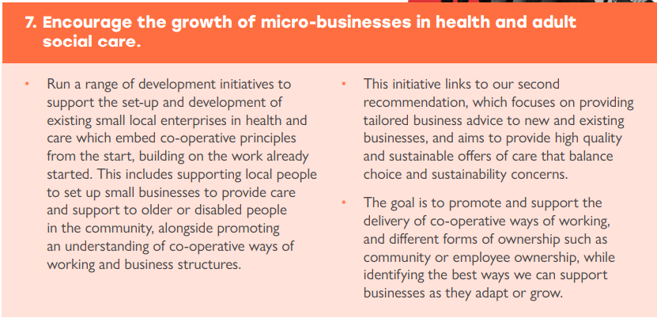
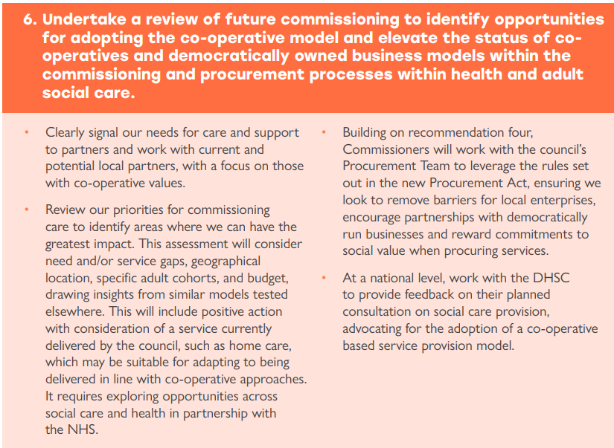
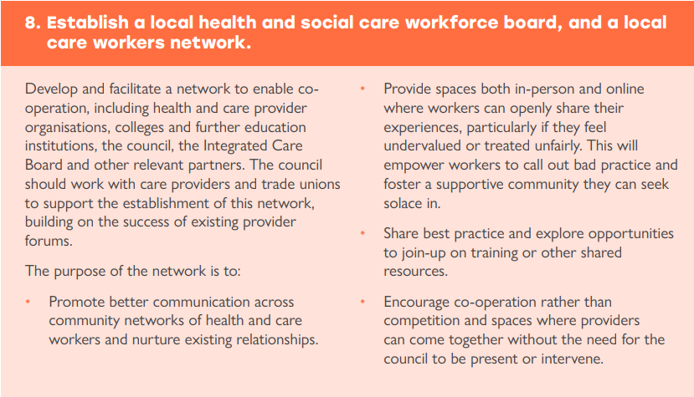

Slide 20
Workshop Section 2 – How do we implement the recommendation for best impact? (20mins)
How do we move forward to deliver these? Break into two groups and consider the following for one of the recommendations:
How can we take what we have heard from Emma and incorporate this into the implementation of the recommendation?
Where shall we start? Your top 3 ideas

Slide 21
Thank you for participating!
Any questions?

