Slide 1
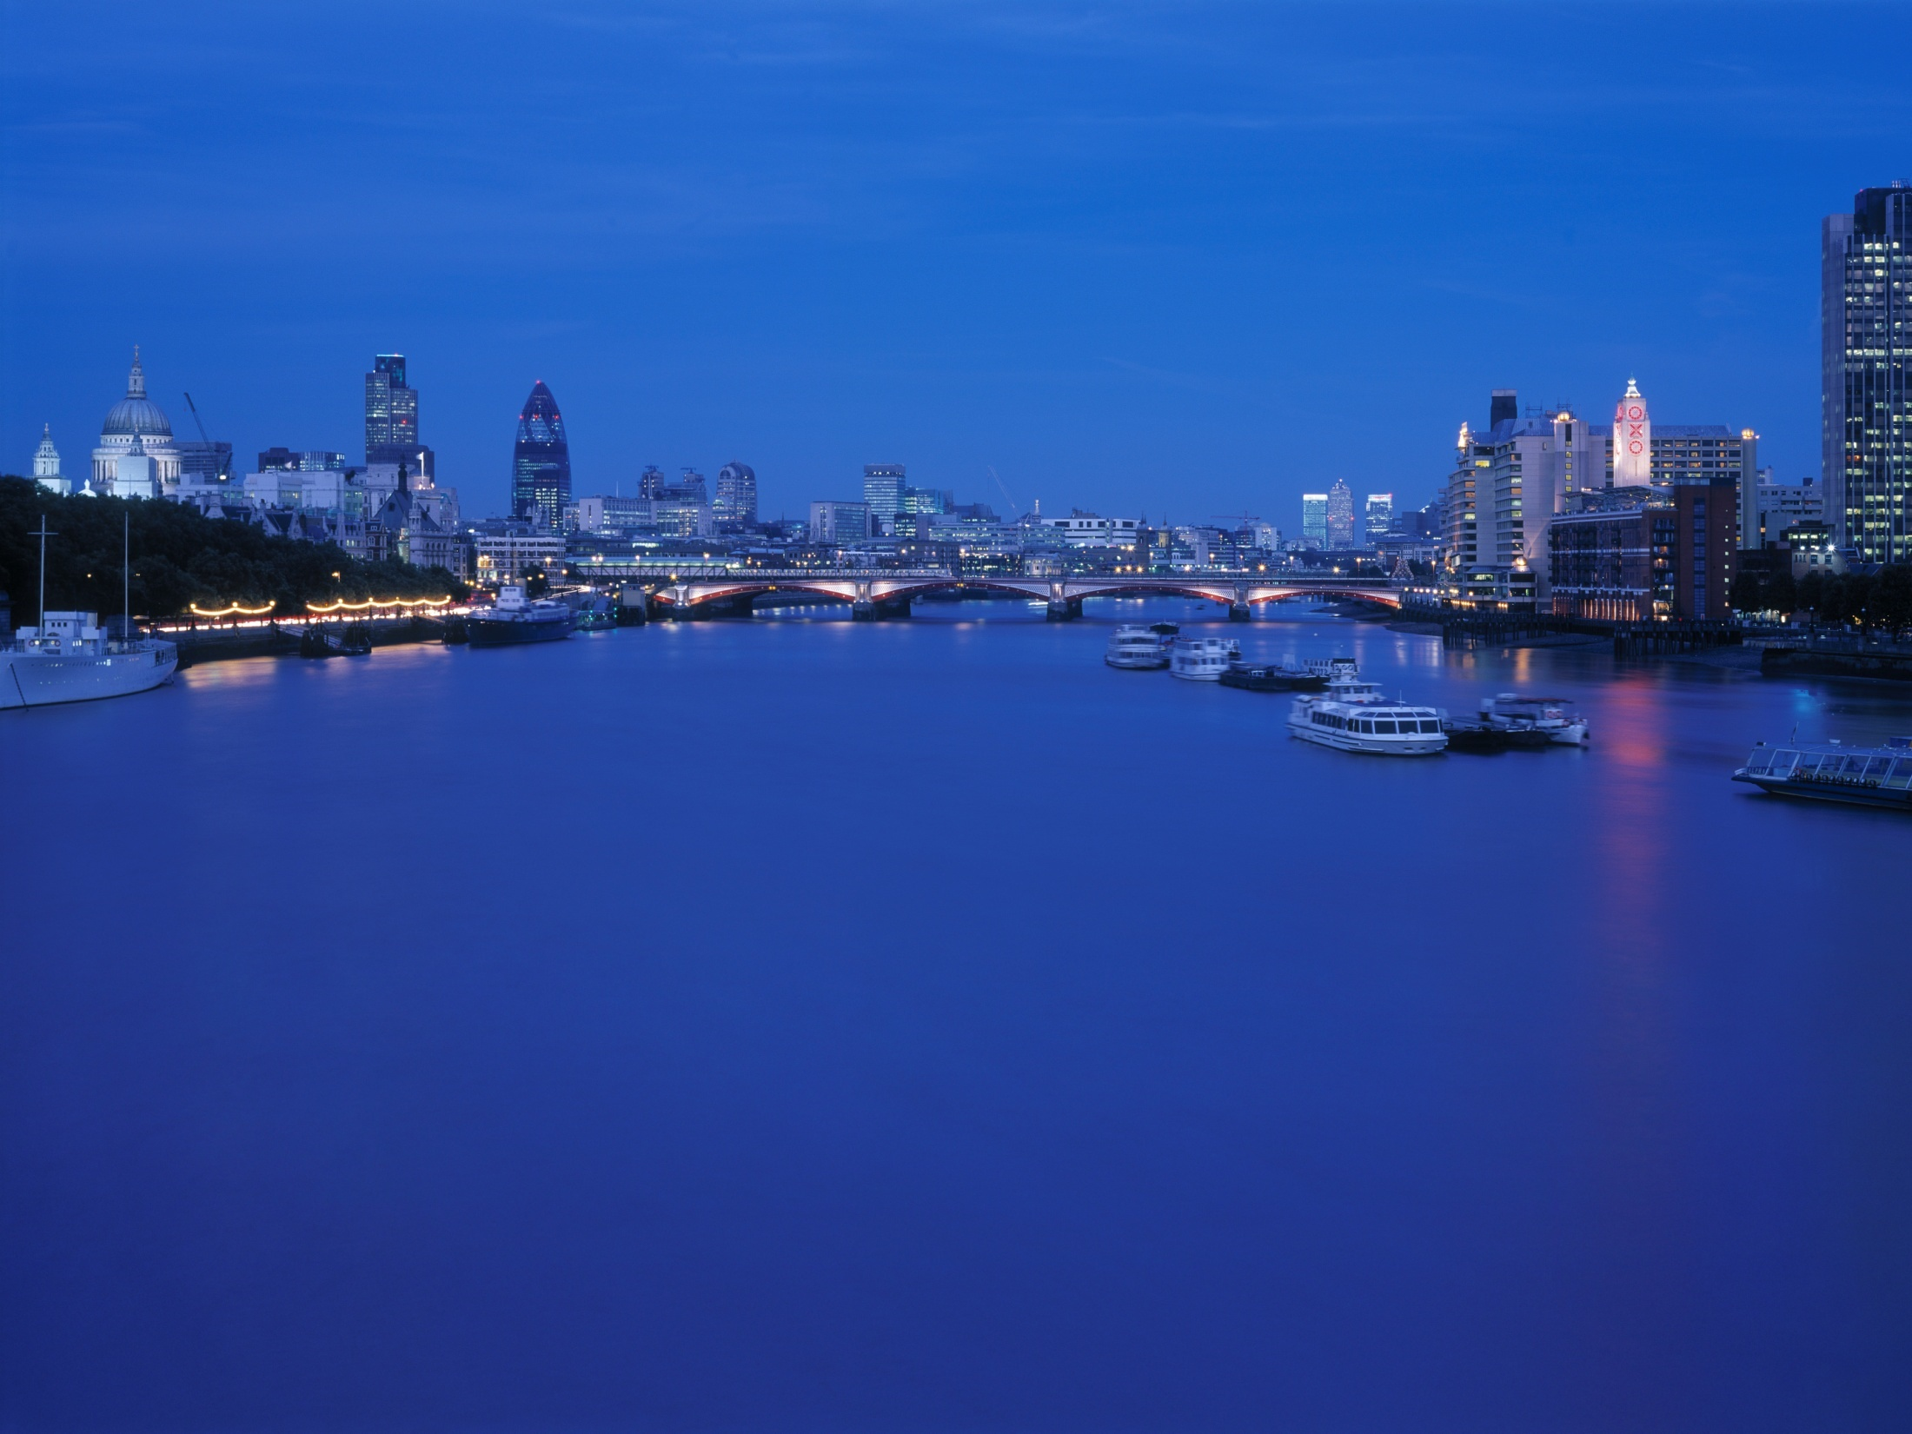
Lessons from Coin Street
David Hopkins

Slide 2
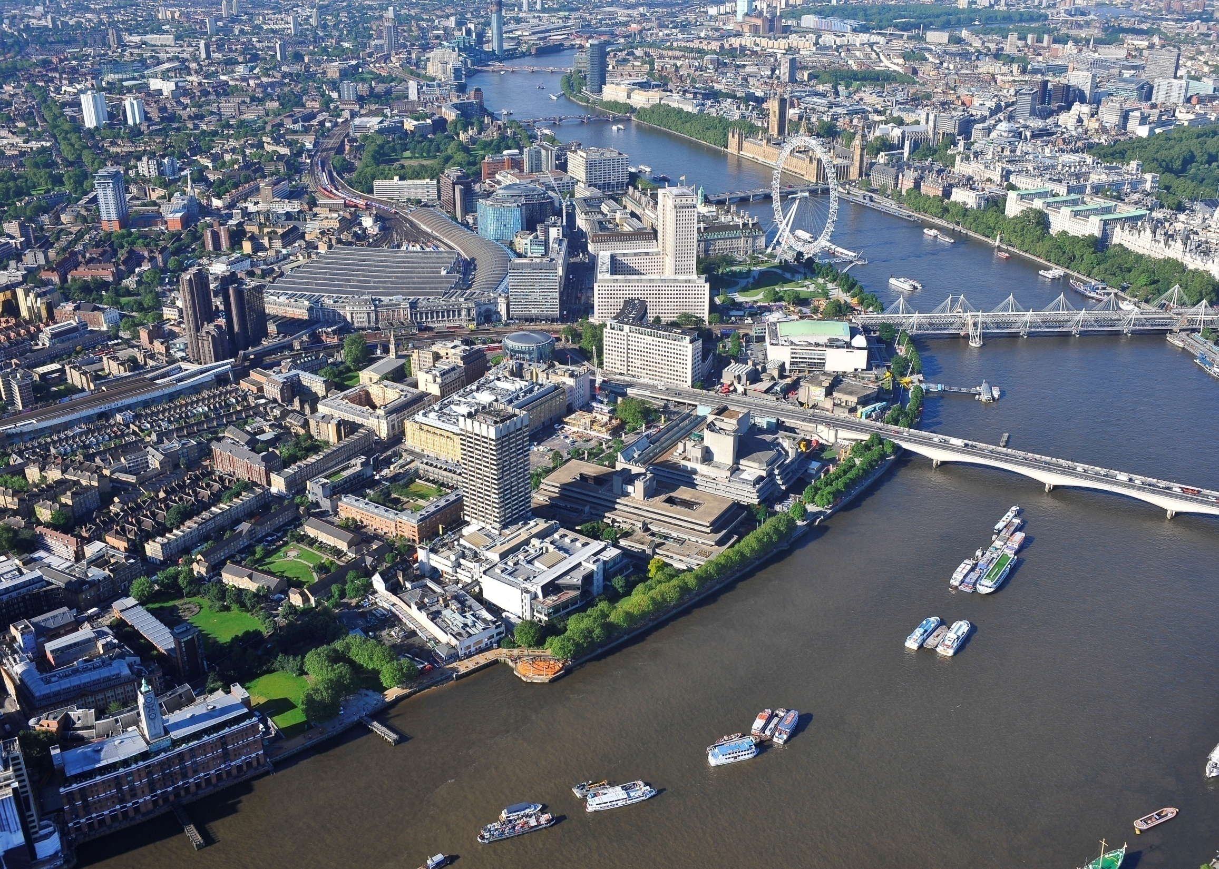

Slide 3
1984
Notes:
In 1983 the Government gave planning consent to both the ‘office scheme’ and the ‘community scheme’. In 1984 the private owners sold their land holdings to the Greater London Council which, in turn, sold the whole Coin Street site to Coin Street Community Builders (CSCB).

Slide 4
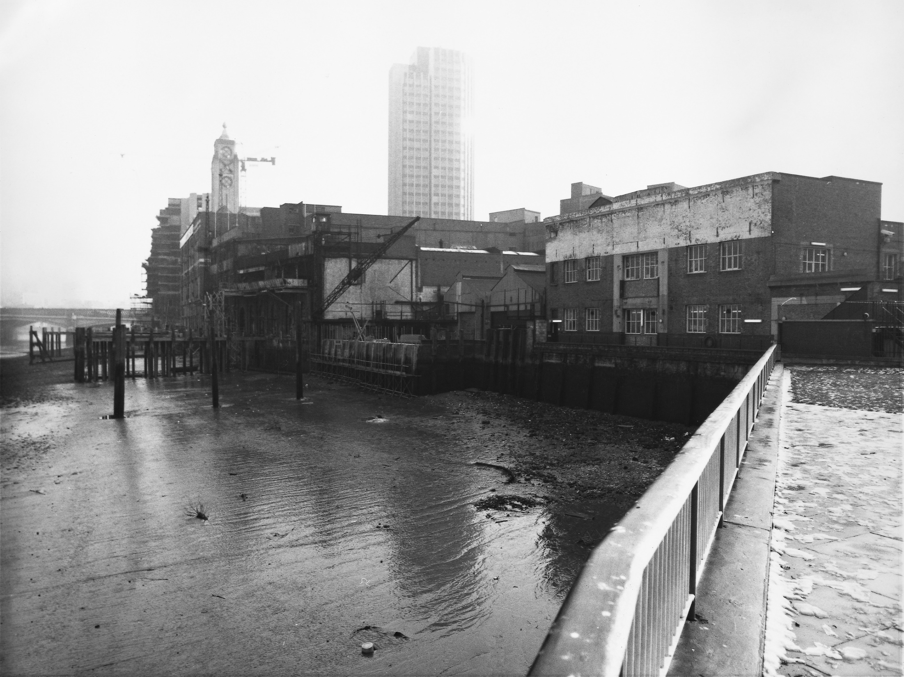
1984

Slide 5
1981
Notes:
During the 1970s a series of large office buildings were proposed for the Coin Street site. This is just one third of a scheme that eventually received consent.

Slide 6
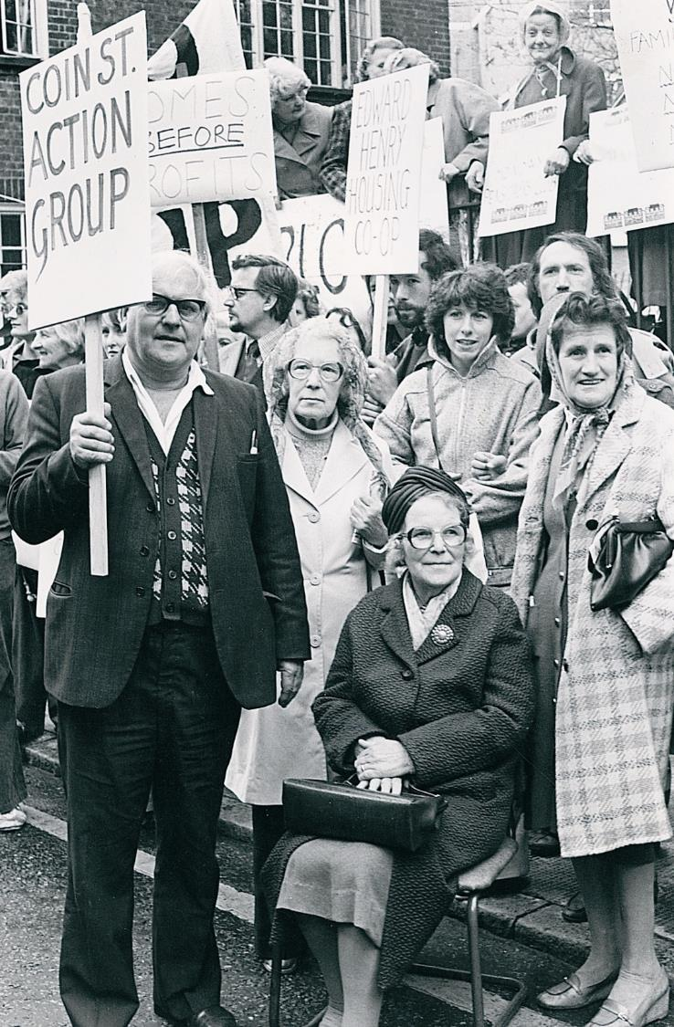
The campaign
Notes:
This physical and cultural ‘invasion’ was opposed by local residents. The consumer/community action movement had come to Waterloo.

Slide 7
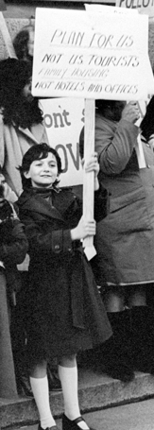

Slide 8
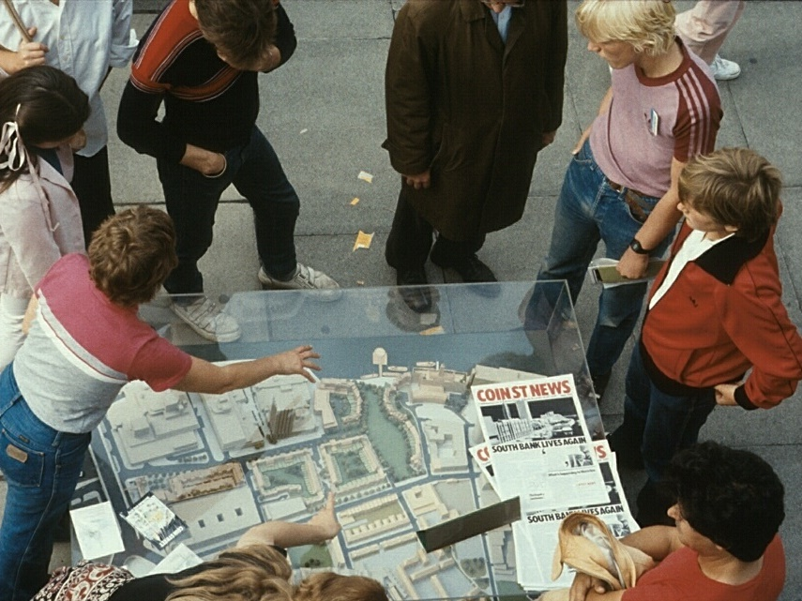
Notes:
From individual stories to a collective vision.
From ‘what’s wrong?’ to a positive vision.
From ‘why don’t they do something?’ to self-help. [Owning the problem]

Slide 9
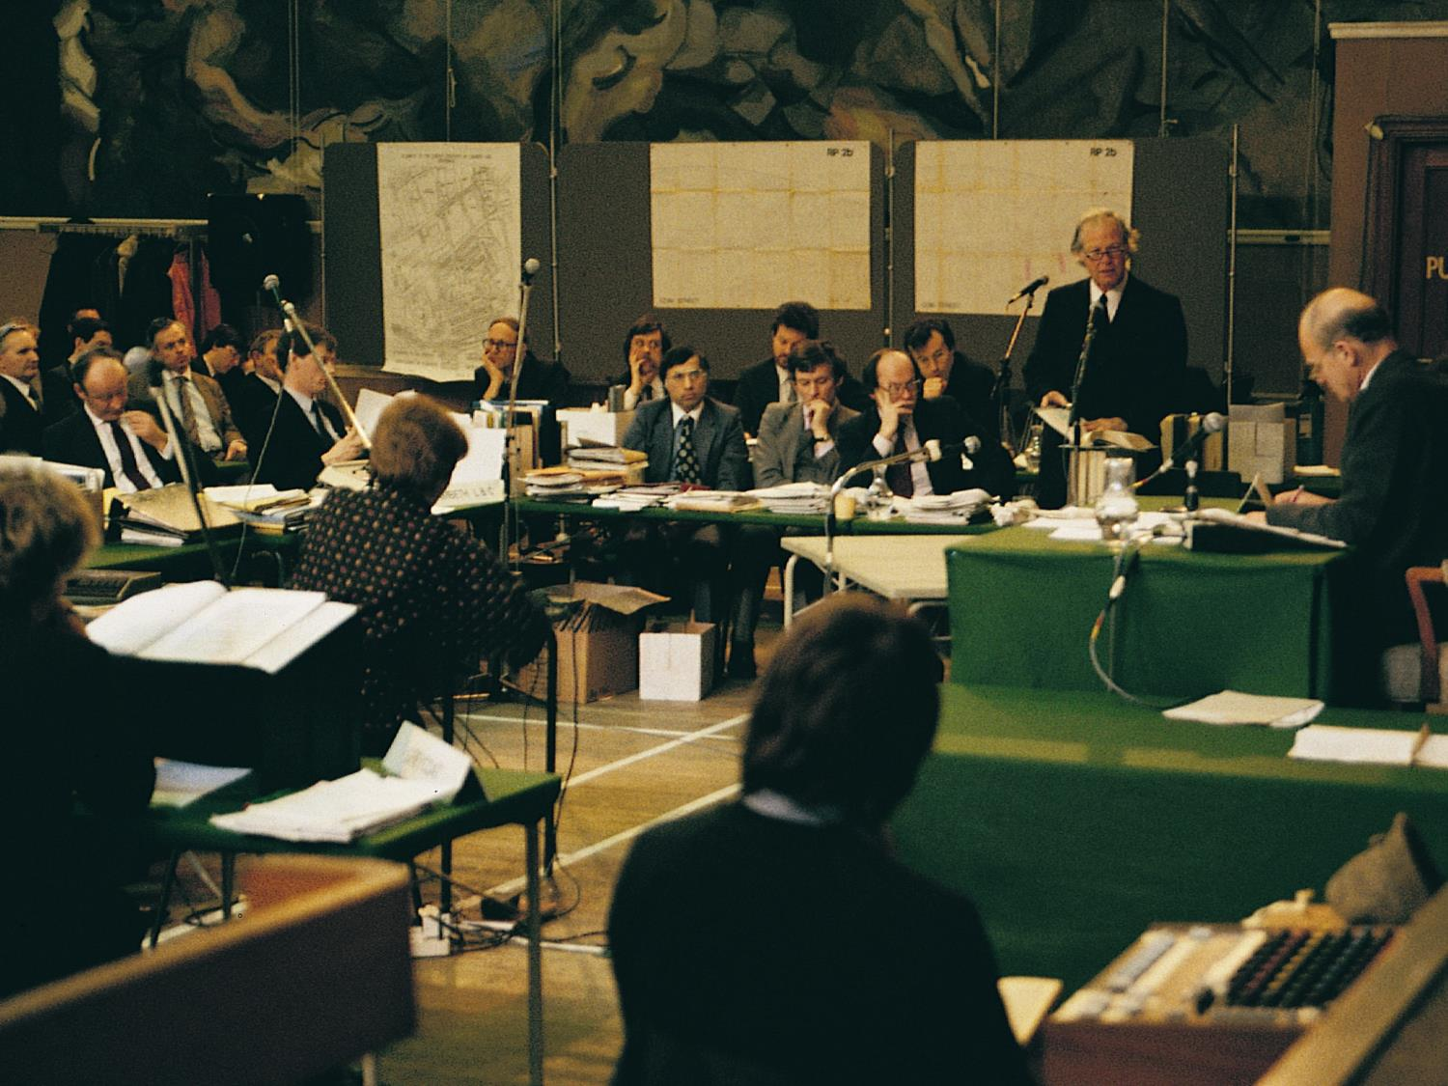
1984: Coin Street Community Builders buys site after campaign & two public inquiries
Notes:
The competing schemes were ‘tested’ at a series of long public inquiries before the Government gave consent in 1983 both to the office scheme and the community scheme.

Slide 10
1984
Notes:
The site at the time of its acquisition for approximately £1 million financed by 2 loans secured against the land and initially serviced by temporary uses, primarily car parking.

Slide 11
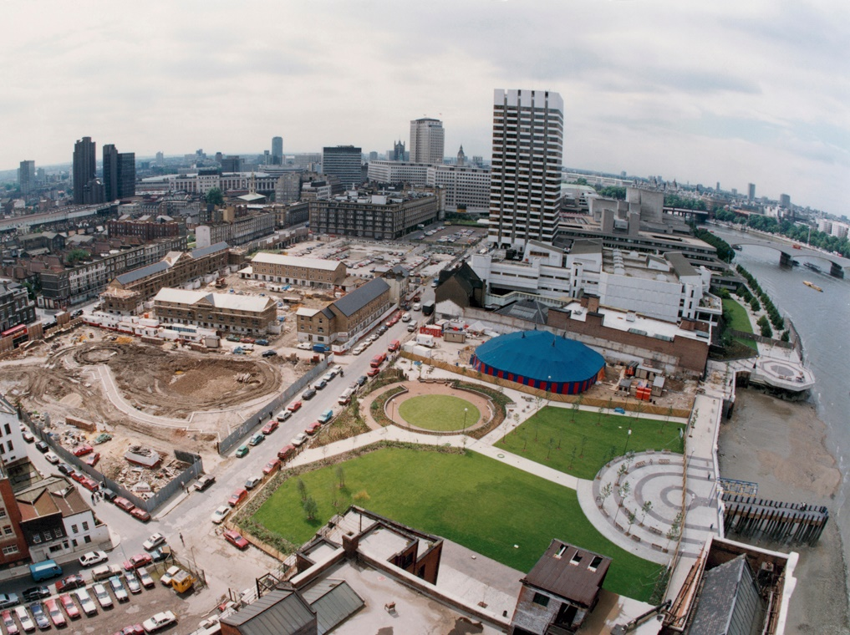
1987
Notes:
3 years later demolition works are largely complete, the riverside walkway and Bernie Spain Gardens are being laid out, and the first housing co-operative is nearing completion.

Slide 12
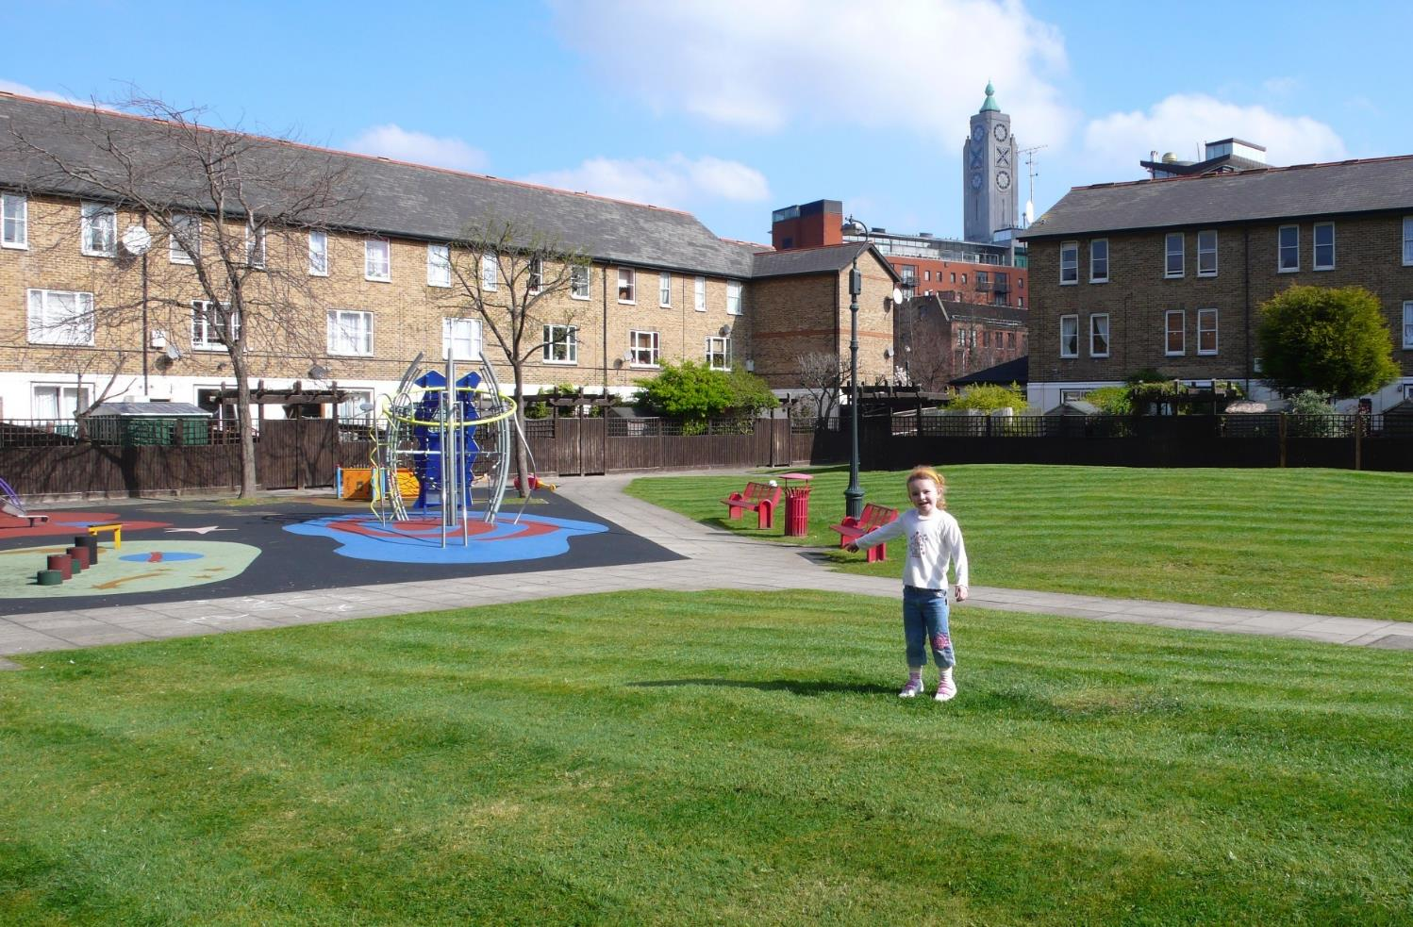
1988: Mulberry Housing Co-op opens

Slide 13
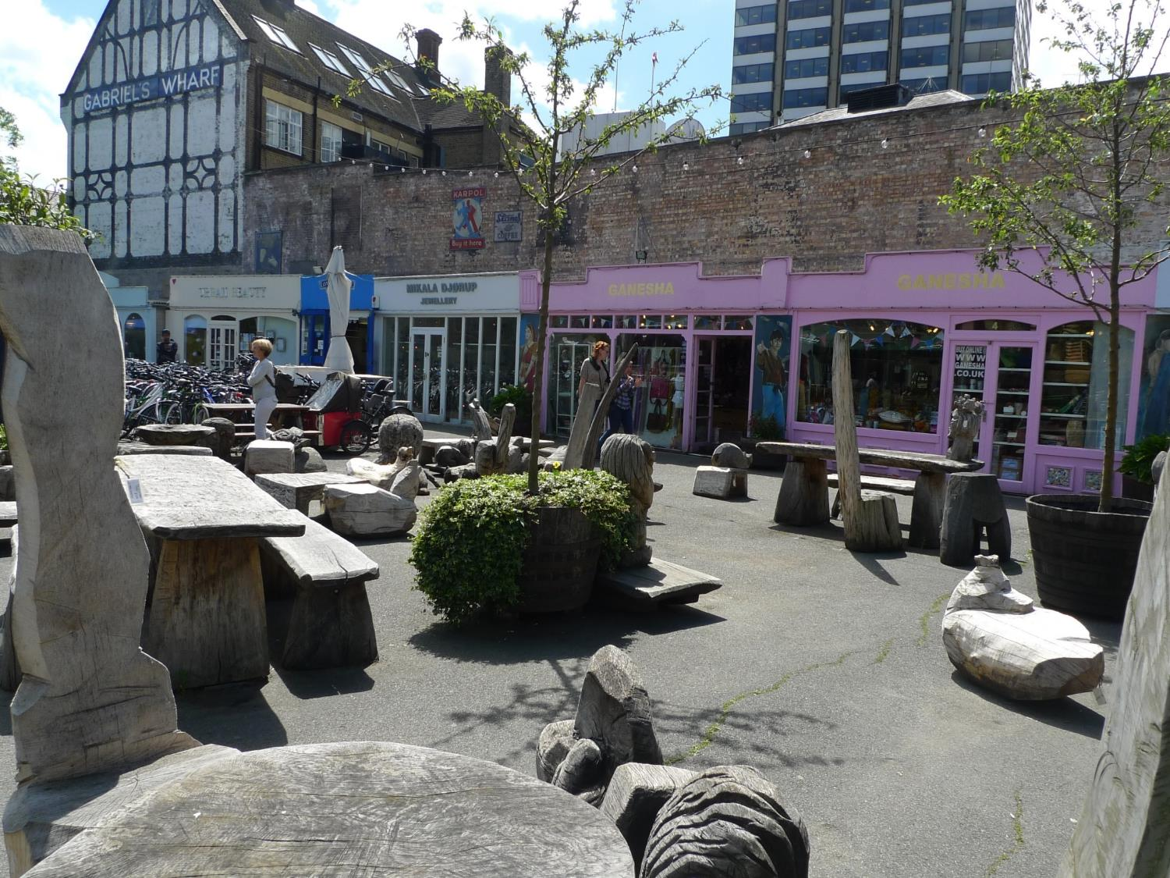
1988: Gabriel’s Wharf opens
Notes:
In 1988 CSCB partnered with USM to create Gabriel’s Wharf (1) to attract people into an area that had been largely derelict for over 30 years, and (2) to test the market for proposed uses at Oxo Tower Wharf.

Slide 14
1988: Bernie Spain Gardens and riverside walkway open

Slide 15
1990 Coin Street festivals start
Notes:
We started an annual Coin Street Festival in 1990, primarily aimed at attracting visitors into our area.

Slide 16
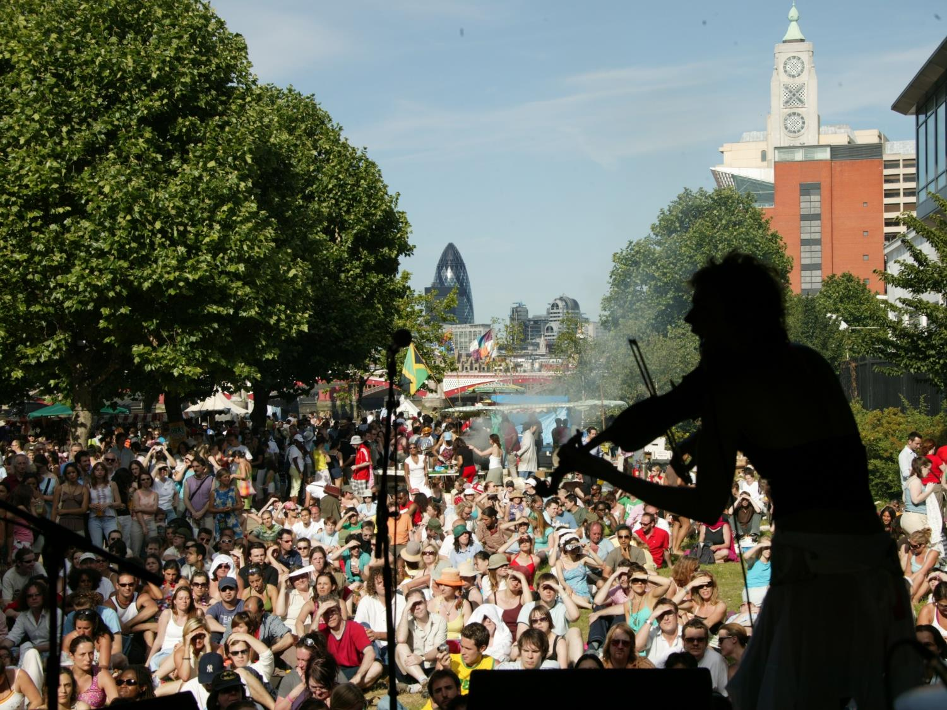
Notes:
The festival programme grew fast and was very popular.

Slide 17
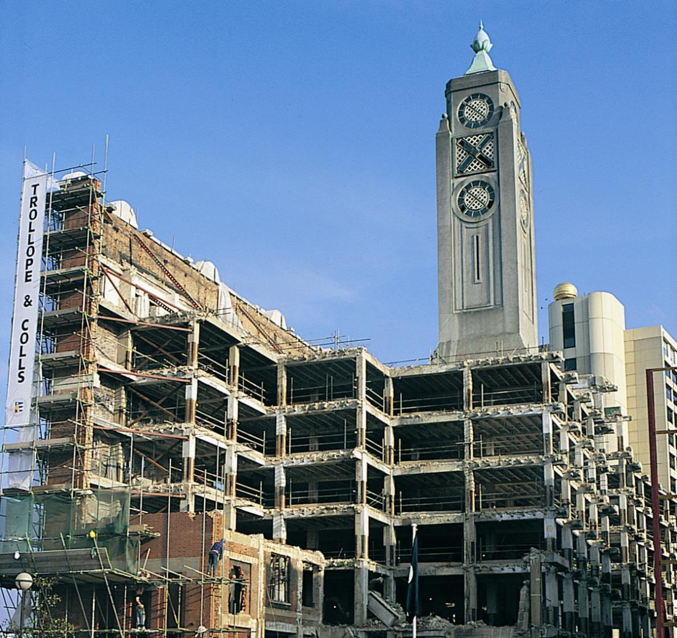
1993: Works start at Oxo Tower Wharf
Notes:
By initially stripping the building and repairing the frame, we managed the risk of the refurbishment. The main contract then commenced in 1993.

Slide 18
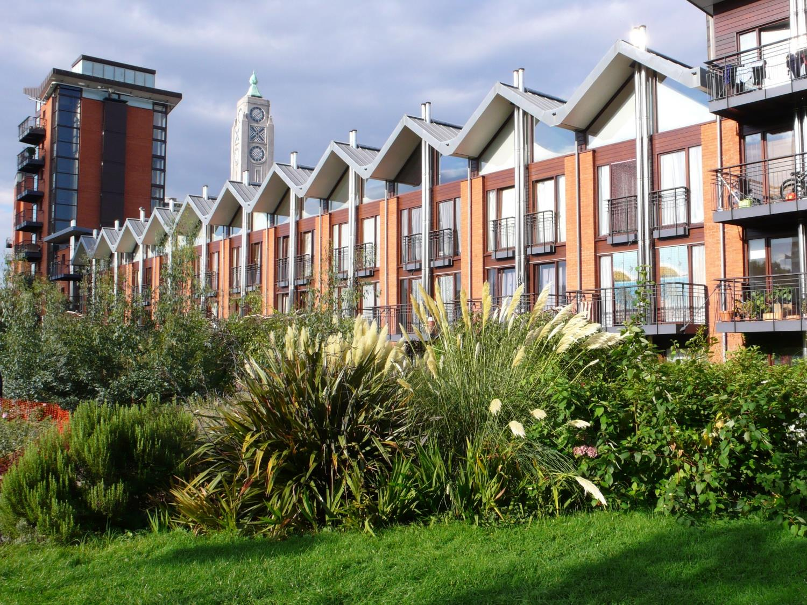
1994: Palm Housing Co-op opens
Notes:
The Broadwall development for Palm Housing Co-operative won the Sunday Times/RIBA ‘Building of the Year Award’ – forerunner of the Stirling Prize.

Slide 19
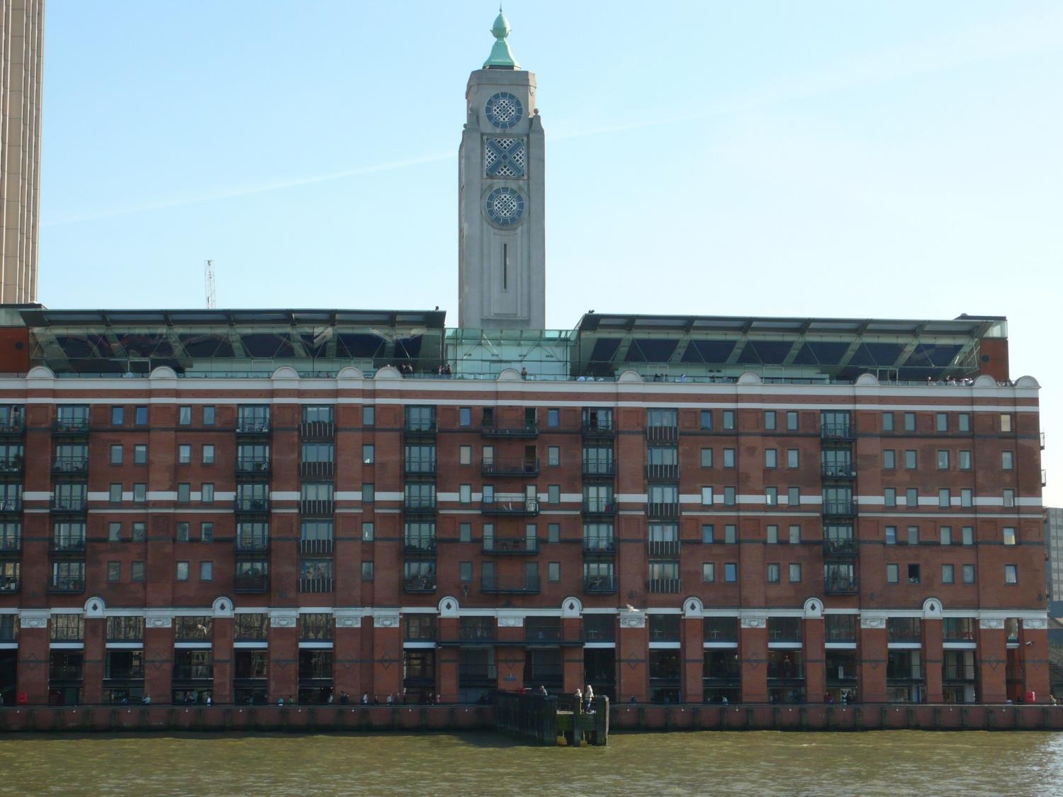
1995: Redwood Housing Co-op opens
Notes:
Oxo Tower Wharf opened to the public in 1996. Having gained experience of managing the much smaller Gabriel’s Wharf development, we decided to also manage Oxo Tower Wharf in-house.

Slide 20
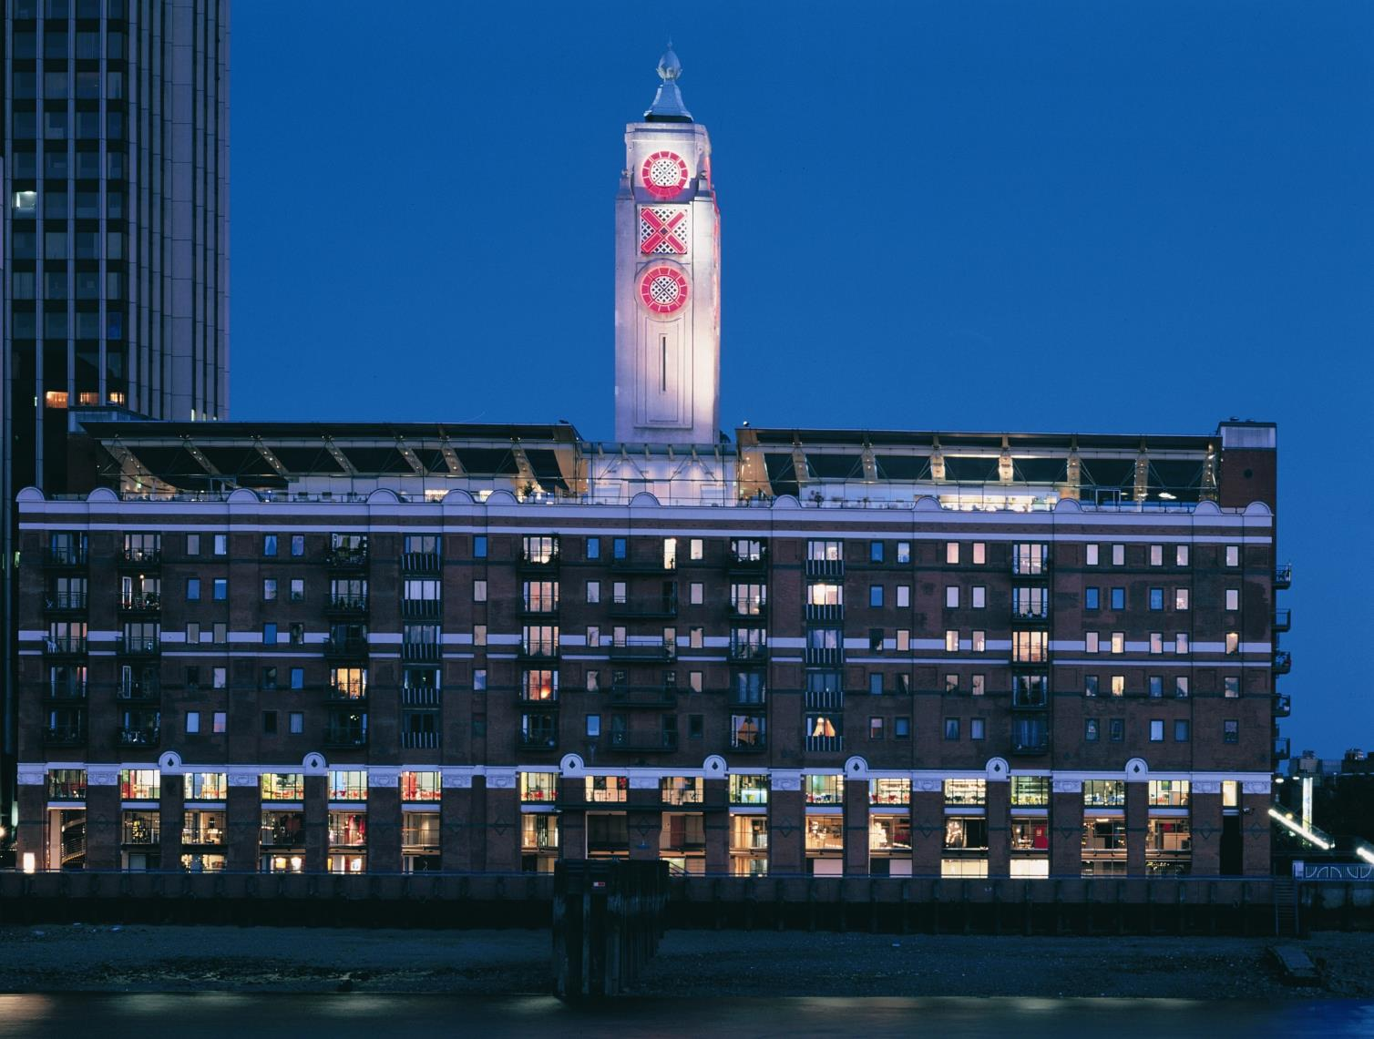
1996: Oxo Tower Wharf opens to the public
Notes:
The rooftop restaurant and brasserie is let to Harvey Nichols, there are 78 co-operative flats on floors 3-7, and a mix of retail, catering, and design workshops on the lower floors.

Slide 21
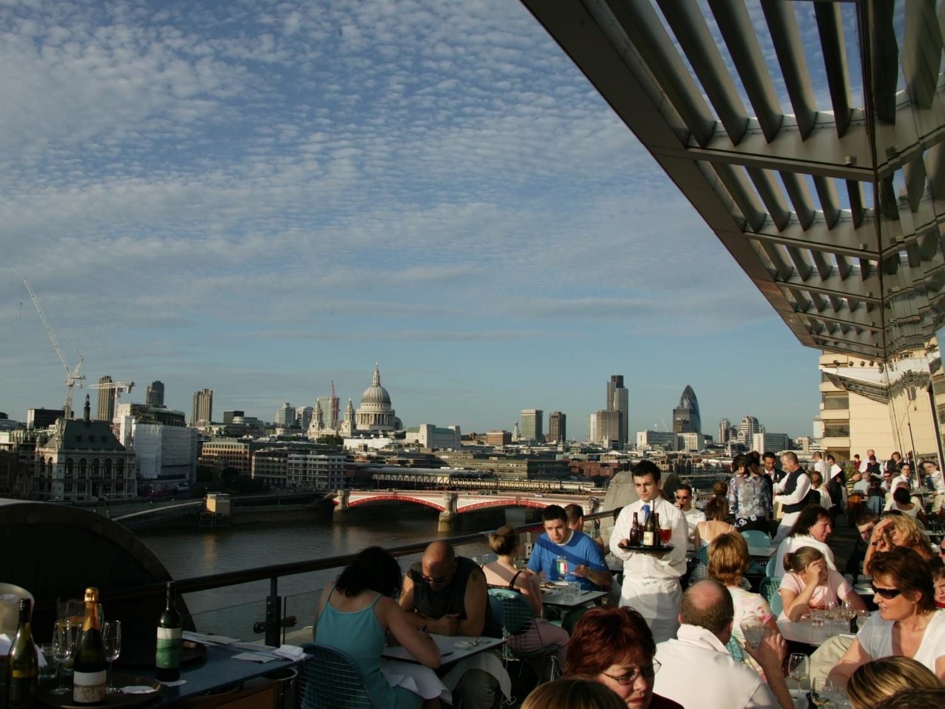

Slide 22
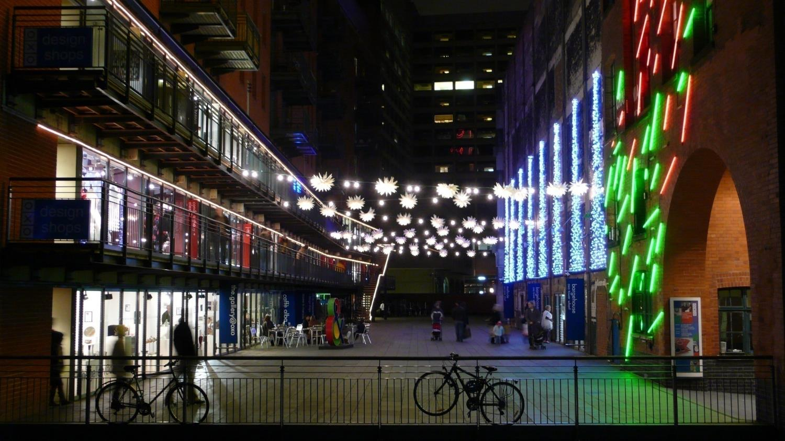

Slide 23
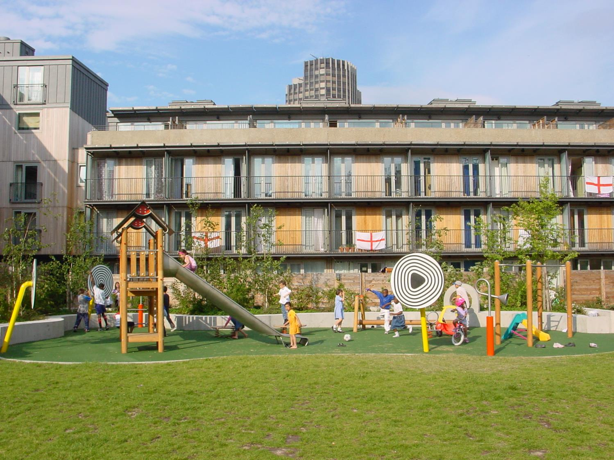
2001: Iroko Housing Co-op opens

Slide 24
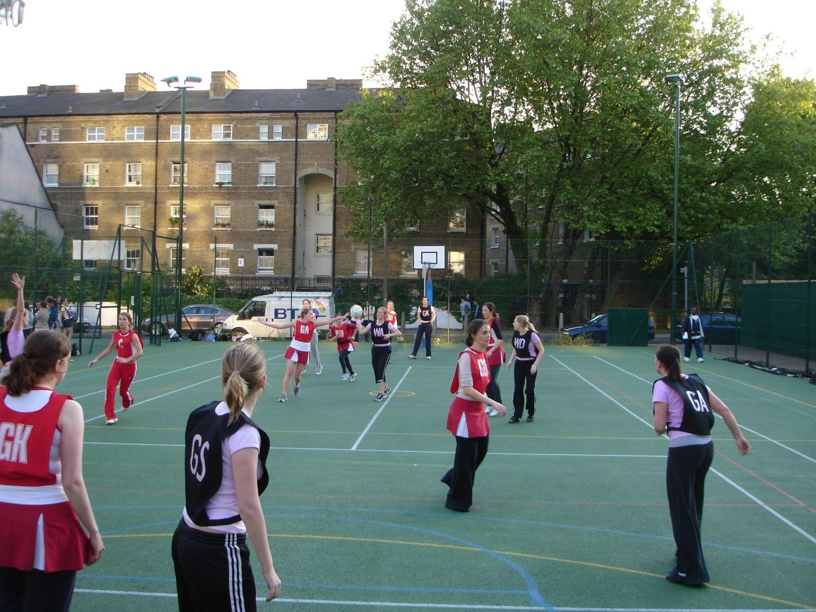
2004: Paris Gardens courts open

Slide 25
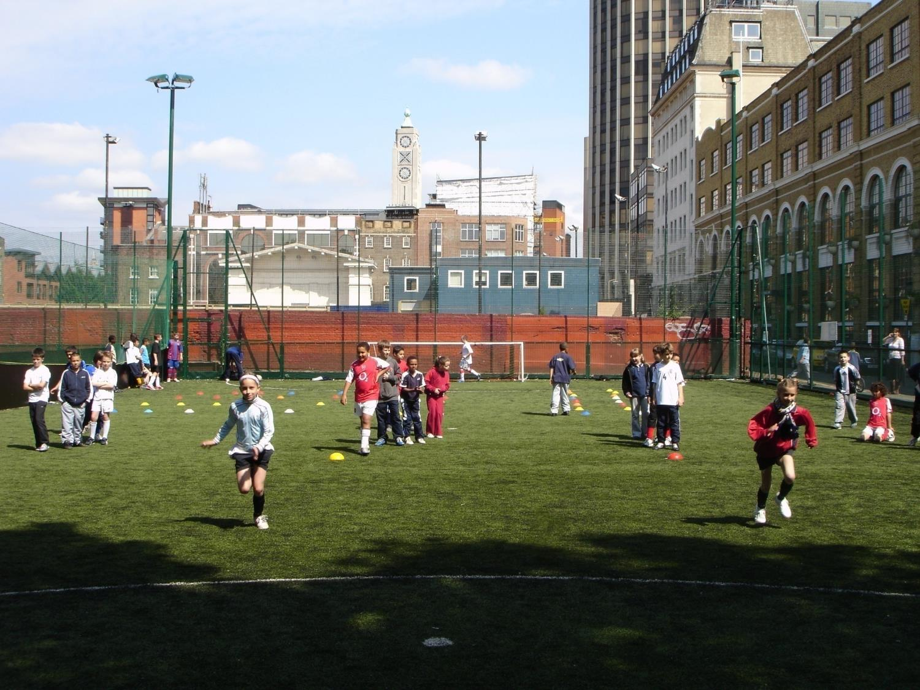
2005: Hatfields pitches open
Notes:
Hatfields football pitches

Slide 26
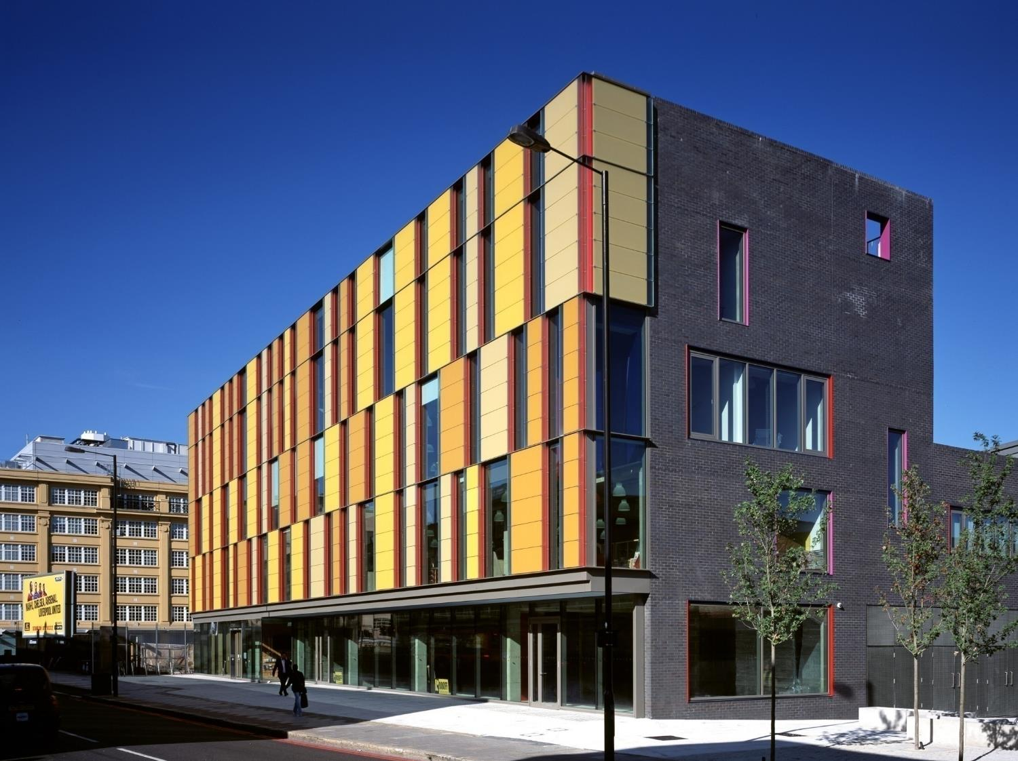
2007: Coin Street neighbourhood centre opens
Notes:
Coin Street neighbourhood centre

Slide 27
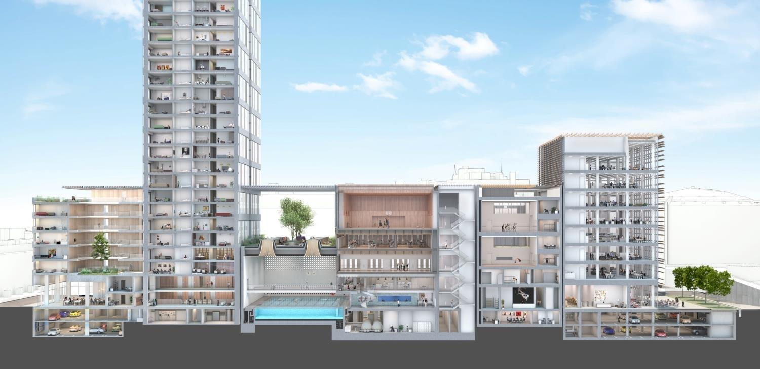
Phase 2: public swimming & indoor leisure centre, 236 flats, and retail/restaurant
Phase 1: Rambert HQ and dance studios
Phase 3: offices, retail/restaurant & town square
2007 Doon Street planning applications submitted

Slide 28
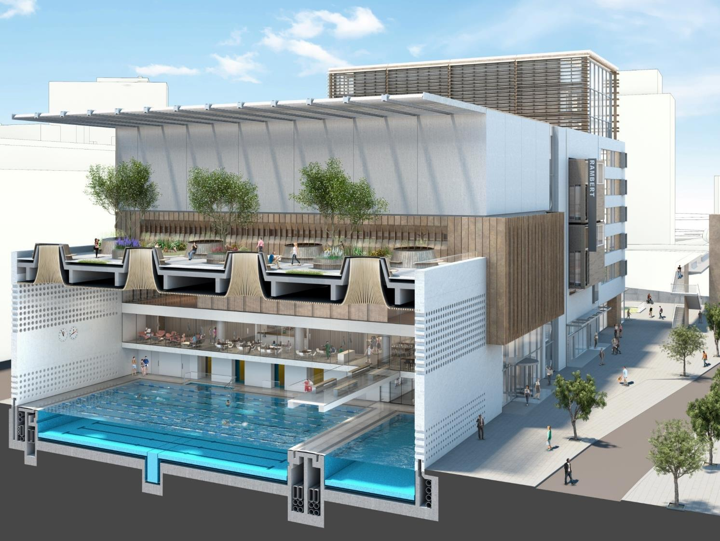
Doon Street phase 2: leisure centre and flats

Slide 29
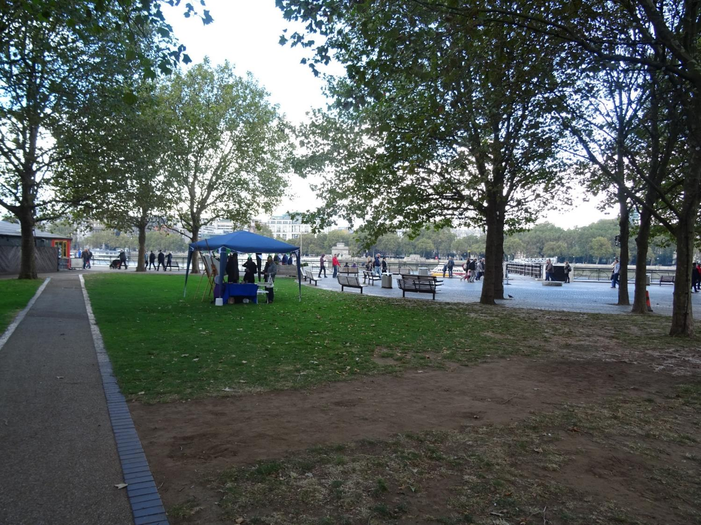
Bernie Spain Gardens and riverside walkway improvements

Slide 30
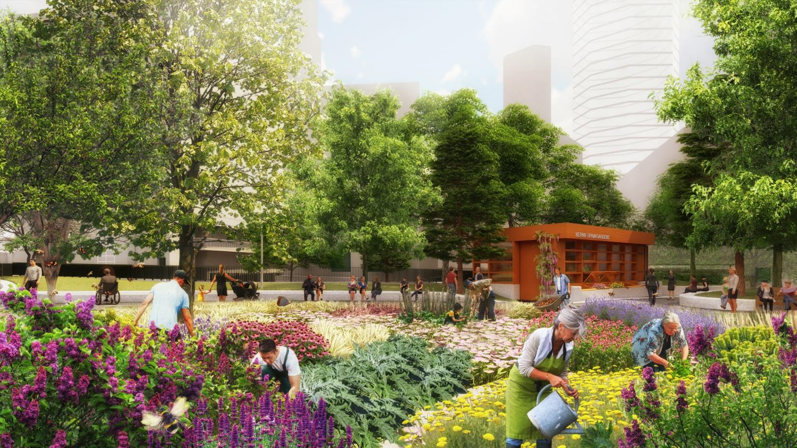

Slide 31
Stanton Williams proposals for 78-bedroom nursing home

Slide 32
Now there are many neighbouring developments and local plans…

Slide 33
2021: application to redevelop the former London TV Centre

Slide 34
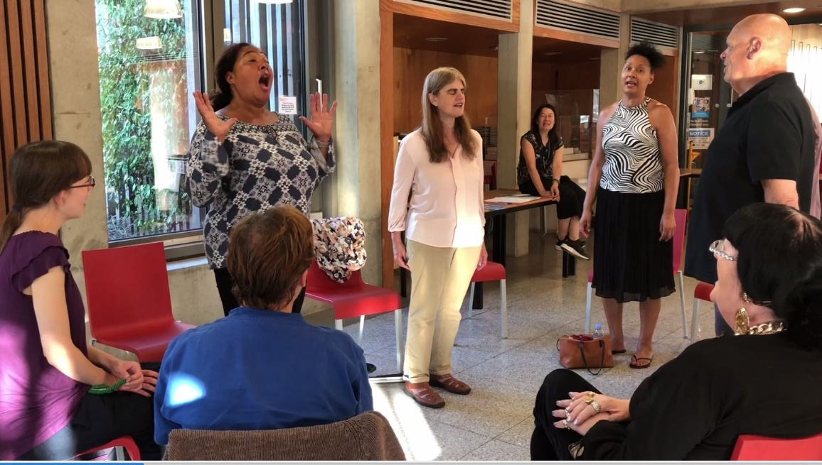

Slide 35
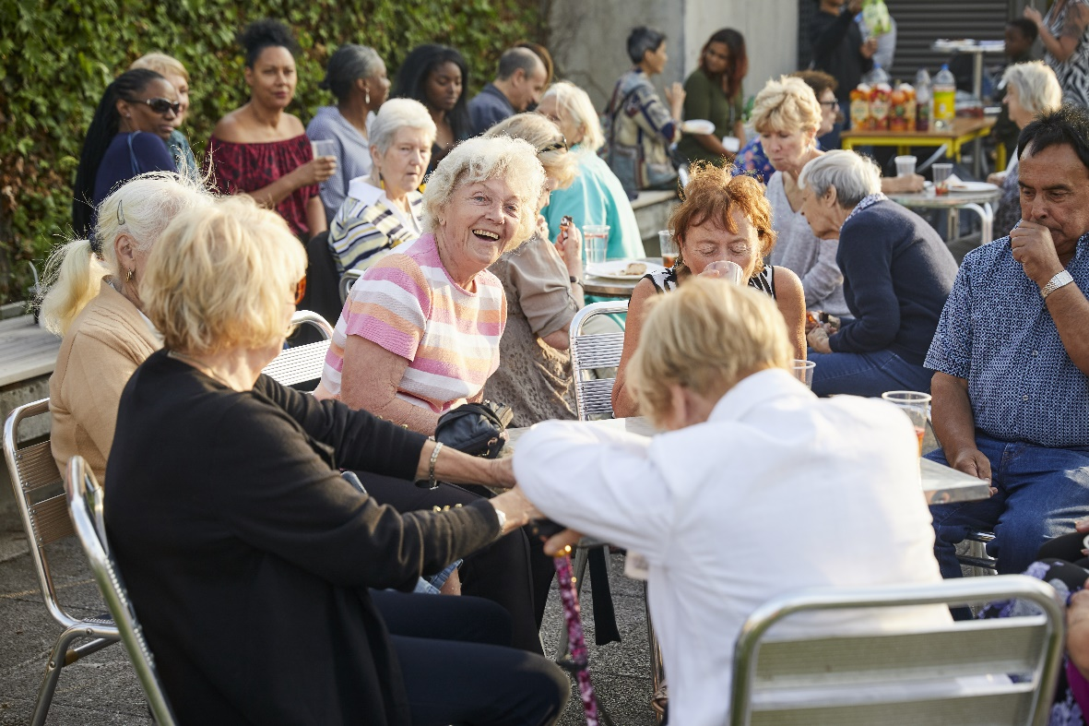

Slide 36
Some reflections
Owning the land means we cannot be displaced, and can leverage our assets to reinvest commercial revenues into community benefit
Co-op housing offers inbuilt protection against the threat of right to buy
The environment for community led infrastructure (co-ops, housing associations, youth orgs etc) is getting more complex and more fragile every year
Communities can “do it themselves” and do quality as well as anyone – just ask our tenant Harvey Nichols
There is another way!

