Slide 1
Foster 4 - A North West Foster Carer Recruitment Hub 15th October 2024
Foster4 Recruitment Hub

Slide 2
Who are Foster4?
Foster4 is a pioneering Northwest Foster Carer Recruitment Hub.
Based at Warrington Borough Council’s offices, we are a collaborative project, recruiting foster carers, providing therapeutic support and mandatory foster carer and specialist training on behalf of eight Cheshire and Merseyside Local Authorities:
Cheshire East, Cheshire West and Chester, Halton, Knowsley, Liverpool, St Helens, Warrington and Wirral.
To make the bid a lead LA had to have Good or Outstanding OFSTED rating – within our collaboration there are 2 of the 8 To with this rating.
Foster4 blueprint which was established in 2018 between Cheshire LA’s did benefit the programme
By pooling our resources, we aim to recruit even more foster carers, provide even greater support to the ones we have, and ultimately keep more local children with local foster carers, reducing our reliance on Independent Fostering Agencies (IFAs).
Foster4

Slide 3
Demographics of Cheshire and Merseyside
Current Situation
There are 4600 children currently in care across the eight Local Authorities but just over 1150 approved local authority foster carers available, there is an urgent need to recruit new foster carers for the most vulnerable children in our region.

Slide 4
Aims of the first 100 days…
Overall Aims of the first 100 days
Improve the journey from enquiry to initial home visit
Increasing consistency across Cheshire and Merseyside Fostering services
Growing a skilled, motivated and collaborative team
Developing and improving the Foster4 training offer

Slide 5
Therapeutic Support Package
Support Fostering Social Workers
Deliver Therapeutic Care Training to existing carers
Provide therapeutic support to Mockingbird constellations
To improve retention of carers during assessment and in the initial first year of approval
Overall Aims of the Therapeutic Offer

Slide 6
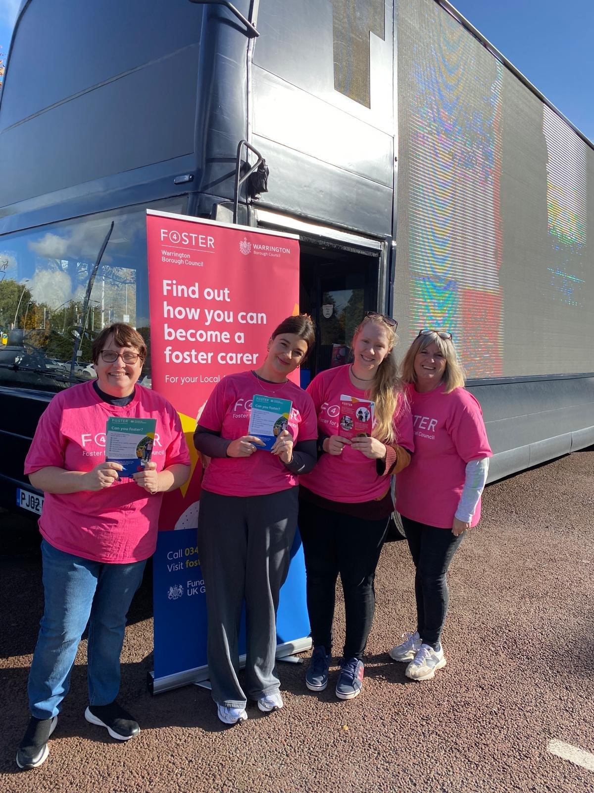
Marketing
Roadshow across Cheshire and Merseyside throughout October
Radio Campaign
Advertorials
New collaborative film produced
New films and interviews with foster carers.

Slide 8
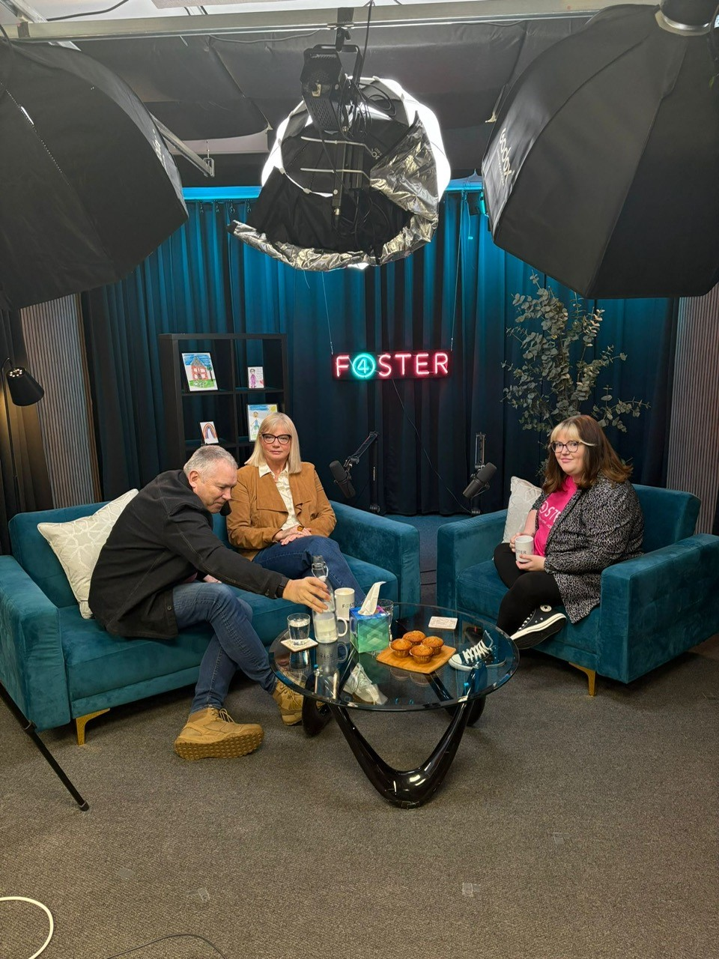
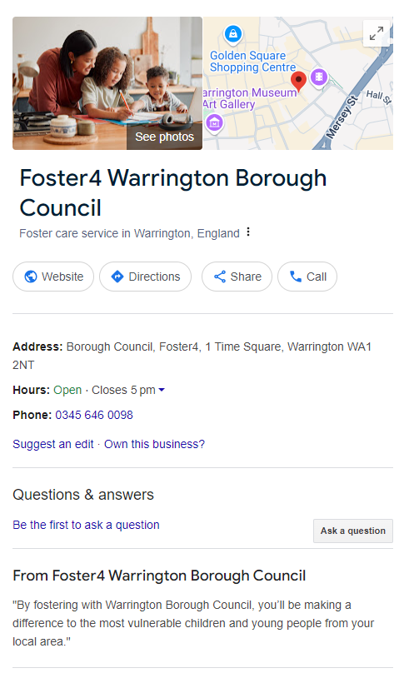
Digital Marketing
Google Business / Bing Business / Apple Business accounts have been created for each Local Authority to improve local ranking across all search engines
Bottom of funnel ads are aimed at those who have already interacted with us, whether that be by searching for us on a search engine, through visiting our website or clicking on an advert ensuring we are receiving quality enquiries from those actively looking to foster and are more likely to convert to approval.
Podcasts

Slide 9
Strengths
‘One Brand’ approach
Digital advertising – no more competing with each other
Sharing best practise = service improvements
Consistent data returns – for DfE and Ofsted data set.
Children at the heart of every decision
Children at the heart of every decision – their voice embedded in our day-to-day operation
Weaknesses
Recruitment of staff– processes and timescales
Digital Advertising contract – procurement timescales
Data development time
Opportunities
Training – USP against IFA competitors
Therapeutic Support service expansion
Geographical coverage of foster carer recruitment
Data!!!
Fostering Friendly – Foster4 friends/partners
Threats
‘Buy in’ from staff on the frontline of LA’s
Sustainability of the pathfinder presents challenges for all LA’s involved. Although we see the positives, 8 months has not provided enough time to establish data that would be expected for budget setting.

